Slide 1

Stammering Artwork
Stammering Awareness Day
22nd October 2026

Slide 2
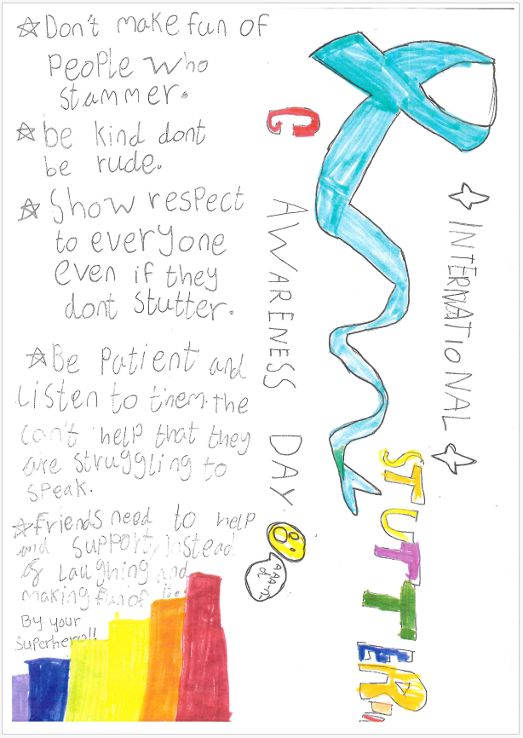
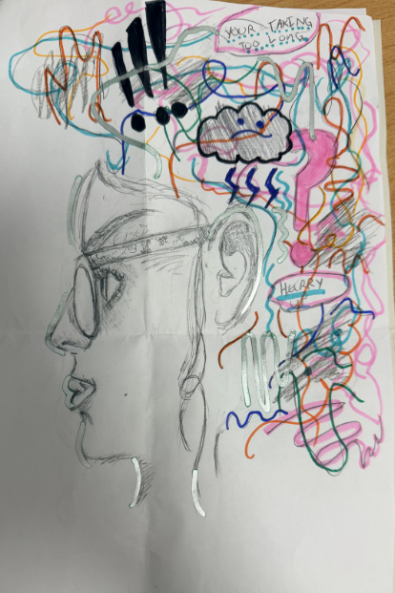
“This picture of a secondary school student who represents a calm outside but inside a brain full of anxiety”
By Eden
By Ayaan

Slide 3
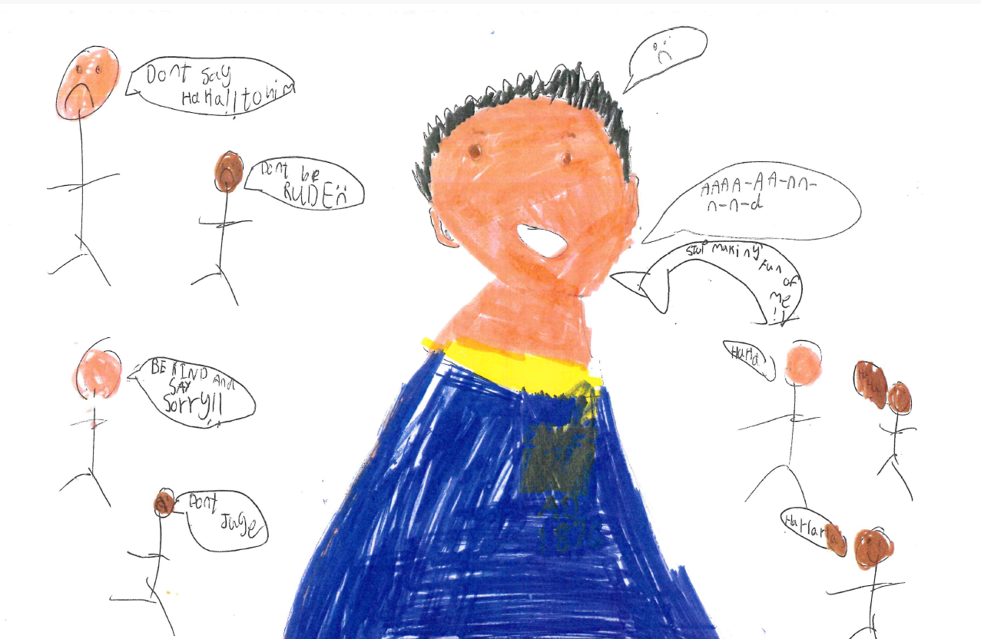
A picture to show how friendship can help a person who stammers overcome unfortunate experiences of teasing.
By Ayaan

Slide 4
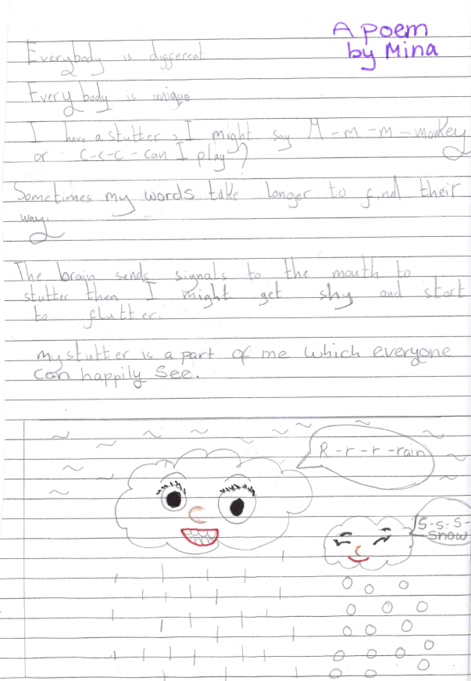
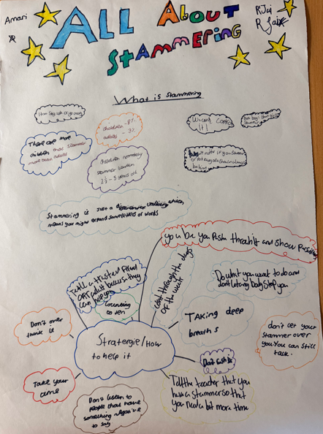
By Mina
By R’Jai and Amari

Slide 5
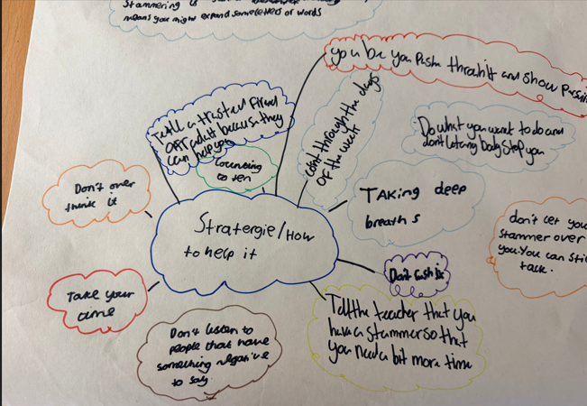
“be you”
“do what you want to do and don’t let anyone stop you”
“don’t let your stammer take over you”
“you can still talk”
“tell a trusted friend or adult because they can help you”
Wise Words

Slide 6
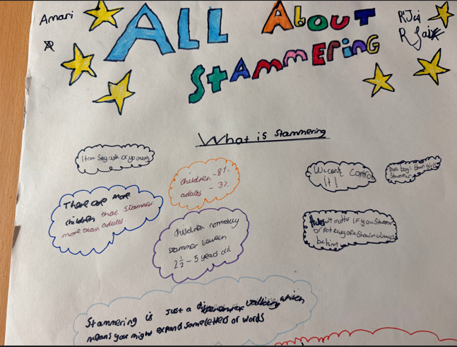
Fun
Facts
“stammering is just a different way of talking which means you might expand some letters and words”
“it doesn’t matter if you stammer or not, everyone should always be kind”

Slide 7
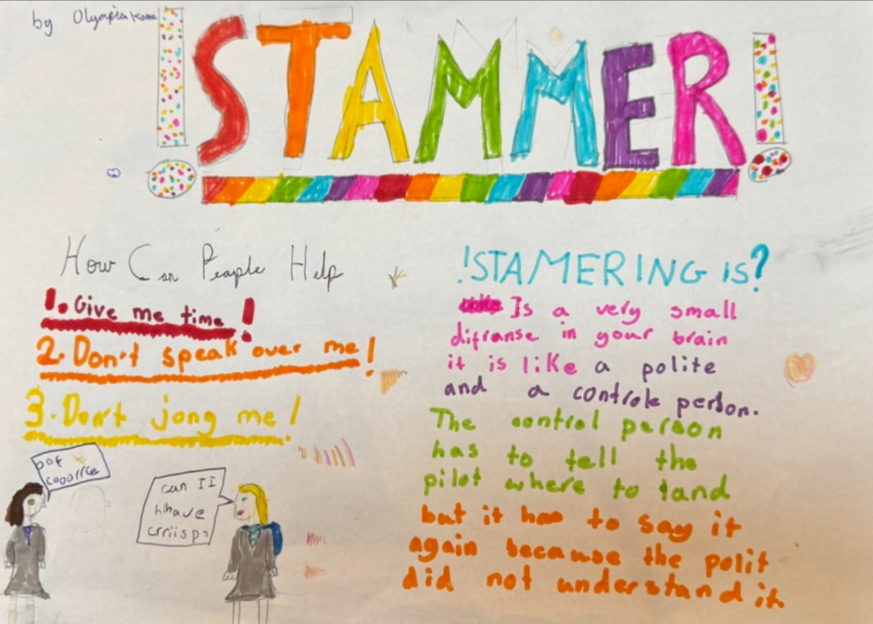
A clear and insightful analogy to describe the science behind why stammering happens and some top tip advice.
By Olympia

