Slide 1

International Stammering Awareness Day
Celebrating Difference

Slide 2


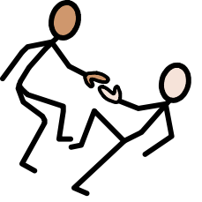

International Stammering Awareness Assembly
Today we are learning how to:
Listen
Help
Celebrate everyone’s voice- even when it sounds
a bit different

Slide 3

What is Talking?
Making sounds into words
Sharing ideas and stories
Having conversations

Slide 4

Talking can sometimes be tricky:
Sometimes people might:
Croaky voice
Mix up sounds
Find it hard to remember words
Find it hard to make sentences
Find it hard to speak smoothly
I wonder if anyone here has ever found talking tricky?

Slide 5
What is Stammering?
A stammer (sometimes called stuttering) is when the flow of speaking is interrupted.
People might:
Repeat sounds: d-d-d-do you want to play?
Stretch sounds: dddddo you want to play?
Repeat words: do-do-do you want to play?
Get blocked- the word does not come out at all
It can change, some days are easier than others.

Slide 6

How many people in the world stammer?
8% of children
3% of adults
More boys than girls stammer

Slide 7
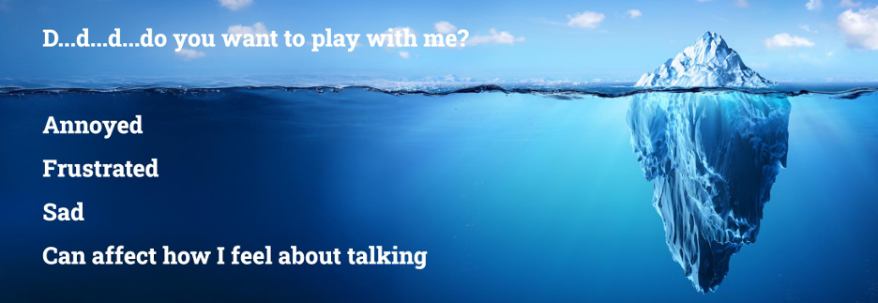
Stammering is like an Iceberg

Slide 8
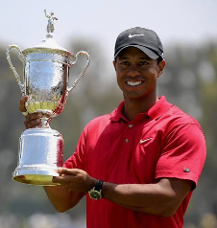

Famous People who Stammer
Guess who has or had a stammer!
People who stammer can still do incredible things!!
Tiger Woods- Professional Golfer

Slide 9
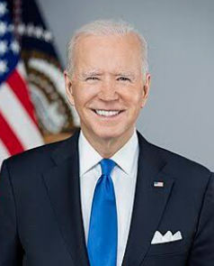
Famous People who Stammer
Guess who has or had a stammer!
People who stammer can still do incredible things!!
Joe Biden – President of USA

Slide 10
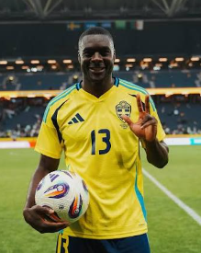
Famous People who Stammer
Guess who has or had a stammer!
People who stammer can still do incredible things!!
Ken Sema- Professional Footballer

Slide 11
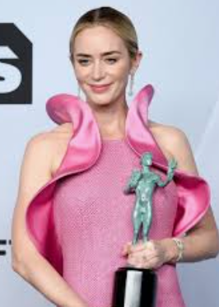
Famous People who Stammer
Guess who has or had a stammer!
People who stammer can still do incredible things!!
Emily Blunt- Actor

Slide 12
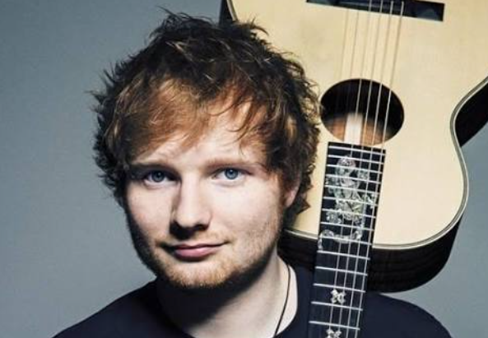
Famous People who Stammer
Guess who has or had a stammer!
People who stammer can still do incredible things!!
Ed Sheeran- Musician

Slide 13
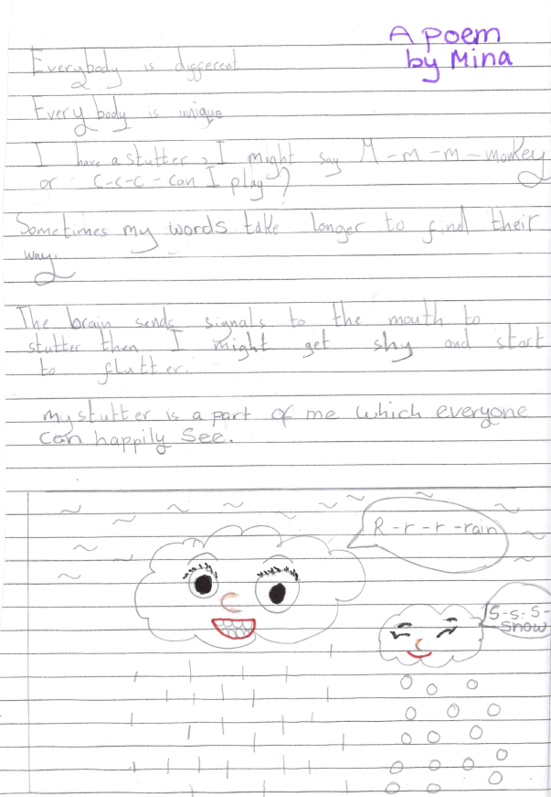
A Poem
By Mina

Slide 14



How can YOU help?
Give people time to talk
Wait for people to finish their sentence
Please do not interrupt
Please do not laugh or copy how they are speaking
Listen carefully
Be kind
Ask your friend
How would this make you feel?

Slide 15

Take Home Message
When we listen kindly, we make people feel confident to talk and included.
Don’t forget, we all need help sometimes.
Thank you for listening!

Slide 16



For more information:
Stammering Tap Video
https://stamma
Jessie from The Traitors

