Slide 1
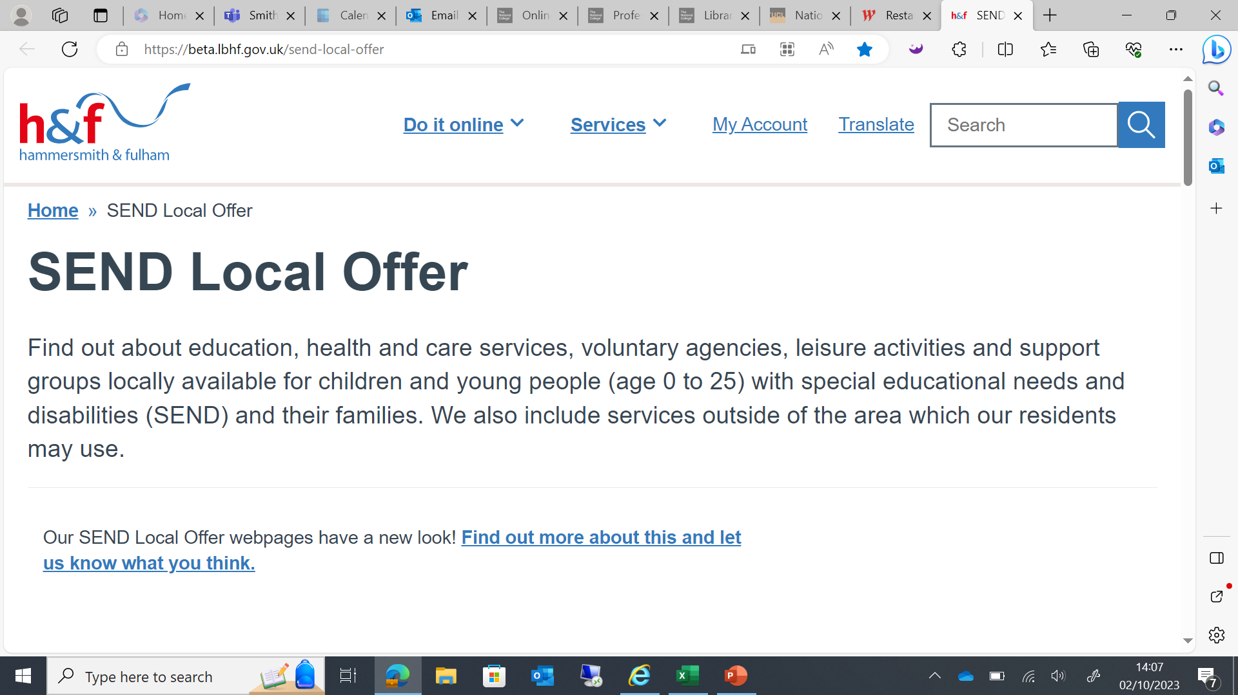
Welcome to Network SENCo Forum Meeting
Thanks to Hurlingham Academy for having us

Slide 2
Agenda
Claire Brundle- Programme Change Lead (OT)
Break
Anna Harper- Tribunal Dispute Resolution and Training Manager
H&F Notices

Slide 3
Stakeholder Engagement Model Development- Whole System OT Transformation
Claire Brundle- Programme Change Lead (OT)

Slide 6
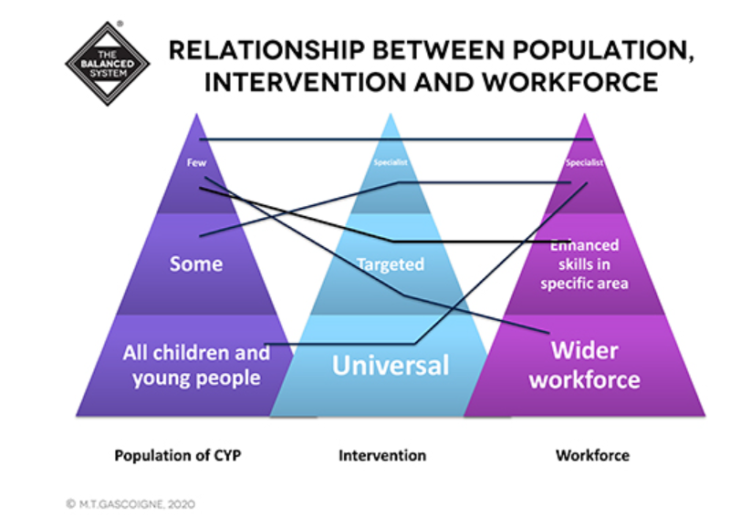
Existent Models of Transformation
Getting Advice
Aim: To create a whole system approach with a graduated, tiered offer. This will allow CYP and their families to access the right support in a timely manner. This will improve both efficient use of total specialist OT resource and service user experience, while providing support for professionals such as school and Early Years staff who work closely with OTs.

Slide 7
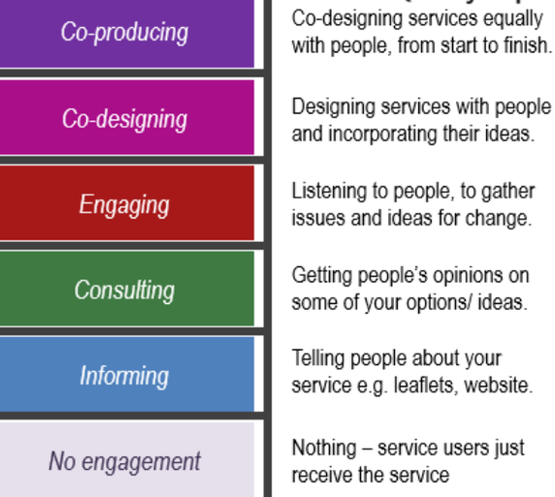
Why are we here today?

Slide 8
SENCo SURVEY (LBHF)
Topic | Theme | Coding | In-vivo
Whole System | Diverse Supports | - | Need continuity in OT provision
 |  | + | Excellent when Advice, training, reports, attend ARs
 |  | Referral Process | Don’t take referrals for sensory needs
 |  |  | Referrals often get turned away for children
 |  |  | No OT support if not on EHCP as don’t meet criteria for CYPOT team
 |  |  | Only EHCP support involvement
 |  |  | Easier, clearer referral procedure
 |  |  | Complicated and drawn-out referral process
 |  | Delivery | OT that comes in for a child who has an EHCP who is great, but we don't see her often
 |  |  | SEN OT very supportive, great for pupils who actually have OT provision. Others also need it.
In-school supports |  |  | More Visits
 |  | Buy-in | schools have the option of buying in to a certain amount of hours.
 |  |  | OT service like the EP service
 | Relationship | MDT | Support in school to implement services
 |  | Know the child | More training for Teachers in Mainstream classroom
 |  | Staff training | Free and regular training [service2schools]
 | Broader than EHCP |  | Don’t have necessary skills in school to support
 |  |  | LSA/TA training would be useful
 |  | Screening | Early identification and screening support
 |  |  | Annual CPD visit to identify school needs and plan support
 |  | Sensory | Support to build sensory spaces in school
 |  |  | Unmet sensory needs

Slide 10
Findings: Interviews with Parents and SENCos
How did you get to know about occupational therapy?
How would you describe occupational therapy has helped your child’s development and/ or education?
What were the biggest challenges that you and your child faced in everyday activities? What happened? How did it resolve? What do you feel would have helped?
What skills and knowledge have you gained in supporting your child to develop key skills in everyday activities?
What made the greatest difference to you and your child?
What ordinarily available support services do you access in the community?
Where do you usually go for support or information?
What other support (from any source) have you found useful?
How would you describe the main SEN challenge in your school that you feel occupational therapy could help with?
In an ideal world, what would occupational therapy support look like for your school?
What would training for your school staff look like? What topics would you find useful from occupational therapy?
How are the recommendations/ skills/ strategies gained from the training implemented in the classroom by the school staff? Where are the challenges experienced?

Slide 11
Universal Access to Advice and Advocacy
This section of the model addresses Access to Advice and Advocacy. It covers the referral, and triage processes and considers the universal resources on offer but would continue throughout the model proposed.
A need for CLEAR & CONSISTENT COMMUNICATION - Unclear remit and referral criteria; struggle to know what is happening; confusion about how OT could benefit their child, particularly in understanding how functional skills are impacted by sensory needs; more multi-agency liaison; long waiting periods for assessments; significant delay to necessary interventions; parent involvement and the importance of actively participating in the decision-making; consistency in the approach in every setting; parent in the wider community and appreciate reaching out to an OT for advice and advocacy for their child at school to enable understanding as to ‘how to’; parents felt empowered working with OT and gained confidence in their ability to respond to challenges at home and ‘made it work’.
“I think what's difficult with the current set up with CYPOT is that you don't feel like you can get through the front door…we've got families that really struggle to answer the phone or attend appointments. … You know, we're that lynchpin of enabling the parent to connect with the service and often we don't know that the service is trying to get in touch with the parents, so that's the bit I think that feels the most frustrating. I think once you get to SEN OT, it does feel more secure.”
Quote from SENCo
“It was important to recognise that the toileting challenges were the result of so many different issues – sensory and physical, anxiety, developmental etc. It was important to remind ourselves that we know him better than anyone.”
Quote from parent

Slide 18
Small Group Work

Slide 19
Comfort Break

Slide 20
Tribunals – General Overview
Anna harper- Tribunal Dispute Resolution and Training Manager

Slide 21
What is the SENDIST?
The Special Educational Needs and Disability Tribunal (SENDIST) is part of the First Tier Tribunal (FTT) (Health, Education and Social Care Chamber (the Tribunal)).
The FTT deals with appeals in relation to children and young people with special educational needs (SEN) as well as claims of disability discrimination in relation to schools.
Appeals in respect of decisions of the First Tier Tribunal are made to the Upper Tribunal (UT).

Slide 22
Decision Making
Panels are usually made up of three members - a legally qualified chair and the other members experienced in SEN and social care / disability issues
Decisions will be based on the evidence. Where counter evidence has been provided, the panel will use their expertise to decide which evidence they prefer
Decisions must be reasoned and evidence based, if there is professional evidence indicating a need and provision to meet that need and you wish to dispute this counter evidence is needed
Panels can rely on their own expertise

Slide 23
Tribunal Statistics
In the academic year 2022/2023 13,659 appeals were registered – a 25% increase on the previous year
In 2023, of 1,829 appealable decisions, 30 appeals were registered (2.6% Tribunal Rate) in LBHF
16,000+ appeals and claims predicted for 2024/25
5,800 receipts received April – June 2024 constituting an increase of SEND receipts by 78% compared to the same quarter last year
https://www.gov.uk/government/statistics/tribunals-statistics-quarterly-april-to-june-2024/tribunal-statistics-quarterly-april-to-june-2024

Slide 24
The Law, Regulations and Statutory Guidance
Statute - Children and Families Act (“CAFA”) 2014
Regulation - The Special Educational Needs Regulations 2014
Case law - Continue to clarify the law
Guidance- The SEN and Disability Code of Practice 2015
Whilst the Code of Practice provides guidance, the ultimate determination is the Legal Test set out in the Children and Families Act, 2014!

Slide 25
The Children and Families Act 2014
The Special Educational Needs Regulations 2014
The Tribunal Procedure (First-tier Tribunal) (Health, Education and Social Care Chamber) Rules 2008
SEND Code of Practice https://assets.publishing.service.gov.uk/government/uploads/system/uploads/attachment_data/file/398815/SEND_Code_of_Practice_January_2015.pdf

Slide 26
The Right of Appeal
A parent, or a person with parental responsibility, has the automatic right to appeal certain decisions made by Local Authorities about a child with special educational needs.

Slide 27
SEN Decision Making
Week 0
EHCNA Request Received
Week 6
Decision to Assess ?
Child has/may have SEN
May be necessary for SEP
Section 36(8)
Week 16
Decision to Issue Plan ?
In the light of EHCNA it is necessary for SEP with EHCP
Section 37
Week 20
Decision re content of EHCP/Placement?
Suitable/Appropriate
Section 38/39
Week 46
AR decision to maintain or cease?
Duty to review. Is it sufficient
Section 27
Week 54
Decision re content of EHCP/placement?

Slide 28
In summary Appeals can be made:
All parents/guardians and young people have a right to appeal to the FTT:
against a decision to refuse to conduct an EHC needs assessment s51(2)(a), Children and Families Act 2014.The test for when an assessment should be carried out is set out in s36(8)
against a decision to not issue an EHC Plan following a needs assessment. The test is whether an EHC Plan is ‘necessary’ s51(2)(b)
against any amendment to an Education, Health and Care Plan (EHC) Plan s51(3)(b)
against a decision to cease to maintain an EHC Plan. The test under s45 is whether a EHC Plan is ‘no longer necessary’ s51(2)(f)
against disability discrimination in relation to children either from schools or local authorities
The FTT also handle appeals against decisions to refuse people under 18 in custody:
an EHC assessment s73(2)(a)
an EHC plan after assessment s73(2)(b)
a placement to a suitable school or other institution after their release s73(2)(c)

Slide 29
Mediation
Before an appeal, there is a requirement to consider mediation (Regulation 33 of the Special Educational Needs and Disability Regulations 2014 and the Children and Families Act 2014).
If the applicant does not wish to pursue mediation, they can obtain a Mediation Certificate within the first two months of receiving the decision which will form the subject of an appeal to the Tribunal reg 39. This should be submitted to the Tribunal with the appeal.
The requirement to consider mediation does not apply when the appeal is about placement only.

Slide 30
Timetable
Week 0 Appeal registered
Week 6 LA response and attendance form
Week 9 Further evidence
Week 12-50 Hearing
Decisions against refusals to carry out EHCNA will generally be considered on the papers unless a specific request is made in writing and there are sound reasons for having an oral (substantive) hearing

Slide 31
Hearings
Telephone Case Management Hearing (TCMH)
Judicial Alternative Resolution Hearing (JADR)
Case Review Hearing (CRH)
Oral (Substantive) Hearing
Paper Hearing
Case Management (justice.gov.uk)

Slide 32
Appealing the Content of the EHCP:
The following sections of the EHC Plan can be appealed:
Section B – description of special educational need
Section F – description of the special educational provision to address the difficulties set out in section B
Section I – placement
Sections C/G and D/H - The Power of SENDIST includes Health and Social Care Recommendations only). Detailed Case Directions are provided at registration
Although section E (Outcomes) cannot be appealed, r43(1) of the SEND Regulations 2014 covers “correcting any deficiencies” in an EHC Plan. If because of changes to Sections B and F the outcomes in Section E are no longer relevant due to changes in B and F, the Tribunal may order that these are changed.

Slide 33
Educational Need:
Educational “need” means “what is reasonably required”: see R (A) v Hertfordshire County Council [2006] EWHC 3428 (Admin), [2007] ELR 95 at [25] per His Honour Judge Gilbart Q.C. (sitting as a Deputy Judge of the High Court).

Slide 34
Specificity:
Provision Must be specified as required by s. 37(2)
L v Clarke & Somerset CC [1998] ELR 129
“so specific and so clear as to leave no room for doubt as to what has been decided is necessary in the individual case. Very often specification of hour per week will no doubt be necessary and there will be a need for that to be done.”

Slide 35
Section 19(a) CAFA 2014
In exercising a function under this Part in the case of a child or young person, a local authority in England must have regard to the following matters in particular –
the views, wishes and feelings of the child and his or her parent, or the young person;
the importance of the child and his or her parent, or the young person, participating as fully as possible in decisions …
the importance of the child and his or her parent, or the young person, being provided with the information and support necessary to enable participation in those decisions;
the need to support the child and his or her parent, or the young person, in order to facilitate the development of the child or young person and to help him or her achieve the best possible educational and other outcomes.

Slide 36
Section 9 Education Act
Pupils to be educated in accordance with parents’ wishes.
“In exercising or performing all their respective powers and duties under the Education Acts, the Secretary of State and local authorities shall have regard to the general principle that pupils are to be educated in accordance with the wishes of their parents, so far as that is compatible with the provision of efficient instruction and training and the avoidance of unreasonable public expenditure”.

Slide 37
Requesting a Setting
Parents can request the following to be named (s38(3)):
Maintained nursery school
Maintained school/academy/free school (mainstream or special)
Non-maintained special school
Further education/sixth form college
Independent school/independent specialist college which has been approved by the Secretary of State under Section 41 of the Children and Families Act 2014

Slide 38
And the LA must comply unless:
It would be unsuitable for the age, ability, aptitude or SEND, i.e. the placement wouldn’t meet their needs, or;
The child’s attendance would be incompatible with:
The provision of efficient education of their peers whom they would be taught with, i.e. the pupils in the school. (our note: we can only rely on this exception if it can shown that there are no reasonable steps possible to prevent this incompatibility; or
The efficient use of resources i.e. the total costs, including transport, would be greater than an alternative placement to such an extent that these are significant or disproportionate. Extra costs should be balanced against any extra benefit for the child in attending the placement.

Slide 39
The Right to mainstream
The threshold for a mainstream school not to be named is extremely high! (Section 33 and 40,CAFA 2014)
Must be educated in a mainstream school unless:
Parent or young person does not wish it
Incompatible with the provision of efficient education of other children and no reasonable steps can be taken to prevent this (steps throughout the school)
Incompatible to SEND does not apply due to expectation regarding differentiation and efficient use of resources argument can only be made by LA.
resources argument can only be made by LA
CoP, Para 9.94 - a decision not to educate in mainstream against the wishes of parents/YP should not be taken lightly.

Slide 40
Code of Practice, 2015
Para 9.89 COP, 2015
Mainstream education cannot be refused by a local authority on the grounds that it is not suitable. A local authority can rely on the exception of incompatibility with the efficient education of others in relation to maintained nursery schools, mainstream schools or mainstream post-16 institutions taken as a whole only if it can show that there are no reasonable steps it could take to prevent that incompatibility.

Slide 41
Case Law
ME v Southwark LBC [2017] UKUT 0073 (AAC)
“the apparent incompatibility between the provision of suitable education and the requirement to name a mainstream school without express regard to [its] suitability […] for the child can only be reconciled on the basis that the local authority is under an absolute obligation to make a school suitable …, subject only to the qualification in section [33(2)(b)].”(Jacobs J)

Slide 42
Response Examples
The School is over number – Not enough to refuse admission. There needs to be a positive finding of incompatibility, school would have to consider reasonable steps and why cannot be taken to mitigate, and evidence needs to be provided re the impact of the admission and which students will be impacted
Child requires more support than a mainstream school can offer. – Evidence the reason the support cannot be made
The child requires specialist provision -This is not for school to determine
The Child is nonverbal –School is expected to make reasonable adjustments
The Child is not toilet trained - Discriminatory

Slide 43
Defending the School position
Can Meet Need:
Provide a detailed witness statement signed by a member of the leadership team detailing the School Offer, SEN, Provision, Progress etc
Provide Evidence eg Attendance Record, Provision Map, Baseline and Tracking, AR paperwork
Be prepared to attend the hearing to defend your position
Cannot Meet Need:
Evidence the impact on all the children (anonymised) in the class
Evidence the impact on other aspects eg curriculum delivery
Evidence what reasonable steps have been taken to demonstrate why the incompatible cannot be removed, throughout the school throughout the day demonstrated by examples or tried tested).
Back up evidence eg pictures of congestion, blueprint of the school
Provide a detailed witness statement signed by a member of the leadership team
Be prepared to attend the hearing to defend your position.

Slide 44
Principles of Being a Witness
The overriding duty of experts is to help the Tribunal on matters within their expertise
Evidence needs to be given in a fair, impartial, and independent way
Professionals must do their utmost to cooperate with each other and comply with any reasonable requests for information
Communication is in the best interest of the child or young person and sharing information and evidence as soon as it is available is promoted

Slide 45
A Witness must demonstrate
Knowledge of the Tribunal process and their role in it
Knowledge of the Code of Practice
An understanding of the issues in the case
Compliance with all relevant professional codes of conduct and best practice
Up to date knowledge of their particular area of expertise
https://www.gov.uk/guidance/send-tribunal-if-youre-asked-to-be-a-witness

Slide 46
Evidence
An accurate identification of needs
Supported by evidence based on the child’s needs
Ethical, sound, and evidence-based standards and principles.
Clear and unambiguous.
Factual and objective which clearly identifies what is within their own knowledge and what is not.
Focussed on the areas which are in dispute
https://www.justice.gov.uk/courts/procedure-rules/civil/rules/part35

Slide 47
Writing Reports
Reports should state purpose for which they are written and also contain the following statements:
“I understand that my overriding duty is to assist the tribunal in matters within my expertise, and that this duty overrides any obligation to those instructing me or their Clients.”
“I confirm I have complied with that duty and will continue to do so I confirm that I have made clear which facts and matters referred to in this report are within my own knowledge and which are not. Those that are within my own knowledge I confirm to be true. The opinions I have expressed represent my true and complete opinions on the matters to which they refer.”
Judge John Aitken (February 2010)

Slide 48
Preparing for the hearing
Familiarise yourself with the bundle
Attend the prehearing meeting
Be clear regarding the issues under appeal
On the day, log in early
Dress in smart clothing
Address the Judge as Sir/Madam

Slide 49
Questions?

Slide 50
H&F Notices

Slide 51
H&F AR and EHCNA Paperwork update
Both are currently with Parents Active and we are awaiting their feedback on these documents.

Slide 52
Year 6-Year 7 Transition Day
Vote on dates that best suit you via the menti poll
https://www.menti.com/alxdztvtgiaa
Access Code:- 5499 9068

Slide 53
Year 11- Post16 with WLC
Secondary schools only
Vote on dates that best suit you via the menti poll
https://www.menti.com/al89er14vmxo
Access Code:- 2491 6374

Slide 54
SENIF Funding Update
The rationale why we do not award SENIF to Reception aged children in schools.
The financial regulations for SENIF do not allow the LA to fund children in Reception as Primary schools receive funding to support additional needs via their delegated school budgets.
PVI’s and childminders do not receive any other funding outside the government funded hours and therefore the SENIF is designed to support children in these settings with emerging needs.

Slide 55
Common Misconception- Admitting a CYP who isn’t toilet trained
School admission for children and being toilet trained- states in Equality act- comes within reasonable adjustments.
Under the terms of the Equality Act 2010, schools must not refuse admission to a child who is not toilet-trained. Providing intimate care is considered a reasonable adjustment for pupils who are not toilet trained or need other help with intimate tasks12.

Slide 56
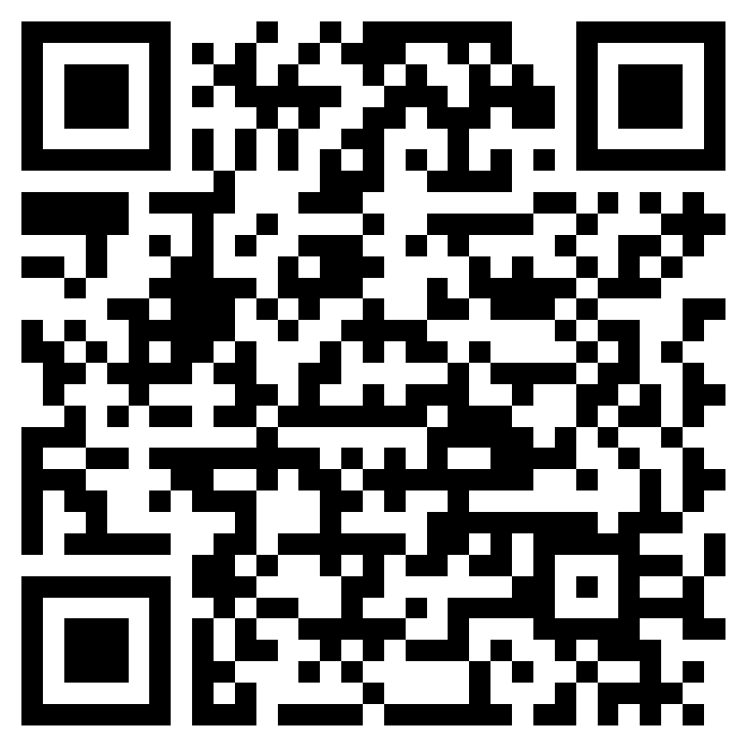
Eys OAP Guidance Feedback Form
EY's OAP Guidance Draft and SENIF Documents Feedback Form- RESPONSE REQUIRED

Slide 57
Observing at Panel
Panel is every Thursday 9:30am-12:30pm
If you are wanting to observe see/ email James a date that you would like to attend this.

Slide 58
Next Network SENCo Forum Meeting Dates
Wednesday 29th January 2025- Westside School 2:30pm-4:30pm
Tuesday 19th March 2025- Ark Burlington Danes Academy time TBC
Wednesday 21st May 2025
Tuesday 8th July 2025

Slide 59
Thank you to Hurlingham Academy for hosting.

Slide 60
After SENCo Meeting drinks
The Duke on the Green
235 New King's Rd, Fulham, London SW6 4XG
Everyone welcome.

