Slide 1

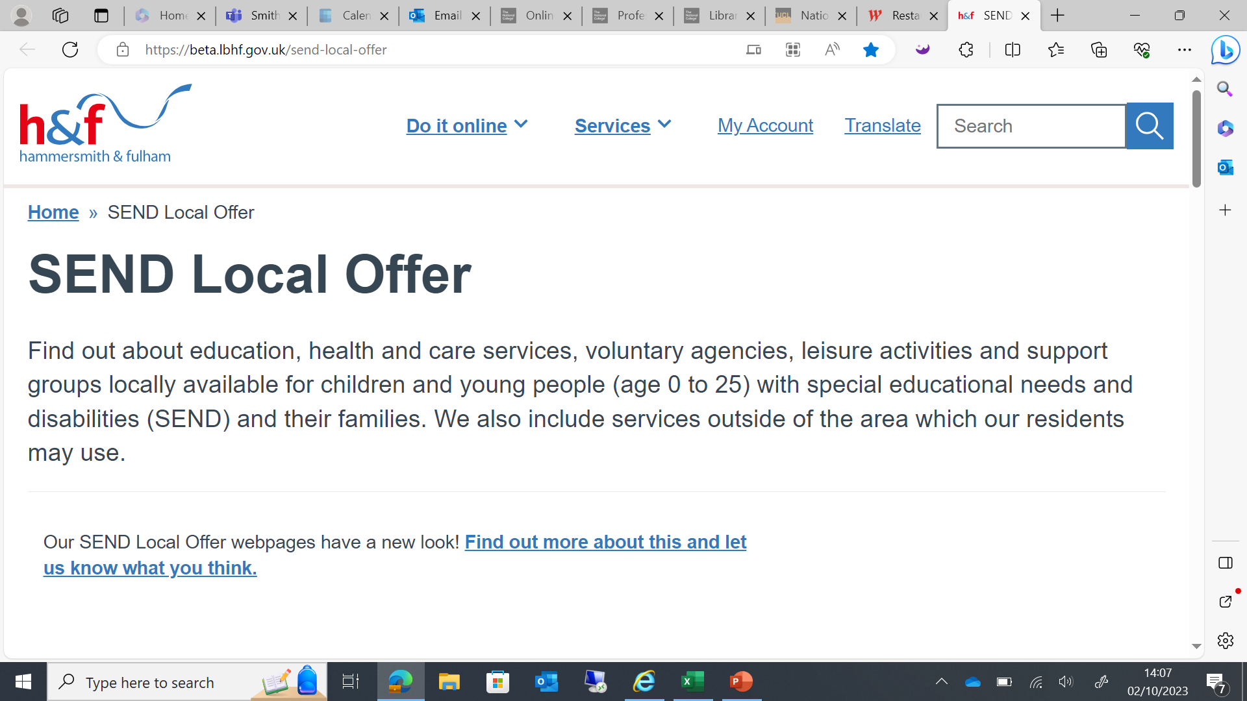

Welcome to Network SENCo Forum Meeting
Thanks to Phoenix Academy for having us

Slide 2
Agenda
School Nursing Service
EBSA
OAP/ASK SAL/SENCO Website Pages
Break
SENCo Activity
School Attendance
H&F Notices

Slide 3
School Nursing Service
Charis Champness- commissioner for H&F school nursing services
September 2024

Slide 4
Aims
To discuss the role of public health nursing in schools.
To discuss how a new school nursing service can be best designed to serve our young residents.
To outline the proposed new service model for 5-19 Public Health Nursing Services in Hammersmith and Fulham
To get feedback on the proposed model and understand the issues, needs and how the new offer can be best placed to serve our residents.

Slide 5
Introduction
Hammersmith and Fulham Council intends to recommission the School Nursing Service for 1st January 2027.
Our current model is one contract that is an integrated 0-19 Public Health Nursing Service that includes Health Visiting and School Nursing.
We are proposing to separate these contracts so that we can focus more on our 5-19 offer all while keeping the principles the same for public health nursing.
Our current offer covers the below and much more:
  The Healthy Child Programme. It offers every family an evidence-based programme of interventions, including screening tests, immunisations, developmental reviews, and information and guidance to support parenting and healthy choices. It also outlines all services that children and families need to receive if they are to achieve their optimum health and wellbeing.
  Support for all children, young people and families at four service levels (community, universal, universal plus and universal partnership plus).​
  Early identification of need, screening, developmental health reviews, focus on high impact areas, and the provision of the National Child Measurement Programme (NCMP)​.
  Delivering Public Health interventions to school-age children and young people, including smoking cessation, physical activity, diet, healthy weight, oral health, emotional health and wellbeing, sexual health and healthy relationships, substance misuse, injury prevention, and work to keep children safe.
  Promoting emotional wellbeing through the school-age years working alongside children and young people to support those with emotional and mental health difficulties, referring to CAMHS where appropriate.
  Reception, Year 6, Year 9, reviews.
  Hearing and Vision screening.

Slide 6
Proposed New Service Model for School Nursing
School nursing plays a crucial role in safeguarding the health and well-being of children and young people within educational settings. These professionals are at the forefront of delivering health promotion, providing health advice, and coordinating care with other services.
However, there is a growing recognition of the need to redesign school nursing services to better address the complex needs of students. This redesign would retain the expertise of school nurses while integrating additional professionals such as peer support workers and admin support.
By doing so, the service can become more holistic. Such a multidisciplinary approach can enhance the service’s ability to support students in a more comprehensive manner, ensuring that every aspect of a child’s health is addressed with the appropriate expertise.

Slide 7
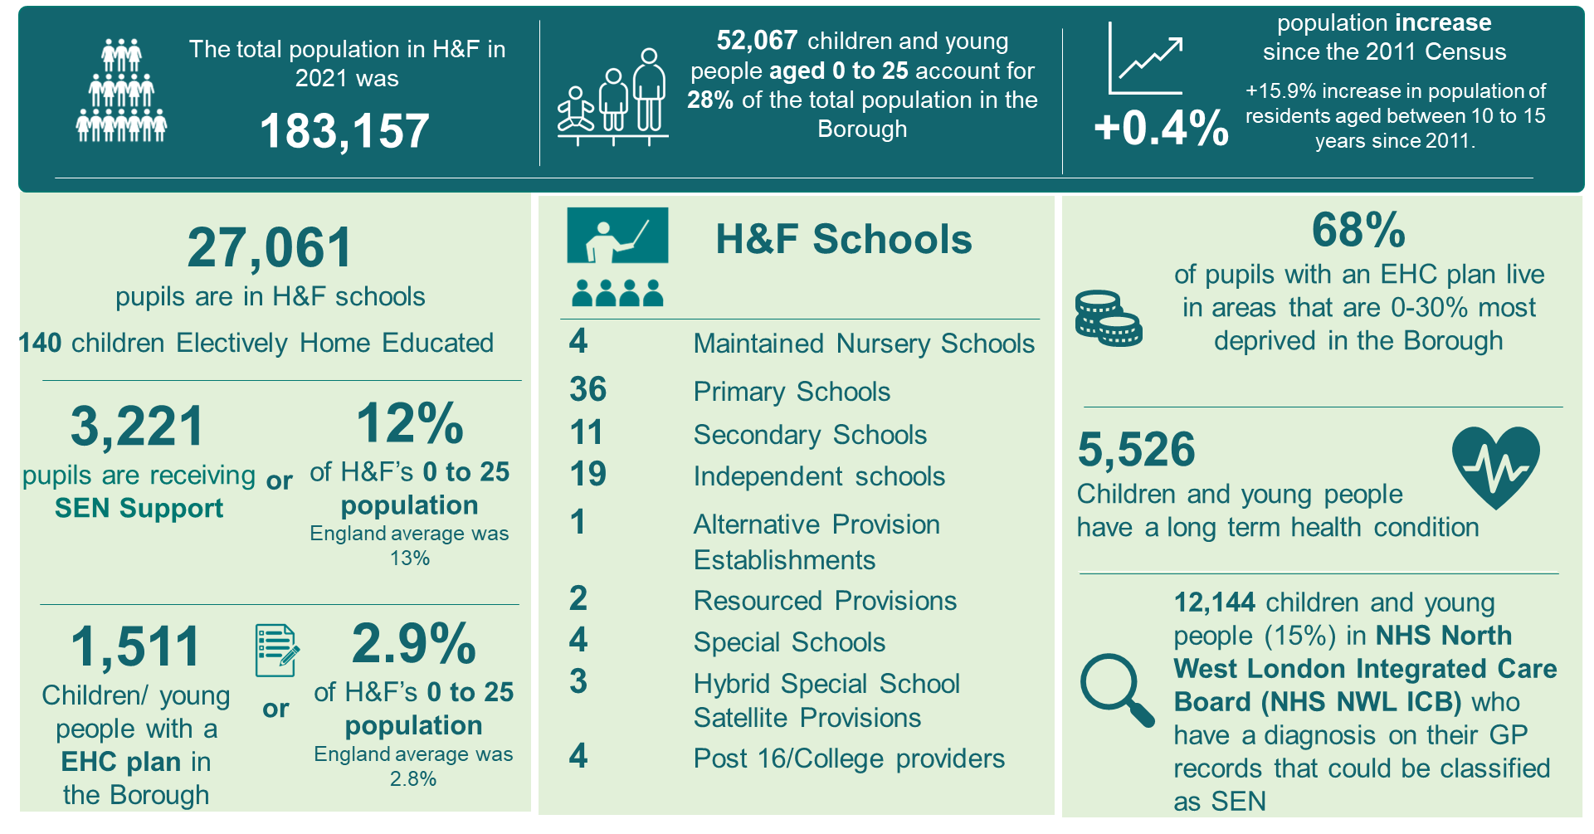
Data
The Hammersmith & Fulham 0-19 Health Needs Assessment (HNA) describes the health of the 0-19 population in H&F and uses data from national and local data sets to understand the health needs of babies, children, and young people (BCYP). Some highlights are described below:

Slide 8
Data
In H&F, we’ve seen a reduction in teenage pregnancy (5.3 per 1000) with rates lower than London (9.4 per 1000) and England (12.7 per 1000).
There is a lower prevalence of overweight/obese children in reception and year 6 compared to London and England.
Covid-19 has had an impact on children and young people (CYP). Areas of concern have included speech, language, and communication (for younger children), as well as mental health.
Speech, language and communication difficulties are the largest of the SEND needs with 34.6% of CYP receiving SEN Support having this as their primary issue.
Although school aged children with known emotional, social or mental health (ESMH) issues is lower than London (2.7%) or England (3.0%), the hospital admission rates of 10-14 year olds due to self-harm in 2021/22 (222.3 per 100,000) are higher than the London rates at 174.7 (per 100,000)
The disconnect between the children with known ESMH and those admitted to hospital due to self-harm indicates that there is a need to support mental health that is not being met especially for the 10-14 year old cohort.
Notes:
Cut out words

Slide 9
Proposed New Service Model for School Nursing
The Institute of Health Promotion & Education released a statement in July 2024 about the key role of School Nurses. They stated that a key role of School Nurses is supporting mental health, and supporting children with medical needs:
  “Promoting and protecting children’s mental health is a central role of school nurses, impacting strongly on overall health and educational attainment. This relationship works both ways, as general health and improved access to education are closely linked to improvements in mental health.”
  “This vital role of school nurses enables children to fully access education, including access to extracurricular activities in a holistic approach to the support of both physical and mental health conditions.”
We are proposing that there are 4 themes to the School Nursing service that looks at:
  Long term conditions
  Wellbeing and mental health
  Weight management
  Safeguarding
Notes:
Watson M C, Neil K E and Tilford S (2024) IHPE Position Statement: School Nursing. Altrincham: Institute of Health Promotion and Education

Slide 10
Substance Misuse
Long Term Conditions Specialist
Weight Management Specialist (Registered Dietician)
Safeguarding Specialist
Wellbeing/Mental Health Specialist
Leadership Team
SEND Specialist
School Attendance
School Exclusions/ suspensions
Healthy Schools Programme
Oral Health
Public Health Interventions
Sexual health
NCMP
Healthy relationships
Enuresis
Healthy Child Programme
Training

Slide 11

Menti- Feedback form

Slide 12
Discussion:
Reflecting on what we have shown you – we want to hear your feedback.
We would also like to gather information on the wider school nursing specification.
Please go to the link so submit your answers to the following questions:
  What support do you think children and young people need?
  What do you think are the key priorities that a School Nursing service should focus on?
  How would your profession like to work better with school nurses?
  What support would you like to see in school for children’s health and wellbeing?
  How do you want to hear from a school nurse about health topics and general communication?

Slide 13
Questions?

Slide 14
EBSA support plan
Summer Term 2024
EPS / Education staff to finish draft ‘Toolkit’ hosted on the Learning Partnership website
Emotionally Based School Avoidance Guidance and Resources for Schools - Learning Partnership (lbhflearningpartnership.com)
Consult with SENCos and finalise Toolkit
Toolkit to be shared with other school support services, health and social care colleagues.
Autumn Term 2024
All schools to receive input in using the EBSA Toolkit resources.
All schools to receive a pack of physical resources to support early intervention
All schools to receive training/support in aspects of good EBSA practice most appropriate to their context (e.g. belongingness, emotional differentiation, whole school audit, policy development, etc) – to be decided in consultation with SMHL and SENCo.
EDLT team to develop resources and solutions to support the more entrenched EBSA cases, based in evidence-based best practice. Working group to look at resourcing this? (Joint approach with Social Care partners and Health).

Slide 15


Slide 16
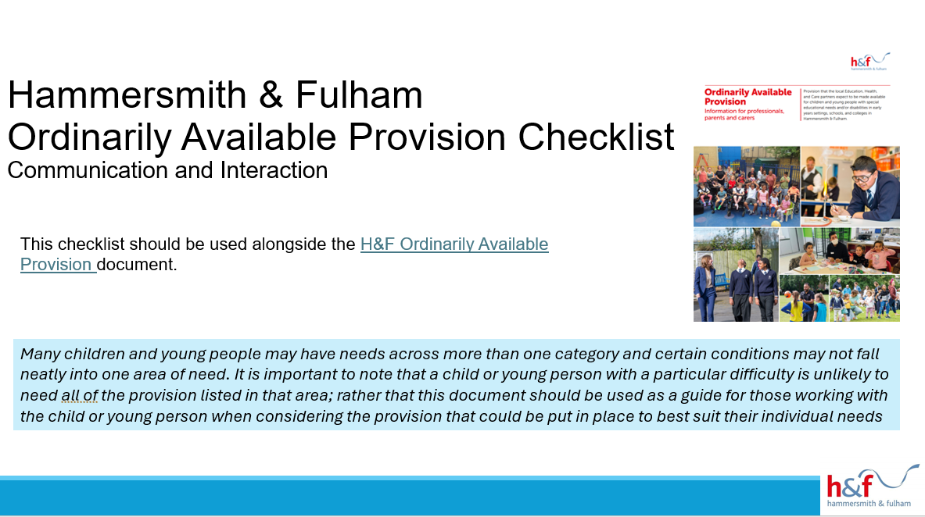
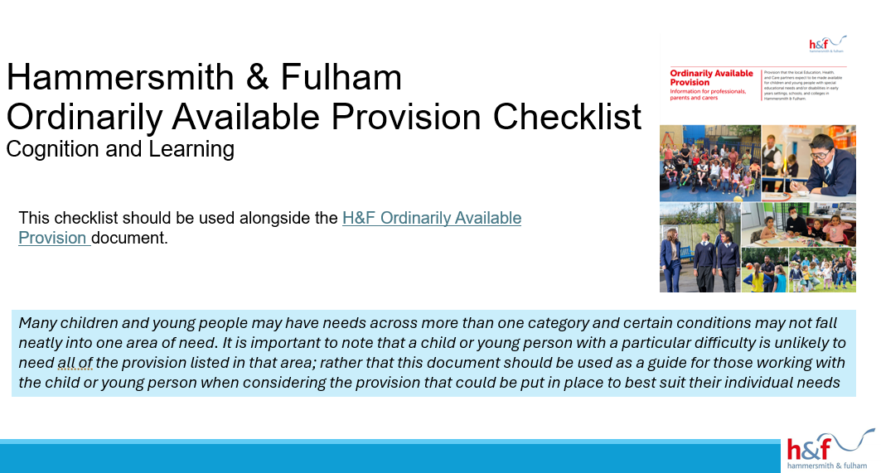
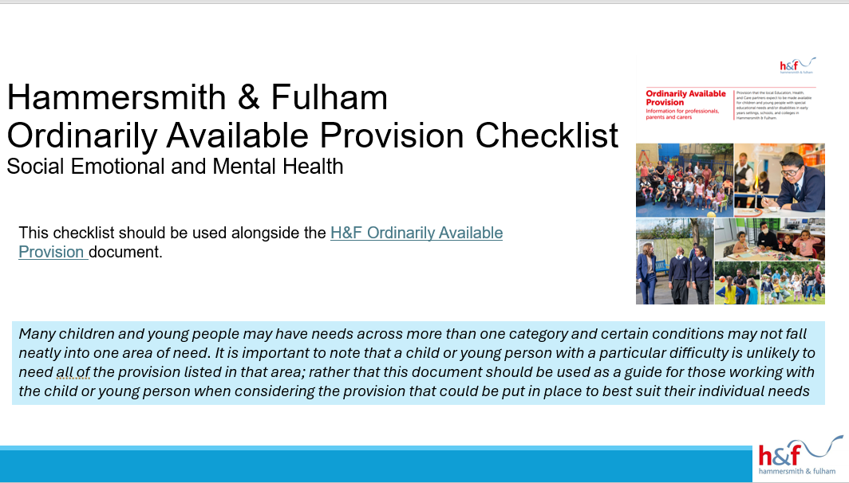
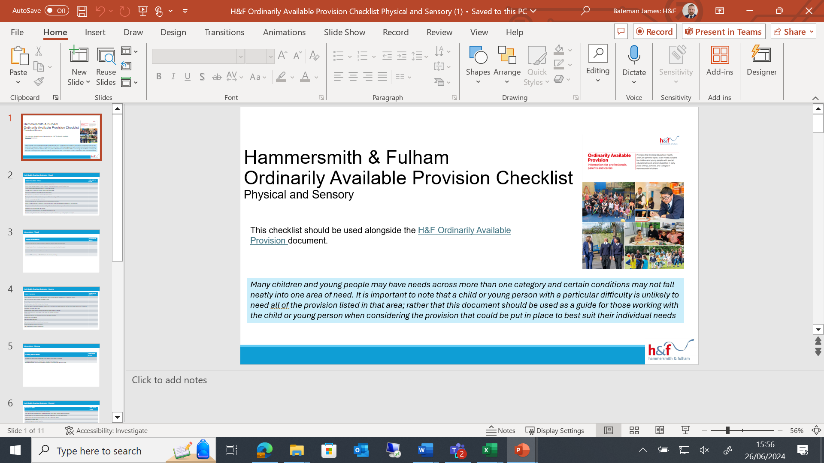
OAP Checklist Documents- 4 broad area of needs
Ordinarily Available Provision - Inspire (lbhfinspirehub.com)

Slide 17
The purpose of the 4 checklists
A proposed array of Teaching and Learning strategies is available to support the learner, along with a checklist for the SENCo to document the implementation of OAP recommended strategies.
A range of interventions are suggested for the school to implement, with clear evidence of adherence to the recommendations.
Next step support is provided if the combined Teaching and Learning strategies and interventions do not meet the learner’s needs. This includes further assessments or referrals to gain a deeper understanding of the learner.
Finally, it encourages reflection, ensuring that all staff working with the learner are adequately trained and equipped, and that the learning environment is appropriately set up.
But MOST IMPORTANTLY- SENCos should share this with school staff so they can implement some of the strategies before knocking on the SENCos door. Empower your staff and provide yourself with some breathing space.

Slide 18

ASK SAL
The front door to SEND at H&F
H&F - Ask SAL SEND Advice Line Referral Form (office.com)

Slide 19
Comms that has gone out to all School Settings
As part of the local areas ongoing commitment to early identification and intervention, a new virtual SEND Advice Line (ASK SAL) has been established starting this term.
This early advice service for SENDCos, SEND Managers and other professionals will support settings with an early conversation to help guide them through the graduated approach and signpost to next steps and resources to support meeting needs.
The Council’s Local Area SENDCO will triage referrals and provide advice to settings on different strategies, approaches, and resources to meet needs.
Where the child or young person’s needs are more complex, they may schedule the case at the next SEND Support Panel. This is a panel which is attended by multi-agency professionals. The panel will agree next steps and recommendations. This may include support from other services or Inclusion Funding to provide short-term targeted support. Other support could include:
educational psychologists
Inclusion and specialist intervention outreach service (Inspire)
child and adolescent mental health services (CAMHS)
speech and language service (JCT)
occupational therapists

Slide 20
Comms that has gone out to all School Settings continued….
How to get help
There are three different ways Ask SAL can help.
Website links
can my answer be found in the H&F Ordinarily Available Provision https://www.lbhf.gov.uk/children-and-young-people/family-hub/education-and-learning/send-support-education/ordinarily-available-provision-guide ?
do you want to contact someone in the SEND team?
Quick questions about SEND processes, EHCP funding, or colleagues looking for the most appropriate contact. Then email: james.bateman@lbhf.gov.uk or call 020 8753 4532.
Concerns regarding individual pupils or whole school issues
Complete the online form with brief details and reason for your consultation request.
Please consider which staff member knows the detail the best and would be most suitable to have the consultation via SAL.
Please note: ASK SAL supersedes the previous Contingency Funding process. All requests for support must be submitted via ASK SAL in the first instance.

Slide 21
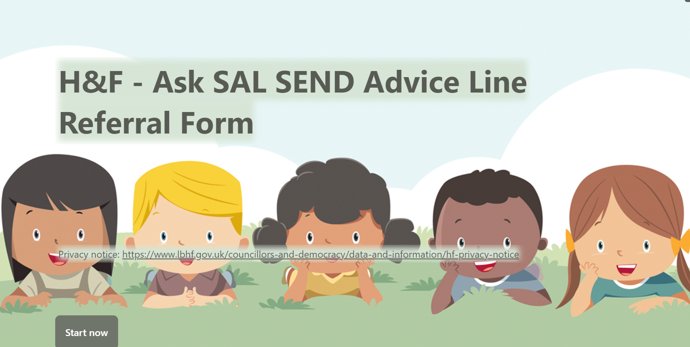

Slide 22






SEND Support Pathway
For Professionals
Assess: child needs are identified by setting
Local Area SENDCO triages referral and provides advice or schedules at SEND Support Panel for professioal discussion
Do: Plan is implemented by school, accessing wider Council SEND Support offer
Implement next cycle of assess, plan, do, review
School map SEND Support offer to Ordinarily Available Guidance
SCHOOL
SEND Support Panel
Provide advice, support via SEND Support services e.g. Inspire, or short term Inclusion Funding
SENCo
Plan: established using Ordinarily Available strategies and recommendations to meet childs needs
Review and inform changes if needed
Further support required: Submit Ask SAL referral.
Ordinarily Available Guidance
H&F Ordinarily Available Provision – Information for professionals, parents and carers (lbhf.gov.uk)
ASK SAL Referral:
Quick questions - email: james.bateman@lbhf.gov.uk
Concerns regarding individual pupils or whole school issues? Complete the online form with brief details and reason for your consultation request.

Slide 23

SENCo Webpage
SENCO Resources Archives - Inspire (lbhfinspirehub.com)

Slide 24
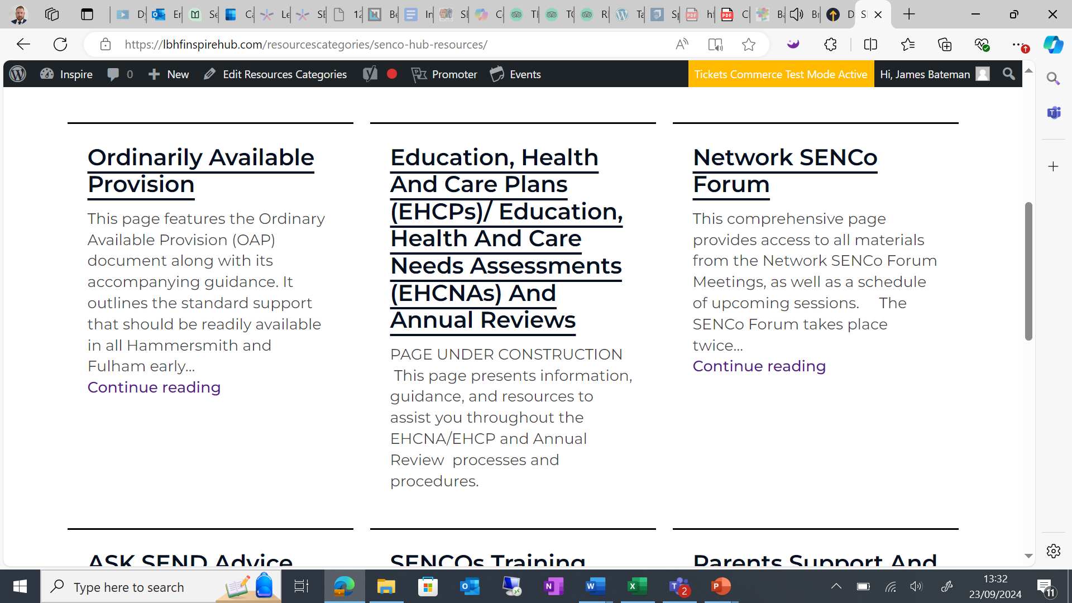
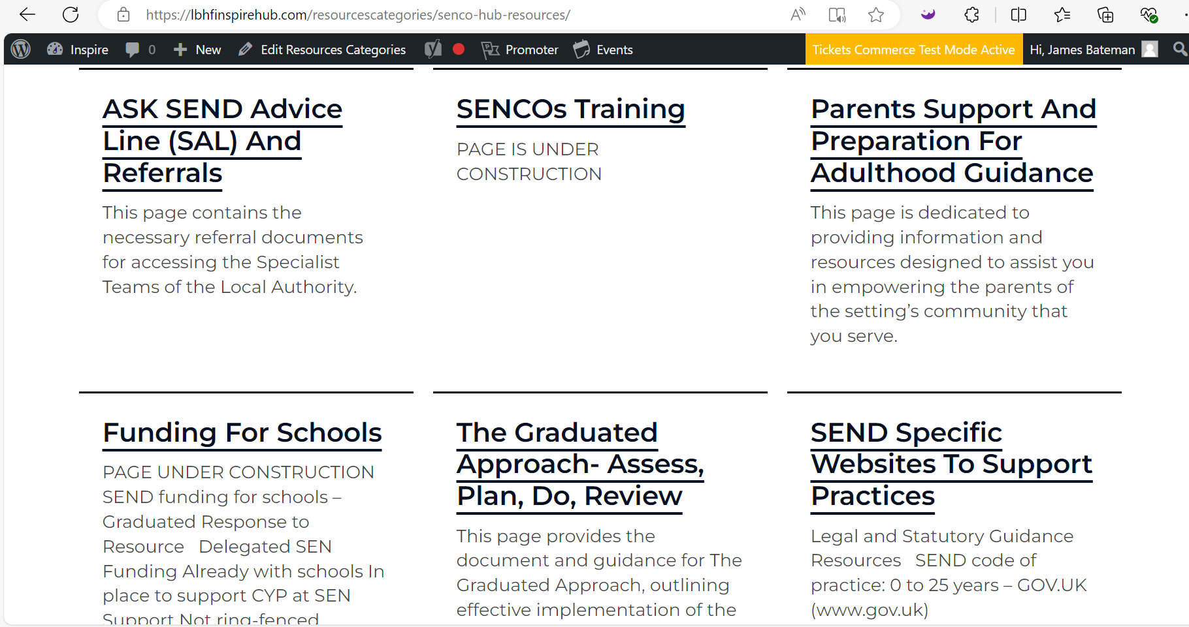
A central place for you to access tools/resources and information that you need to continue doing your role in school.

Slide 25
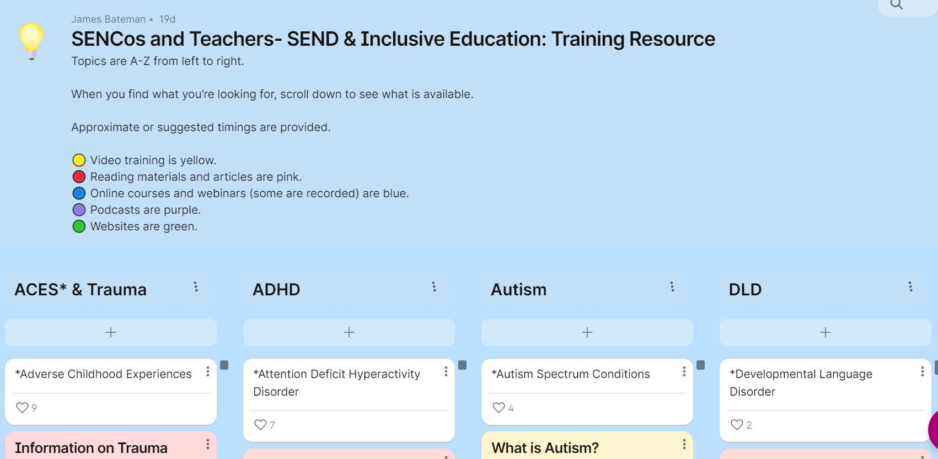
SENCo Training resources page
SENCos and Teachers- SEND & Inclusive Education: Training Resource (padlet.com)

Slide 26
SENCo School resources
Pupil Passports
SEND Support Plans
Provision Maps
Etc
SENCo Working Group?

Slide 27


Comfort Break

Slide 28
SENCo Activity
Quick Teaching and Learning revision task

Slide 29
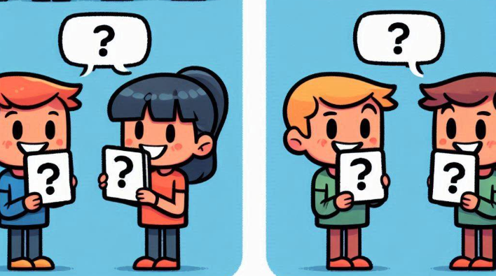
Instructions- SENCo-ing
Each player receives a card with a question and an answer on it.
Players must keep their card secret from others.
Pair up with another player.
Player 1 asks the question on their card to Player 2, who attempts to answer.
Then, Player 2 asks their question to Player 1, who tries to answer. Question and Answer are in Bold.
When players answer correctly, they exchange cards with each other.
If, you get the answer incorrect then your partner can re-word the question or act it out to help you to answer it.
After swapping cards, each player finds a new partner and repeats the process.
Only ask the question first, then if your partner is struggling, then give them the options of A, B and C

Slide 30
Questions and Answers 1-5
1. What does SENDCo stand for?
2. Which act provides the primary legal framework for the SEND system in England?
3. What are the four broad areas of SEND?
4. Name the four parts of The Graduated Approach process.
5. Name the two legal documents that are referenced in the SEND Code of Practice.
1- B) Special Educational Needs and Disability Coordinator
2- B) The Children and Families Act 2014
3- B) Communication and Interaction, Cognition and Learning, Social, Emotional, and Mental Health difficulties, Sensory and/or Physical needs
4- C) Assess, Plan, Do, Review
5- B) The Children and Families Act 2014 & The Equality Act 2010

Slide 31
Questions and Answers continued 6-10
6. What does EHCP stand for?
7. What does EHCNA stand for?
8. Who can request an EHCNA?
9. How often should an EHCP be reviewed?
10. What is the maximum age up to which an Education, Health, and Care (EHC) plan can support a young person?
6- C) Education, Health, and Care Plan
7- C) Education, Health, and Care Needs Assessment
8- C) Parents or guardians of a child with SEND, a young person over the age of 16, professionals working with a child or young person with SEND such as teachers or doctors
9- B) Annually
10- C) 25 years

Slide 32
On your table- Reflective Discussion
1. How easy is something like this replicated in your classroom environment?
2. Which students are able to utilise this type resource/activity?
3. Can you identify a student who would gain from this method?
4. Is it possible to apply this technique to a different subject?

Slide 33
Annual Reviews
Annual Review schedules - schools will receive an annual list of cases that require Annual Reviews in the coming academic year (but note that we are still improving our data set). Schools ensuring that all reviews take place helps us in improving the schedules for years to come. This will go to the SENDCo recorded on children's/young people's record as well as a generic school email address (e.g. Office@ info@), marked "FAO SENDCo) to negate an issues with staff changes.
Annual Review schedules termly - schools will receive, around a week before the end of term, a list of cases that require Annual Reviews in the following term, same note as above re the data set. This will go to the SENDCo recorded on children's/young people's record as well as a generic school email address (e.g. Office@ info@), marked "FAO SENDCo) to negate an issues with staff changes.
Annual Review paperwork reminders - schools will receive an automated email when 14 days has passed since the Annual review meeting date as a reminder to send in the paperwork, it is very challenging for the EHC Casework Team to meet statutory deadlines if the paperwork is not submitted on time. This will go to the SENDCo recorded on children's/young people's record as well as a generic school email address (e.g. Office@ info@), marked "FAO SENDCo) to negate an issues with staff changes.
REMINDER:- All paperwork should be circulated 2 weeks before the Annual Review meeting and then after the AR all post-review paperwork needs to be emailed to all parties within 2 weeks of the date of the meeting. The LA have 4 weeks to take a decision so when paperwork comes in beyond 2 weeks, this is very challenging.

Slide 34
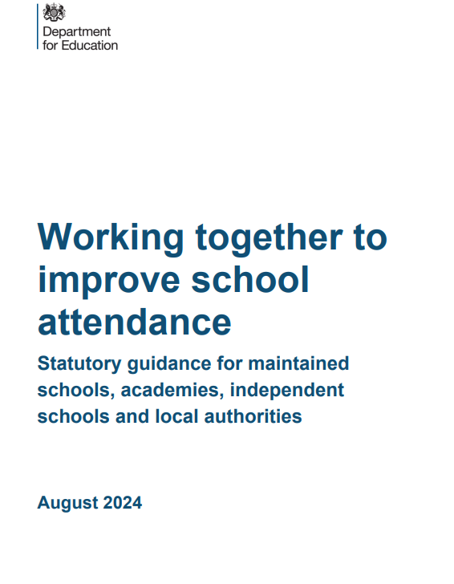
Attendance- Jayne Howarth
Working together to improve school attendance - GOV.UK (www.gov.uk)

Slide 35

SENCo Working Group
Join the SENCo Working Group!
Engage in Monthly Discussions: Participate in dynamic monthly meetings to share insights and collaborate with fellow SENCos.
Showcase Best Practices: Highlight your school’s outstanding SEND practices at our Network SENCo Forums.
Develop Valuable Resources: Contribute to the H&F SENCo Webpage by creating and sharing essential resources.
Mentor and Support: Play a pivotal role in guiding and supporting other SENCos through mentorship and collaboration.
Expressions of interests by Friday 4th October:- James.bateman@lbhf.gov.uk
Just a quick email is needed.

Slide 36
EHC Team Notice- Phase Transfers
The EHC Casework Team sent out parent/carer preference forms by 18th September 2024 to those families where their child will be transitioning to primary or secondary school in September 2025.
Please support any families in your school with putting forward their preferences by the deadline of 2nd October 2024.

Slide 37
Network SENCo Forum Meeting Dates
Tuesday 19th November 2024- Hurlingham Academy 2:30pm-4:30pm
Wednesday 29th January 2025
Tuesday 19th March 2025
Wednesday 21st May 2025
Tuesday 8th July 2025

Slide 38

Thank you to Phoenix Academy for hosting.

