Slide 1

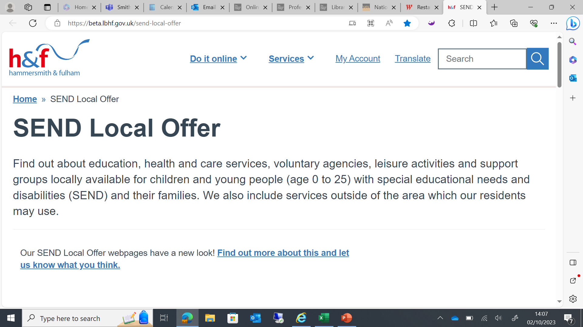

Welcome to Network SENCo Forum Meeting
Thanks to Sacred Heart High School for having us

Slide 2
Agenda
1. Welcome
2. You said, we listened- feedback from last session
3. OAP checklist document launch
4. ASK SAL
5. Caseworker Allocation update
6. Reflection on this academic year and moving into 24/25.

Slide 3
You said | We did/are doing | Why? What’s the impact?
The amount of paperwork that is needed to do an EHCNA request/ Annual Review Documents | In consultation with 7 SENCos (4 Primary/3 Secondary) these have been streamlined, reformatted and amended. These will now be shared across the system | Reduction in time taken to complete these pieces of paperwork. Reduced bureaucracy.
Lack of Support from school leadership LA professionals not fully knowing your settings SEND Context. | Discussions at Headteacher meetings – SEND is a key topic on every agenda. Holistic SEND reviews to take place in the Autumn. EHC Caseworkers moved to a school-based allocation. | Socialising the impact of SEND Review will highlight good practice and identify possible gaps. Provide clear information which can be shared with professionals Inform the training that can be offered to support the individual school. Caseworkers will have closer relationships with schools.
Lack of funding | Continuing to lobby central government Review of mainstream top-ups Support through the holistic SEND review,. Look for opportunities around efficiencies and how we can possibly support with inclusion funding. | Better outcomes for young people Potential to receive inclusion funding
Clarification over Panel decisions | Working on improving the comms. Caseworkers are encouraged to contact the schools prior to panel and then afterwards to inform them of the outcome. If the decision is unclear, then schools are encouraged to seek further advice from either JB or JH. | Better outcomes for young people Improved communication across the system
Families needing more support | Parents Active have been in consultation with updating The Local Offer. Fliers/QR codes have sent out to the schools and GP surgeries. Three Families hubs in H&F which are readily available and Early Help referrals. Parents Active and SENDIASS can also support parents. | Better outcomes for young people Support systems are clearer for parents.

Slide 4
Holistic SEND reviews- Autumn Term
Thoughts?
What would you like the purpose of a Holistic SEND review to be?
What activities do you feel need to be involved to gain an accurate reflection of your settings SEND Landscape?
Any volunteers?

Slide 5
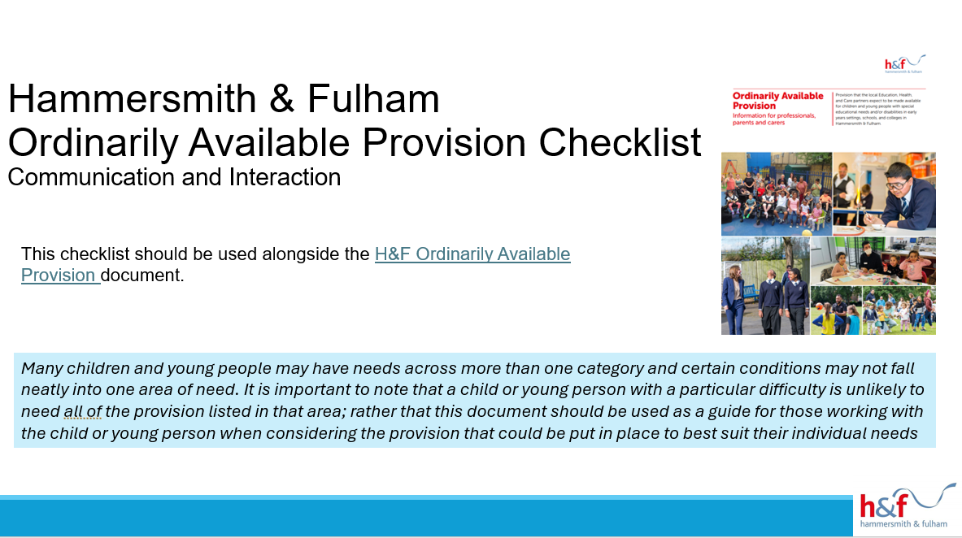
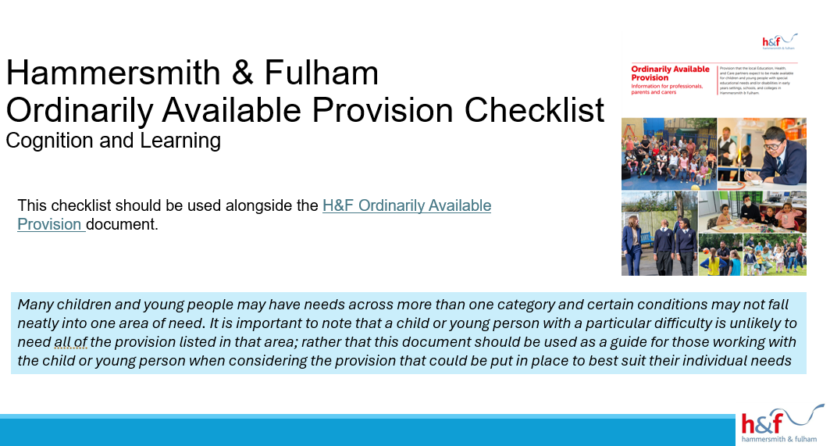
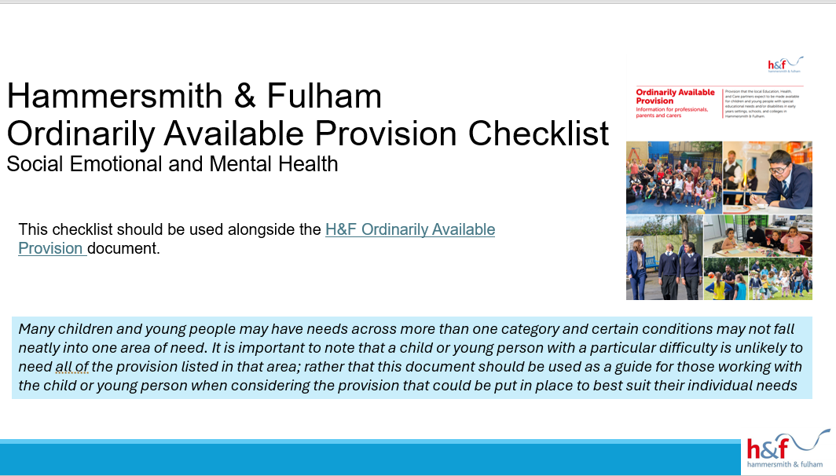
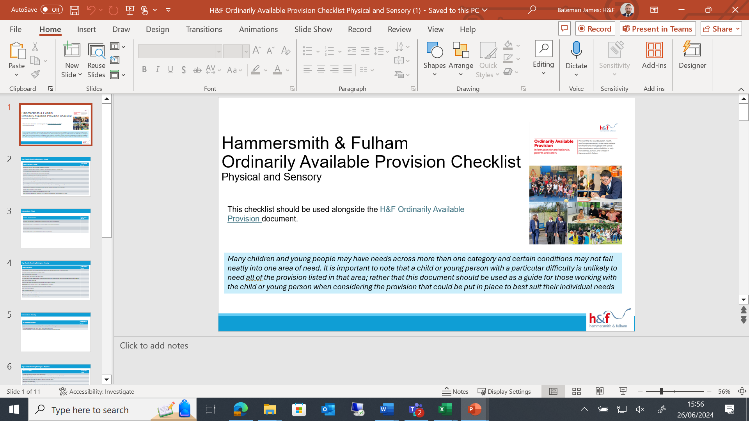
OAP Checklist Documents- 4 broad area of needs

Slide 6
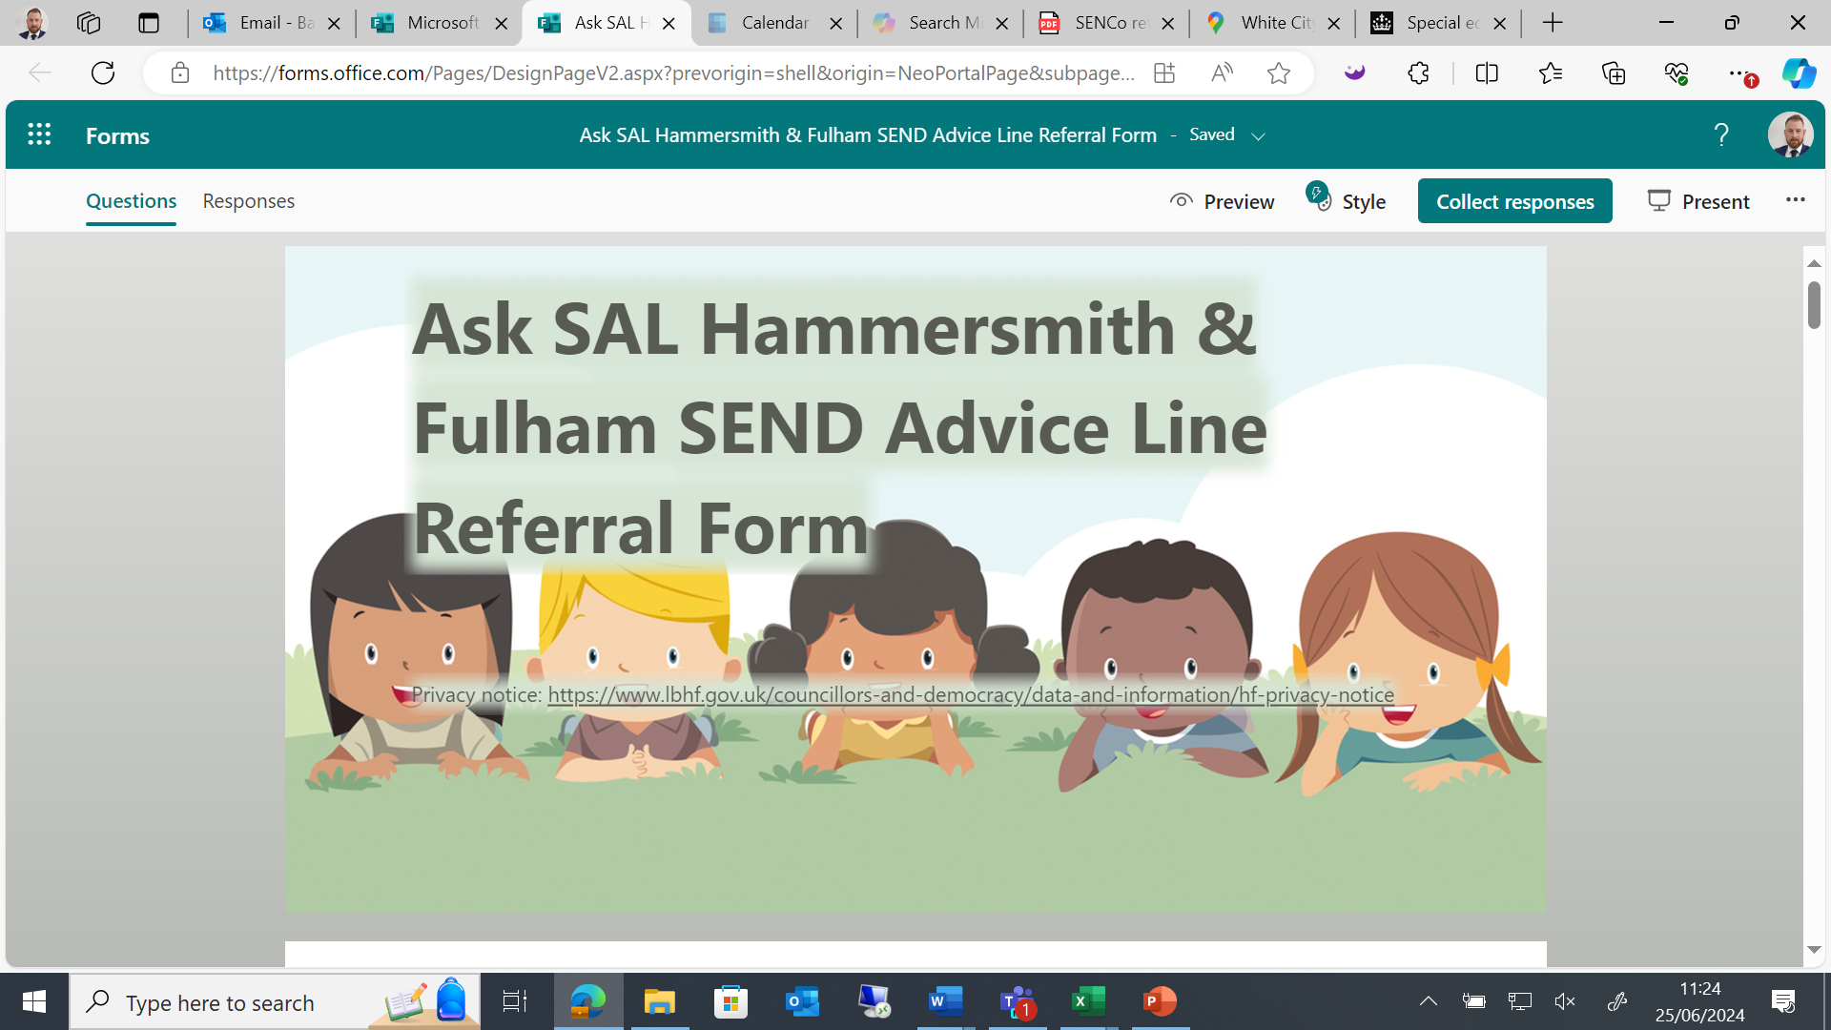
Ask SAL

Slide 7






SEND Support Pathway
For Professionals
Assess: child needs are identified by setting
Local Area SENDCO triages referral and provides advice or schedules at SEND Support Panel for professioal discussion
Do: Plan is implemented by school, accessing wider Council SEND Support offer
Implement next cycle of assess, plan, do, review
School map SEND Support offer to Ordinarily Available Guidance
SCHOOL
SEND Support Panel
Provide advice, support via SEND Support services e.g. Inspire, or short term Inclusion Funding
SENCo
Plan: established using Ordinarily Available strategies and recommendations to meet childs needs
Review and inform changes if needed
Further support required: Submit Ask SAL referral.
Ordinarily Available Guidance
H&F Ordinarily Available Provision – Information for professionals, parents and carers (lbhf.gov.uk)
ASK SAL Referral:
Quick questions - email: james.bateman@lbhf.gov.uk
Concerns regarding individual pupils or whole school issues? Complete the online form with brief details and reason for your consultation request.

Slide 8
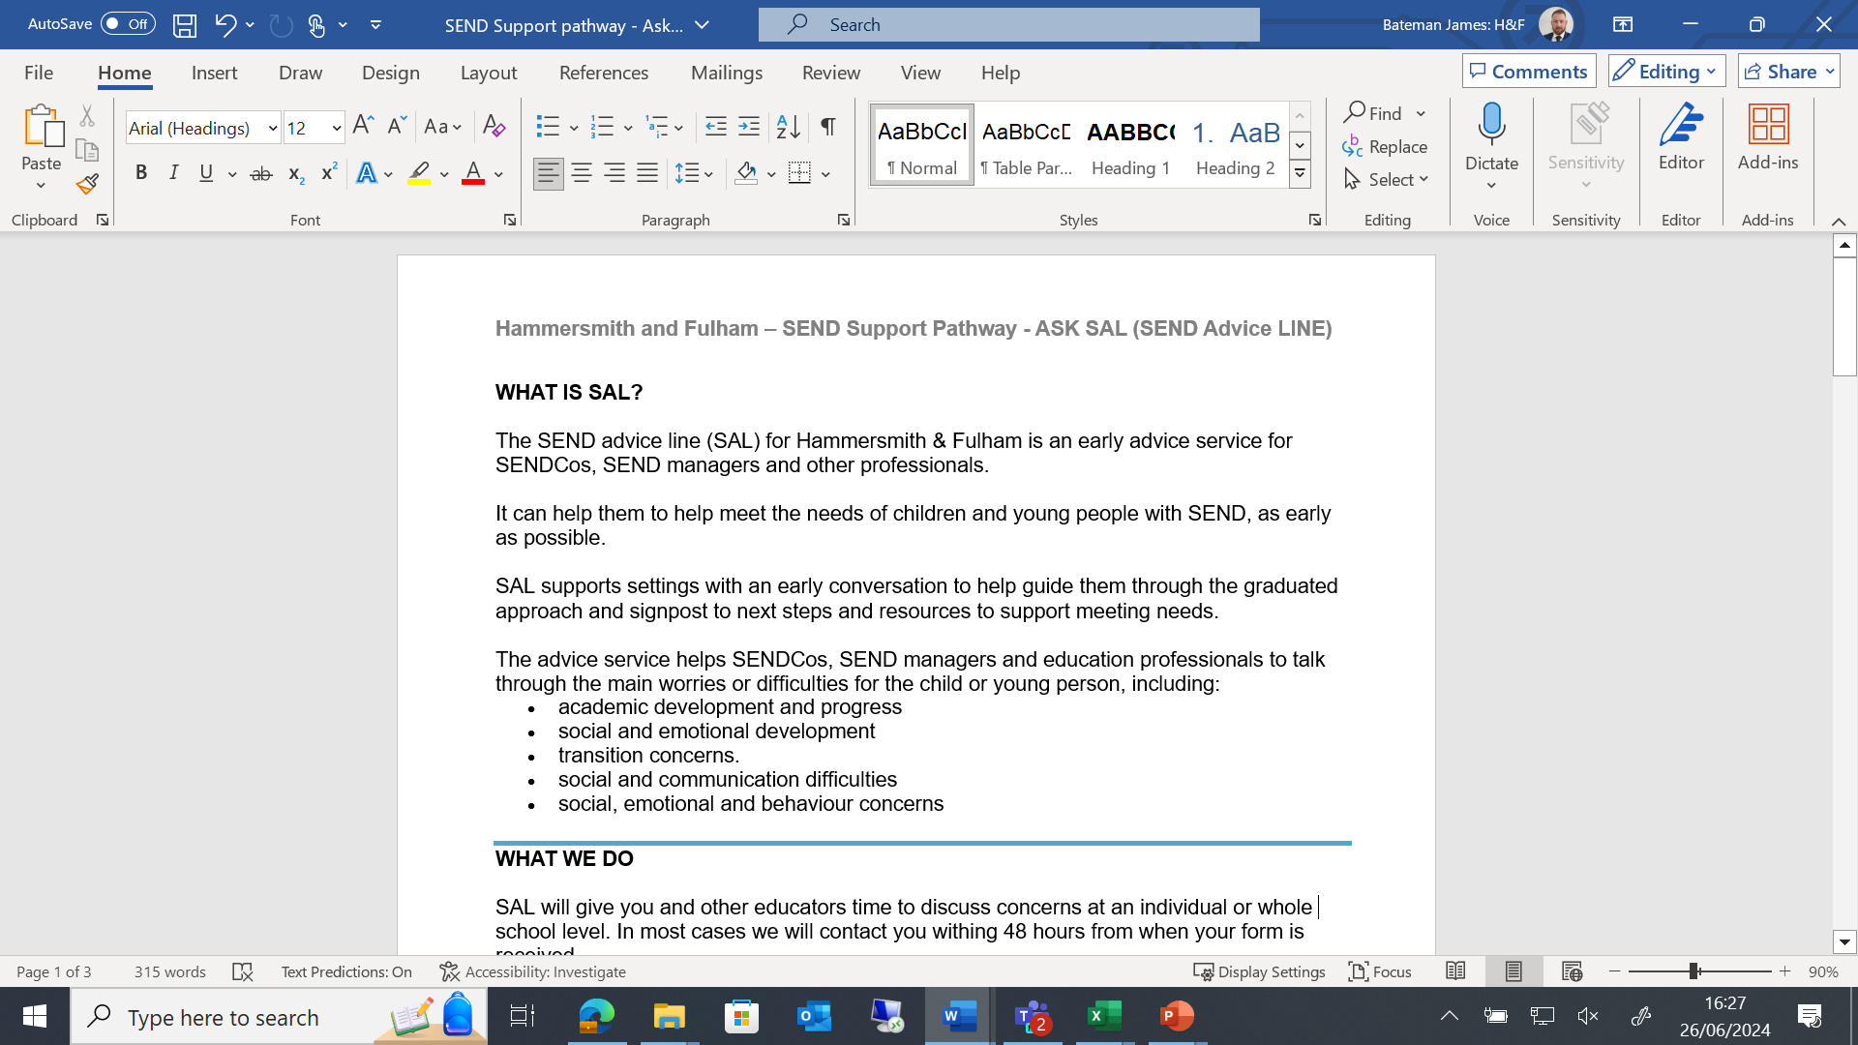
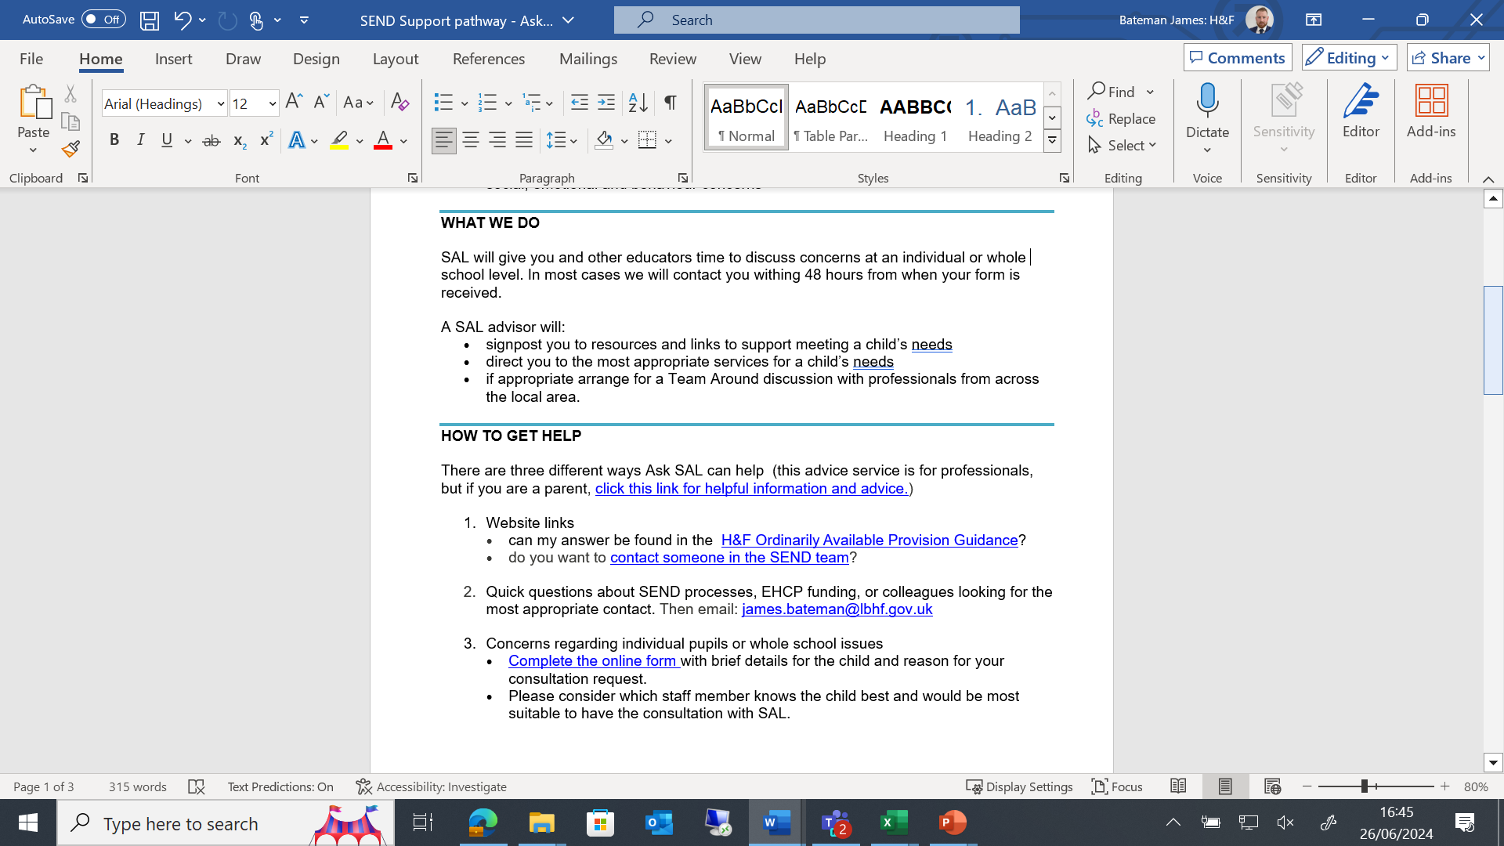

Slide 9
Ask SAL- What the SEND Advice Line Form Looks like

Slide 10
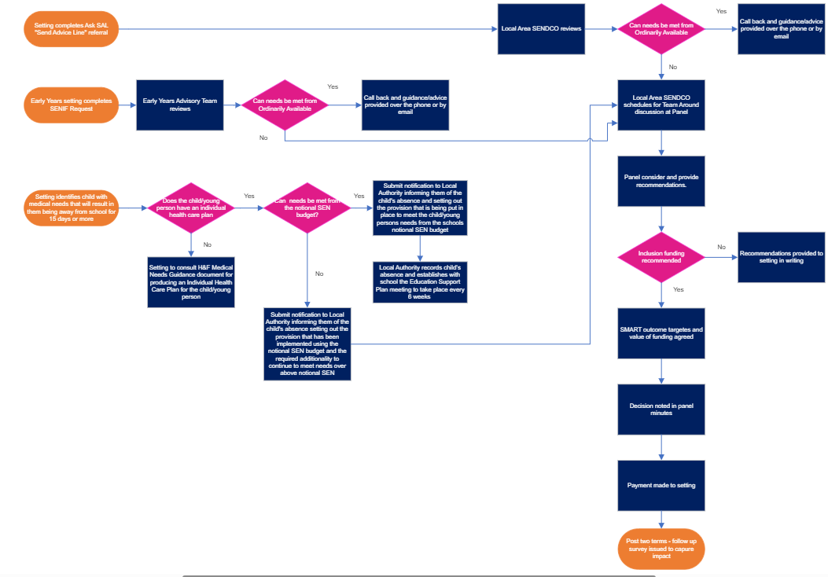

Slide 11
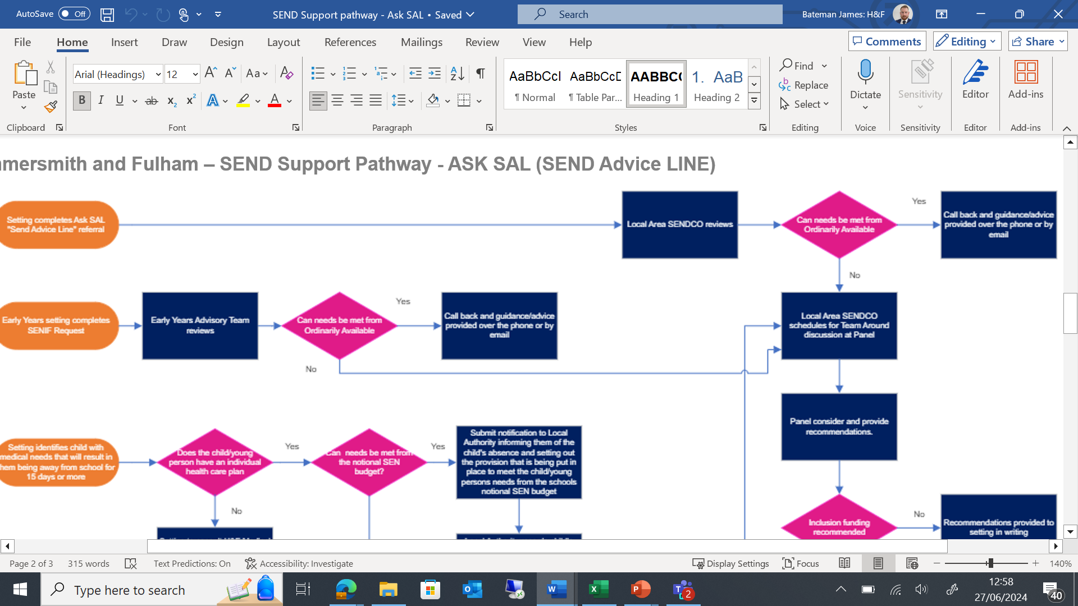

Slide 12
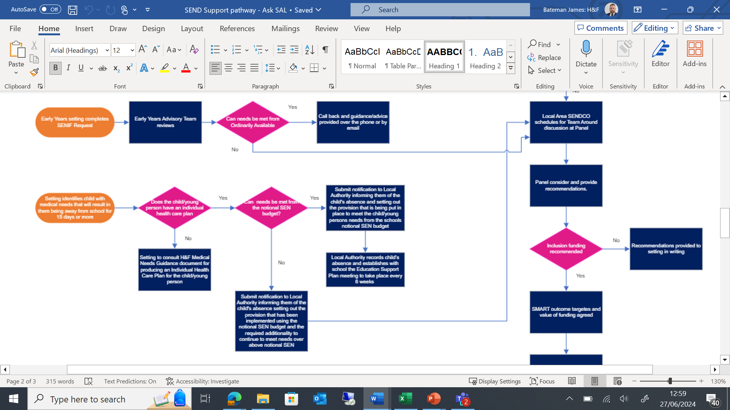

Slide 13
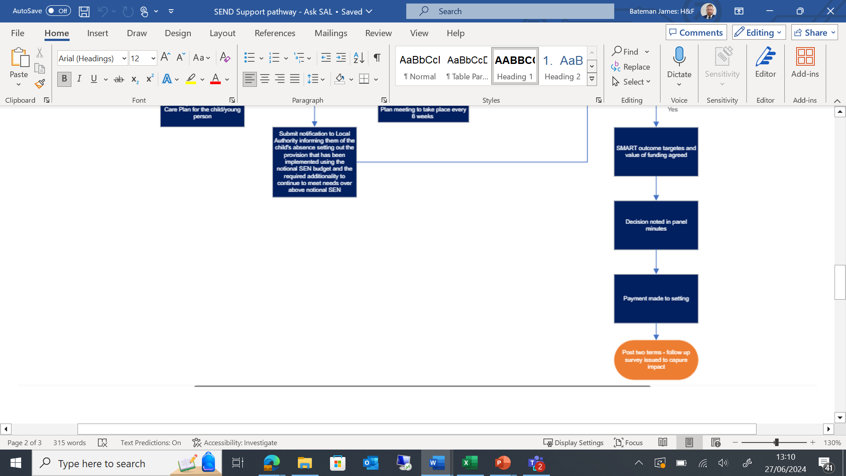

Slide 14
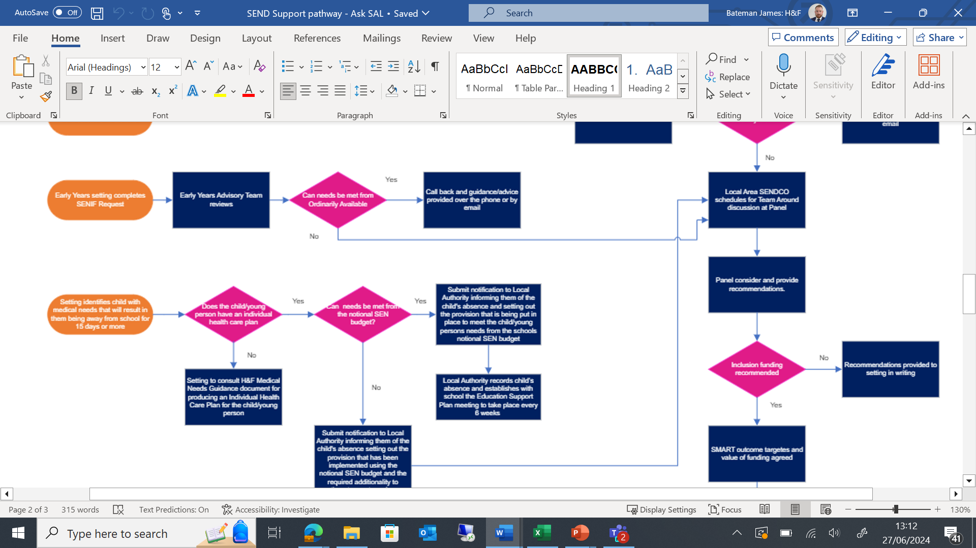

Slide 15
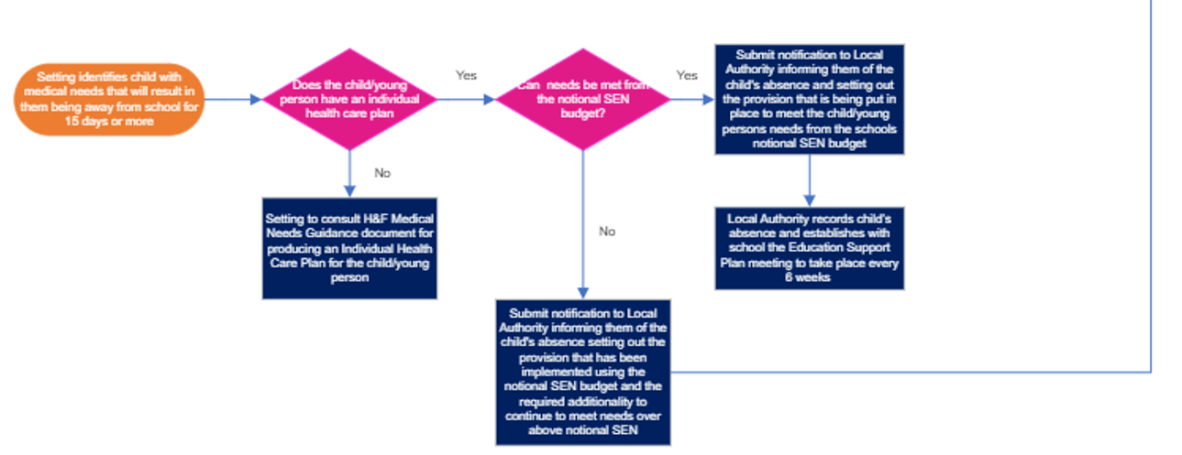

Slide 16


Comfort Break

Slide 17
Notices for Jack O’Donoghue

Slide 18
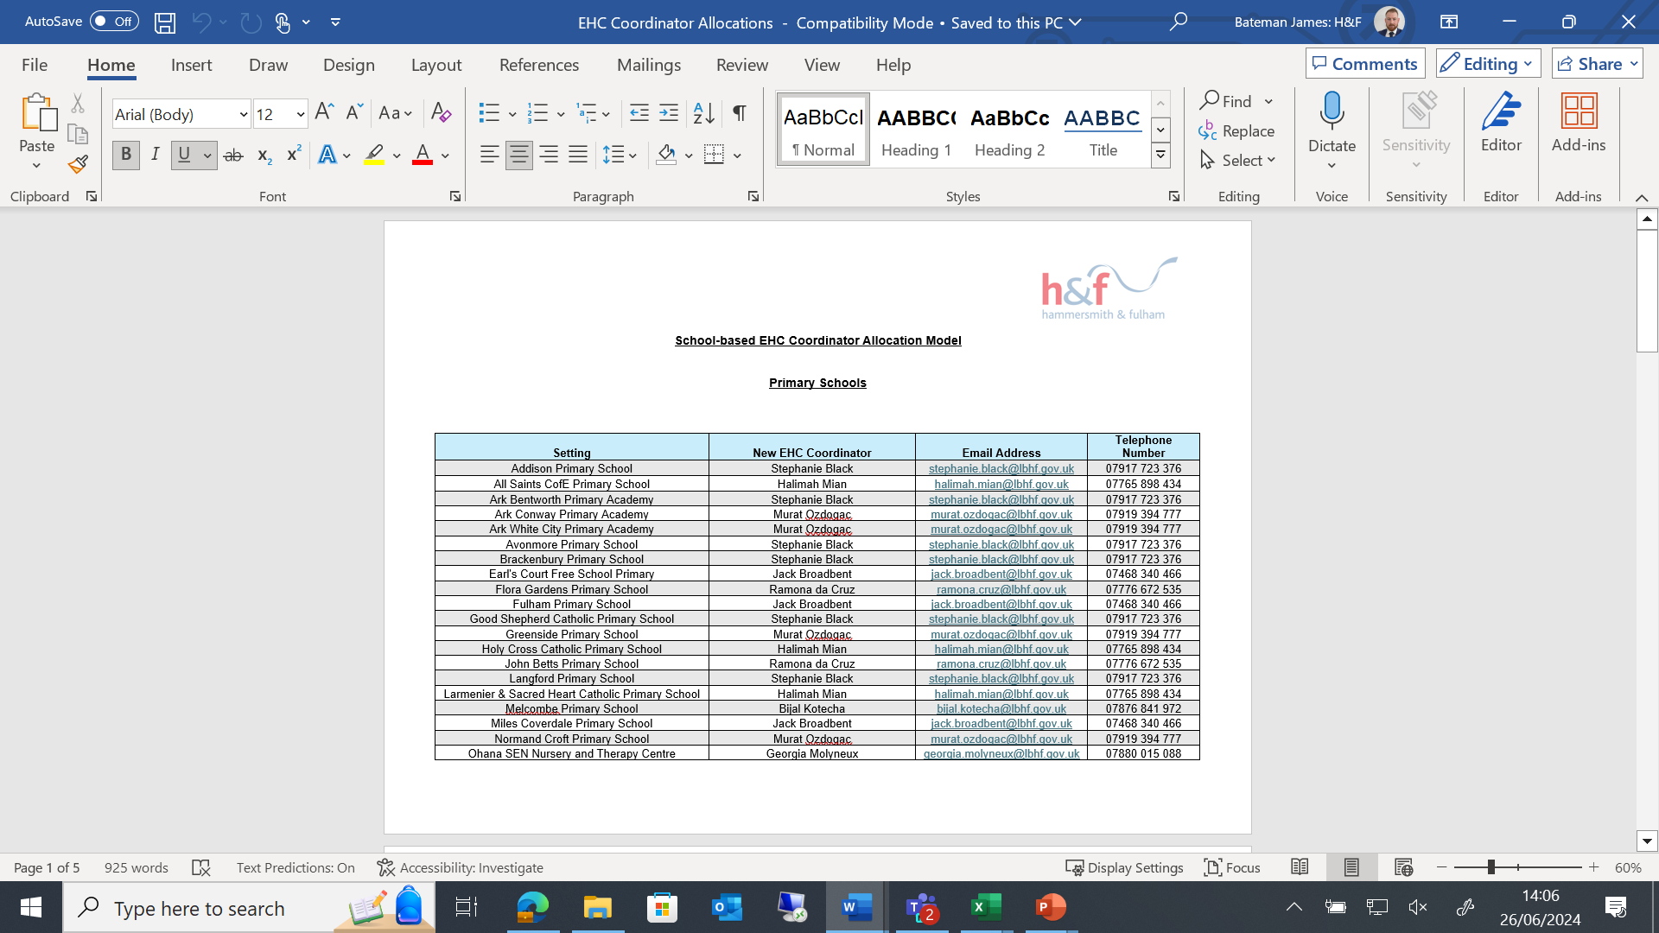
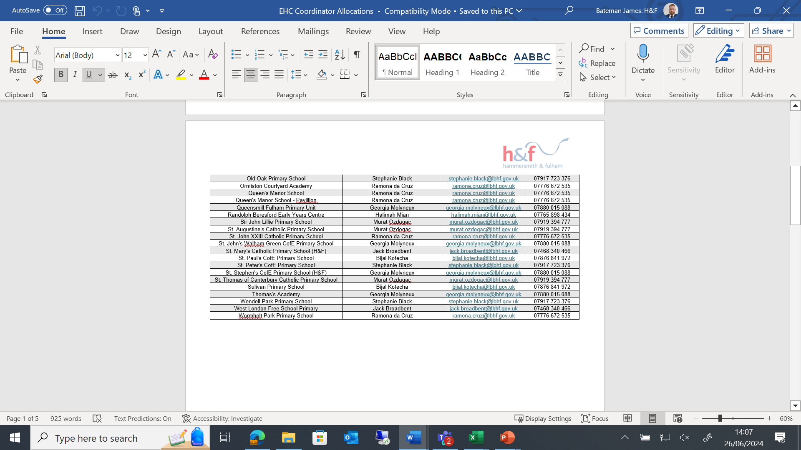
Caseworker Allocation- School-Base Model
Primary Schools

Slide 19
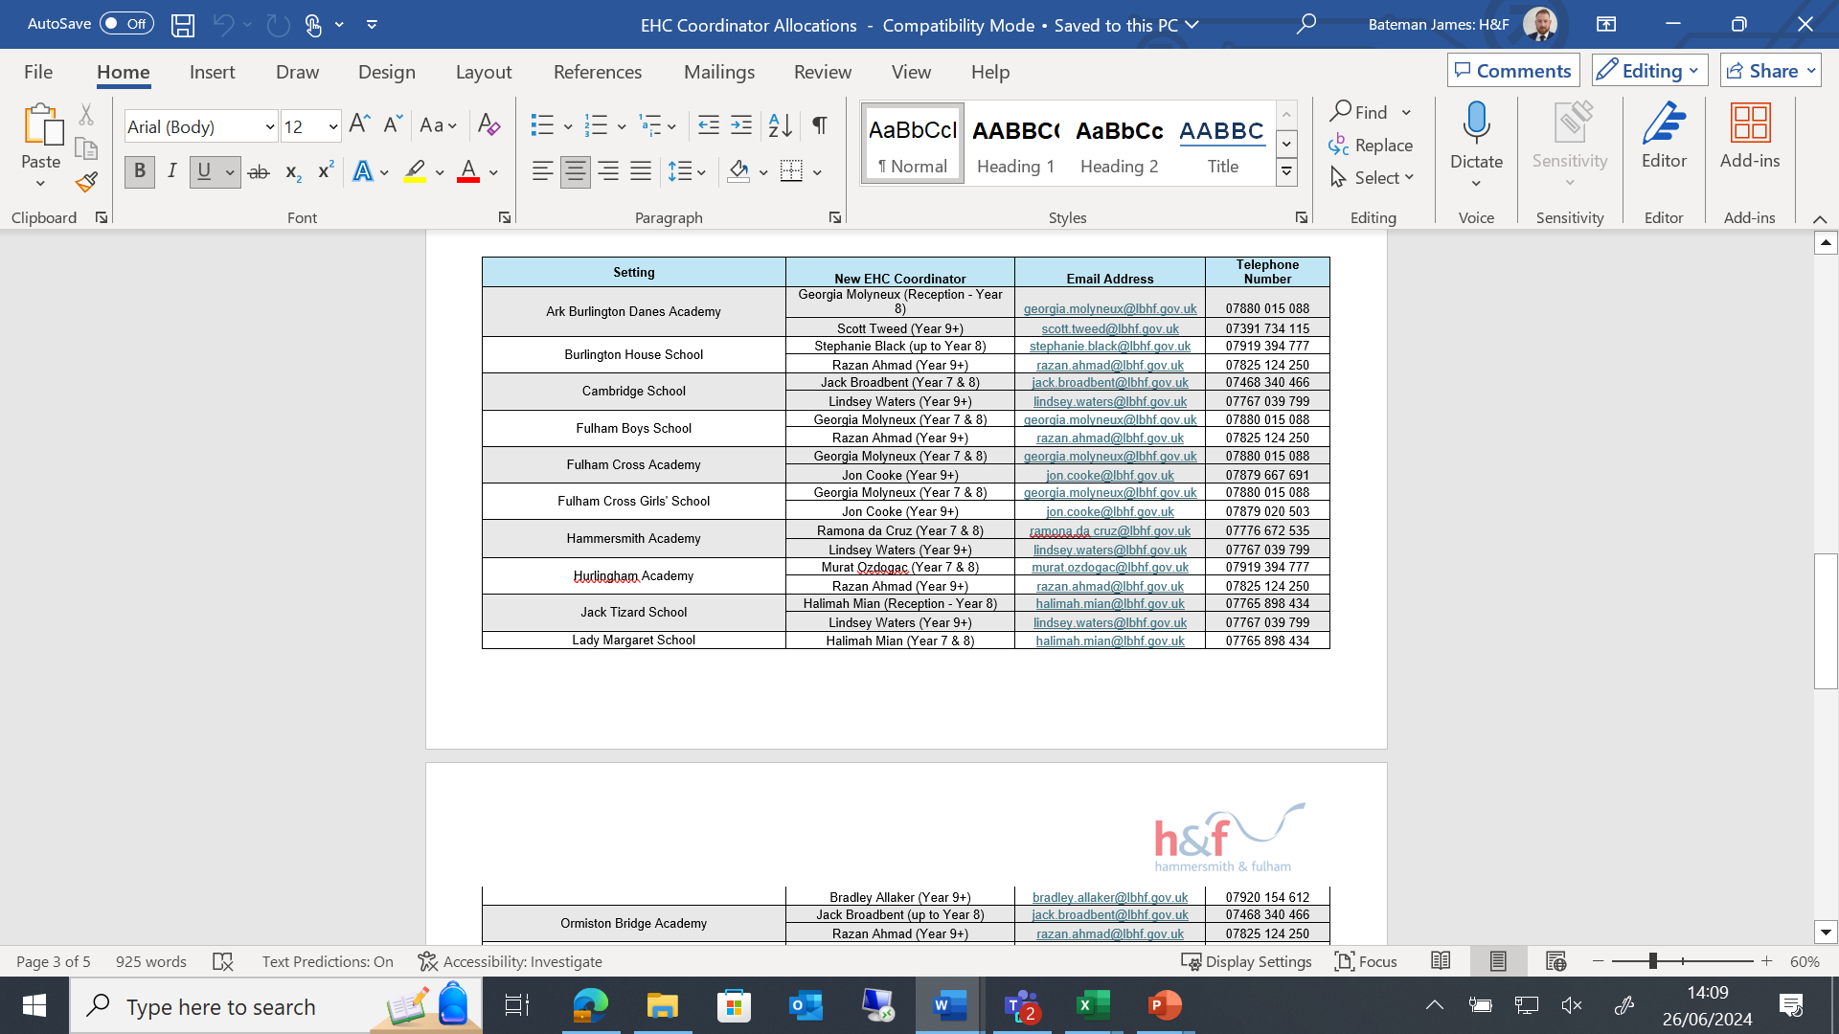
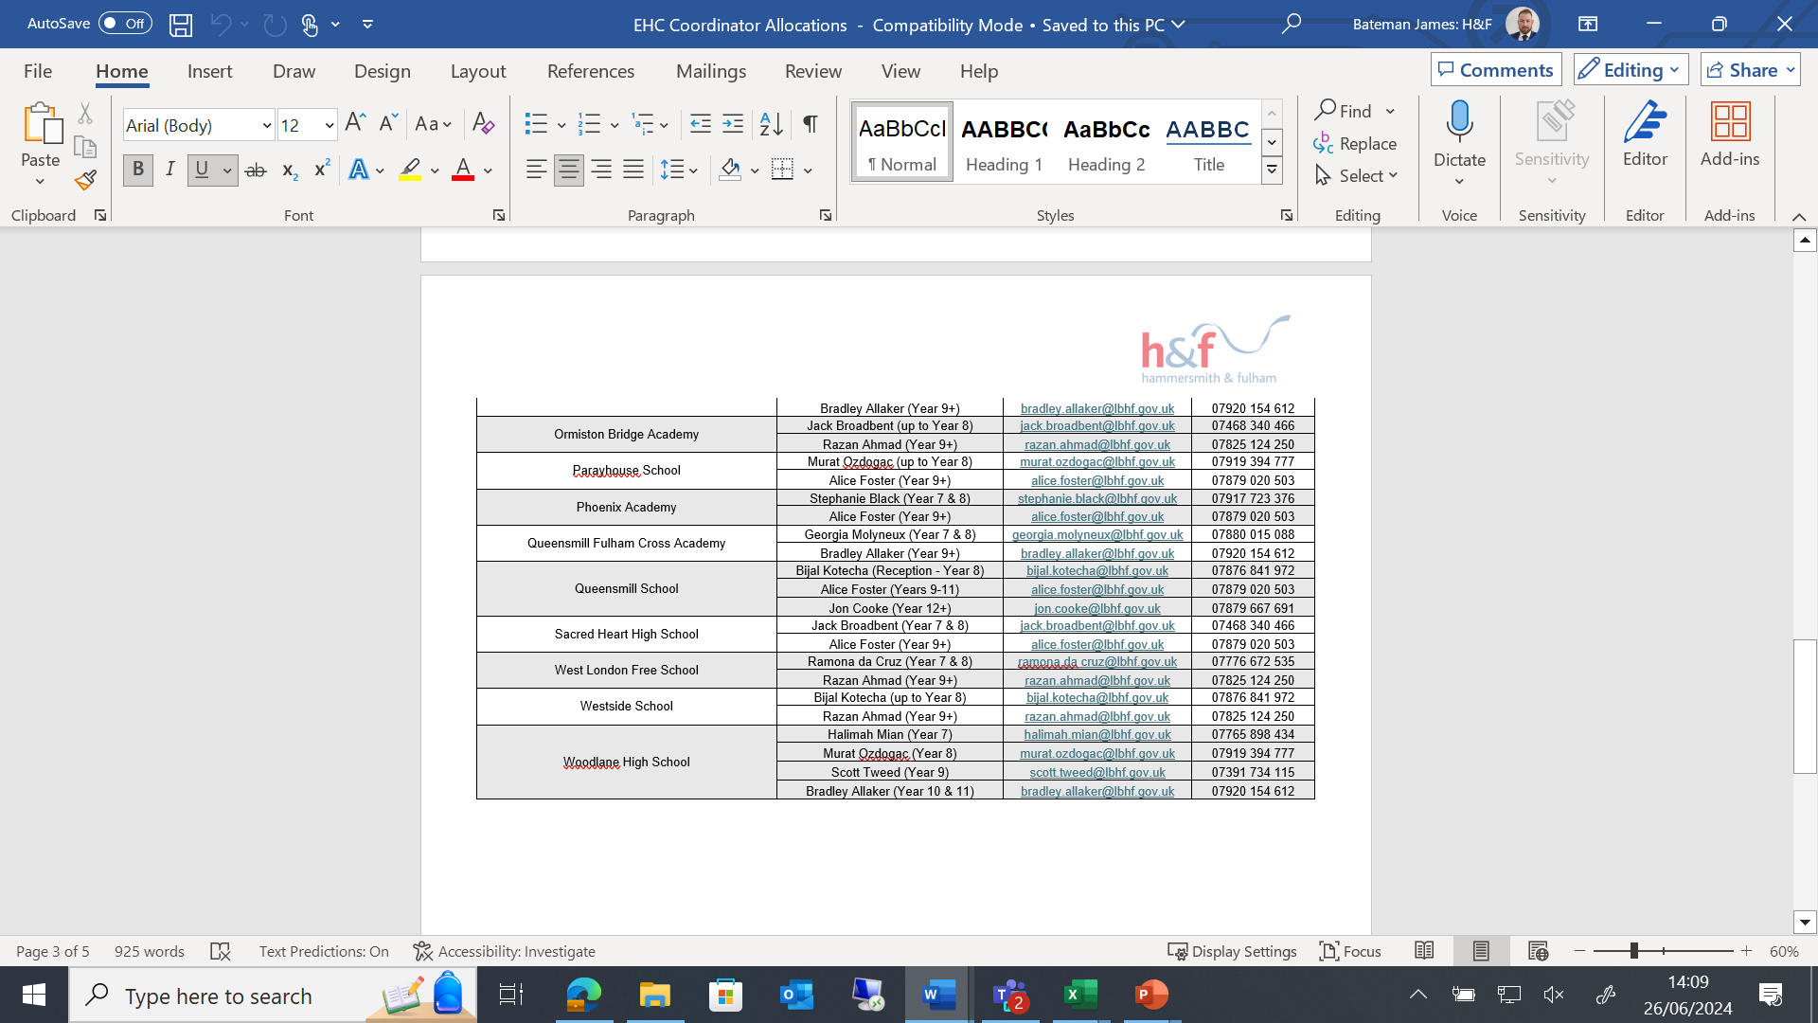
Caseworker Allocation- School-Base Model
All Through and/or Secondary Schools

Slide 20
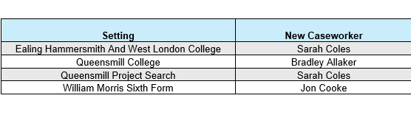
Caseworker Allocation- School-Base Model- Colleges/ Sixth Forms

Slide 21
Notices from Erik Dwyer
Thanks to you all from the team
Annual feedback and ‘CORs’ (OFSTED)
SLAs
Planning for next year

Slide 22
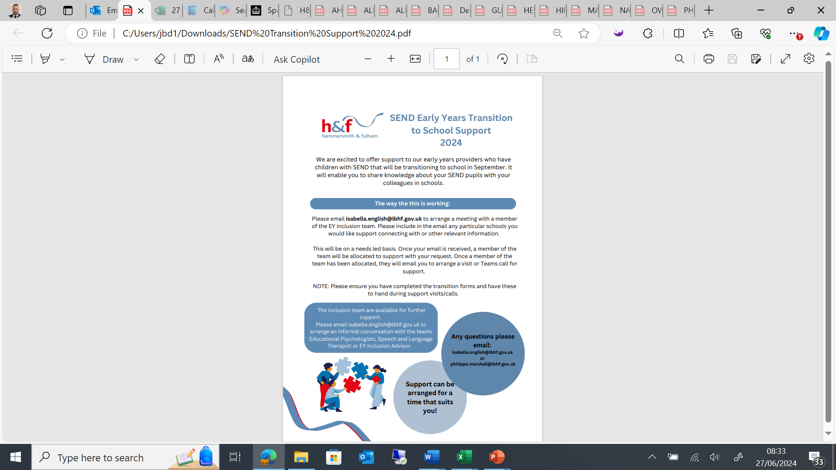

Slide 23
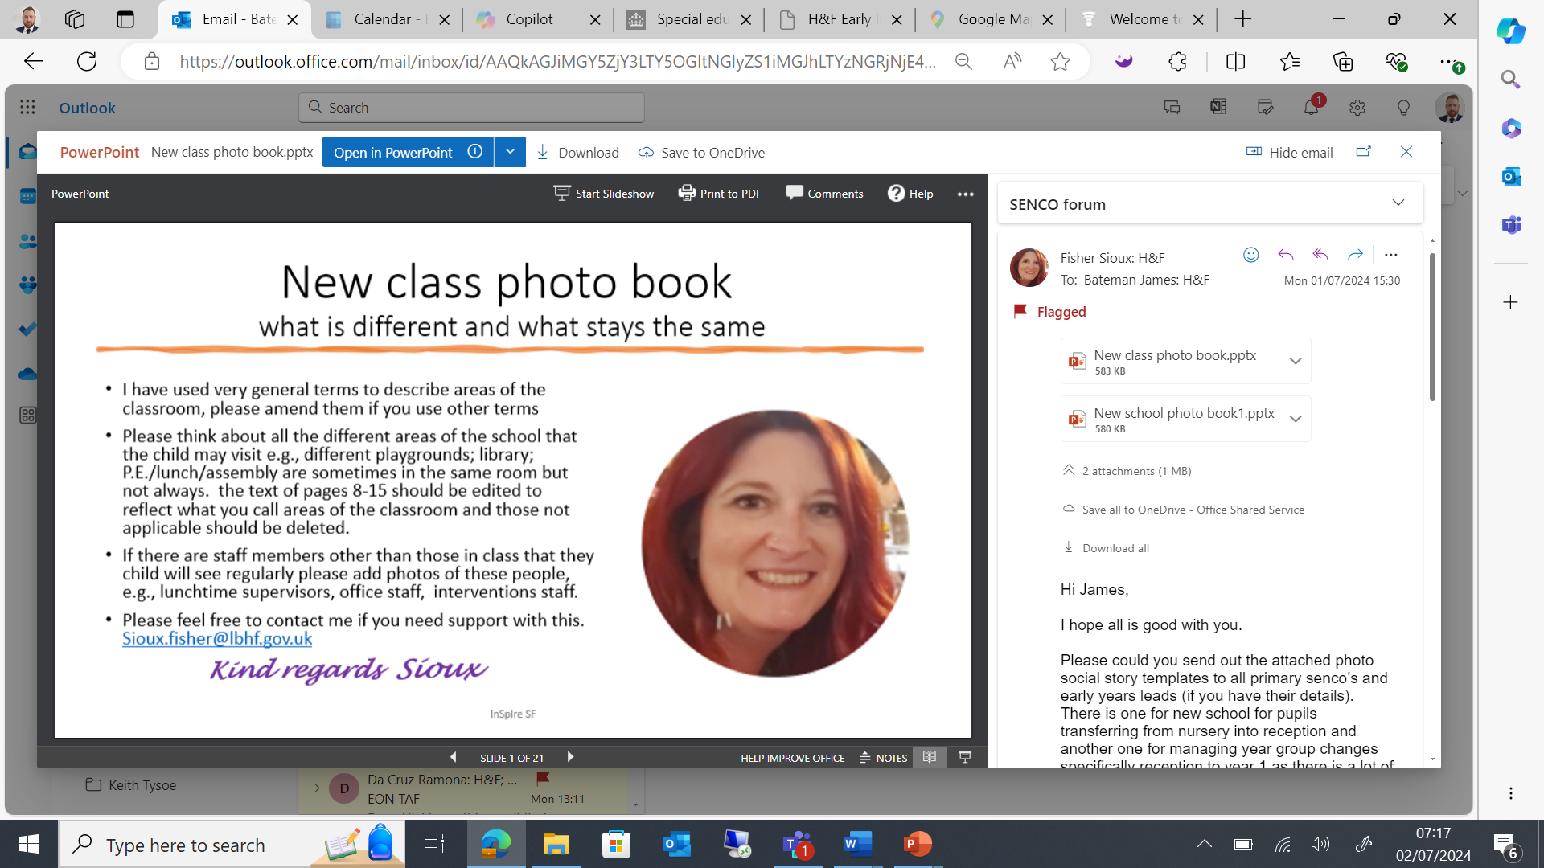
Editable Documents from Sioux
Sioux has put together- photo social story templates to support with transition.
There is one for new school for pupils transferring from nursery into reception and another one for managing year group changes specifically reception to year 1 as there is a lot of change in curriculum and provision.
It is pre-populated and all schools need to do is add photos and adapt the text to fit their setting.

Slide 24
Progress so far: What have been H&F SEND Departments key actions over the last 12 months?
Launched the SEND strategy
Embedded the SEND delivery group
Implemented the SEND Sufficiency Plan
Implemented the Ordinarily Available Guidance and profile of need
Created and implemented a new outcomes framework and scorecard
Refreshed the Local offer
Significant recruitment into the EHCP team
Implemented a new finance workflow
New processes and tracking for annual reviews
Operated new QA cycle and multiagency QA process.
Opened the family hubs
Developed a new transitions plan around preparation for adulthood
Continue to implement the High Needs Block strategy and work within the safety valve target

Slide 25
Reflection on 23/24- Discussions with your colleagues
1. What was your most challenging moment this academic year and why?
2. What was you most rewarding moment this academic year and why?
3. What are your top 3 priorities for next academic year?

Slide 26
Moving onto 24/25
H&F SENCo Mentoring system
H&F EHCNA Paperwork
H&F Provision Map document
H&F Annual Review Paperwork
H&F Ask SAL
H&F OAP Checklists
Format of Network SENCo Forums- changing

Slide 27
Network SENCo Forums- 24/25
1. High Quality T&L aspect- Best Practices from SENCos within H&F
2. H&F Notices
3. Other services workshops
The High Quality T&L aspects- Primary School and Secondary School Specific
Other workshops- Primary School and Secondary School Specific
The idea is that when Primary Schools are accessing the HQTL session that the Secondary Schools will access the other services workshops and then swap over. With everyone coming together for the H&F Notices.

Slide 28
Next Year (24/25 Academic Year) Network SENCo Forum Meeting Dates
Wednesday 25th September 2024
Tuesday 19th November 2024
Wednesday 29th January 2025
Tuesday 19th March 2025
Wednesday 21st May 2025
Tuesday 8th July 2025

Slide 29
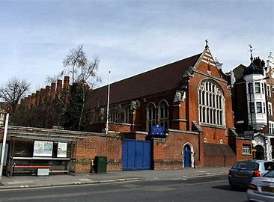
Thank you to Sacred Heart High School for hosting.

Slide 30

I look forward to seeing as many of you as possible at Hop Poles- 5pm
17-19 King Street, Fulham W6 9HR

