Slide 1

Is it Sensory?
Dorette Vermeulen
SEN OT Team Lead
SENOTservice@lbhf.gov.uk

Slide 2
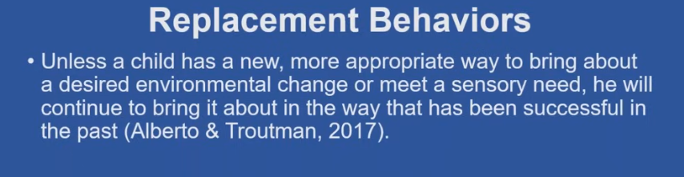
What is the behaviour telling us?
! Nothing about behaviour is linear.
Sensory problems can manifest themselves in problematic behaviour.
Behaviours serve to
solve multiple problems.

Slide 3
Where to start?
Problem behaviour is often to avoid or obtain something.
Learners with decreased communication skills are at higher risk to use behaviour to avoid/obtain.
When under stress, our ability to communicate our needs drop by 10%.
Sensory processing difficulties in younger learners:
indicators include: constantly moving or rough play, lethargic and slow processing.
OBTAIN
AVOID

Slide 4
Behaviour to
OBTAIN
SOCIAL/
COMMUNICATION
SENSORY CAUSES
Notes:
Productive – sensory obtaining or seeking behaviour – active strategies to get what the seek. Visceral needs or non productive – done purely for pleasure.

Slide 5
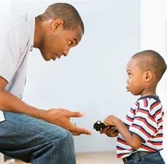

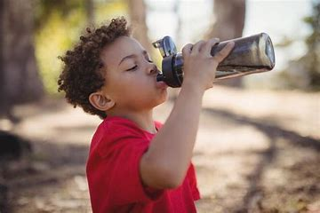
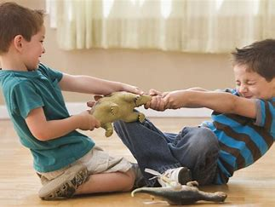
OBTAIN
SOCIAL/
COMMUNICATION
SENSORY CAUSES
OBJECT/ACTIVITY
ATTENTION
Smiles Hugs Praise
Close contact
Negative attention
Need/want object or activity:
Personal need: toilet, drink, food
Preferred object/activity
Delay of gratification
Notes:
Productive – sensory obtaining or seeking behaviour – active strategies to get what the seek. Visceral needs or non productive – done purely for pleasure.

Slide 6


OBTAIN
SOCIAL/
COMMUNICATION
SENSORY CAUSES
OBJECT/ACTIVITY
ATTENTION
PRODUCTIVE STRATEGIES
NON-PRODUCTIVE
STRATEGIES
Smiles Hugs Praise
Close contact
Negative attention
Need/want object or activity:
Personal need: toilet, drink, food
Preferred object/activity
Sensory seeking behaviour to gain required input: process information or arouse postural tone or self-soothe.
Endorphin release
Self-stimulation without a purpose
Pleasure
Notes:
Productive – sensory obtaining or seeking behaviour – active strategies to get what the seek. Visceral needs or non productive – done purely for pleasure.

Slide 7
AVOID
SOCIAL/
COMMUNICATION
SENSORY CAUSES
Notes:
Productive – sensory obtaining or seeking behaviour – active strategies to get what the seek. Visceral needs or non productive – done purely for pleasure.

Slide 8


AVOID
SOCIAL/
COMMUNICATION
OBJECT/ACTIVITY
Task/object/activity:
Willingness vs ableness
Demand causing anxiety
ATTENTION
New people or situations
Negative attention
Reprimands/making mistakes
SENSORY CAUSES
Notes:
Productive – sensory obtaining or seeking behaviour – active strategies to get what the seek. Visceral needs or non productive – done purely for pleasure.

Slide 9
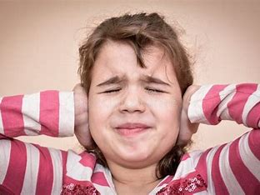

AVOID
SOCIAL/
COMMUNICATION
SENSORY CAUSES
OBJECT/ACTIVITY
SENSORY TRIGGERS
INTEROCEPTION
Over-arousal/stimulation
Sounds, touch, smell, movement, taste, light
Effort to self soothe
Pain or discomfort
Hot/tired/sweaty
Feeling unwell
Task/object/activity:
Willingness vs ableness
Demand causing anxiety
ATTENTION
New people or situations
Negative attention
Reprimands/making mistakes
Notes:
Productive – sensory obtaining or seeking behaviour – active strategies to get what the seek. Visceral needs or non productive – done purely for pleasure.

Slide 10
Reasons for avoiding:
Ability –
can’t do
Willingness – won’t do
Or is it can’t do due to sensory reasons?
Skill deficits: fine motor, gross motor, knowledge, attitude
Performance deficits: knows what to do but is unmotivated to do it - ? underlying anxiety
Adds to the can’t do category – i.e. sensory processing & modulation skills are interfering

Slide 11
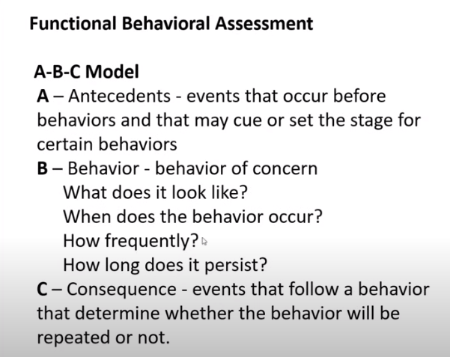
Functional analysis of behaviour
Where, when, who was there, what preceded it, what helped to calm the situation, time of the day.
Minute detail is required – the smallest detail can make the biggest difference.
What is the function of the behaviour?
How do they process sensory information?
(Sensory profile, alerting & calming strategies)

Slide 12
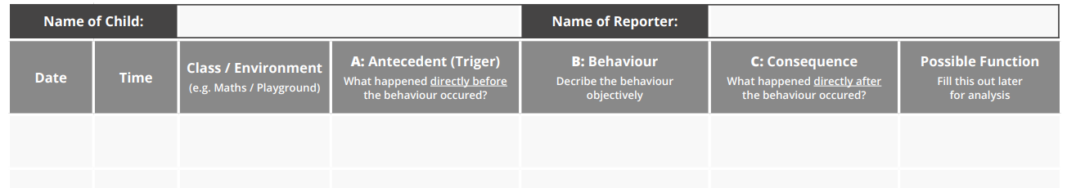
ABC Form

Slide 13
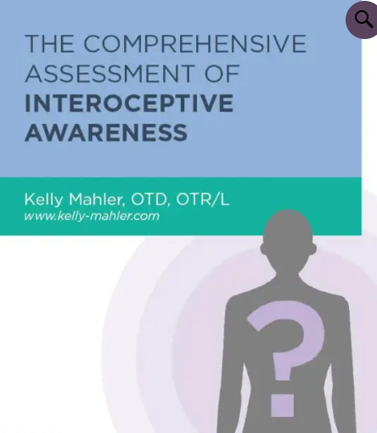
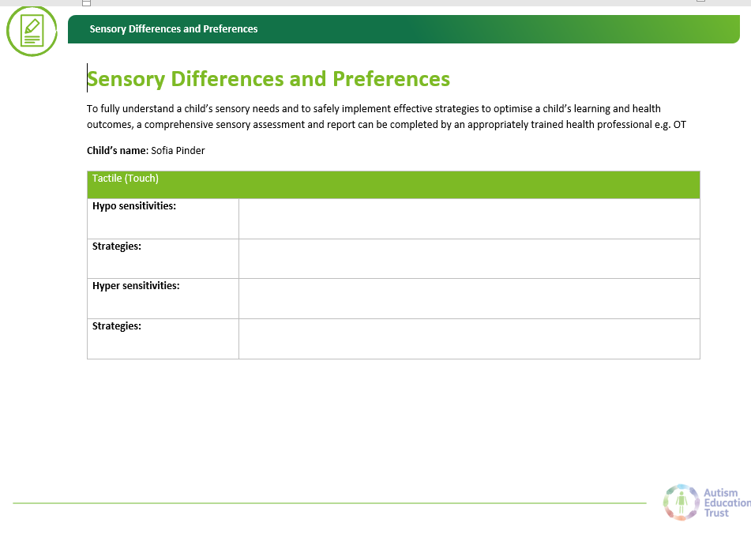
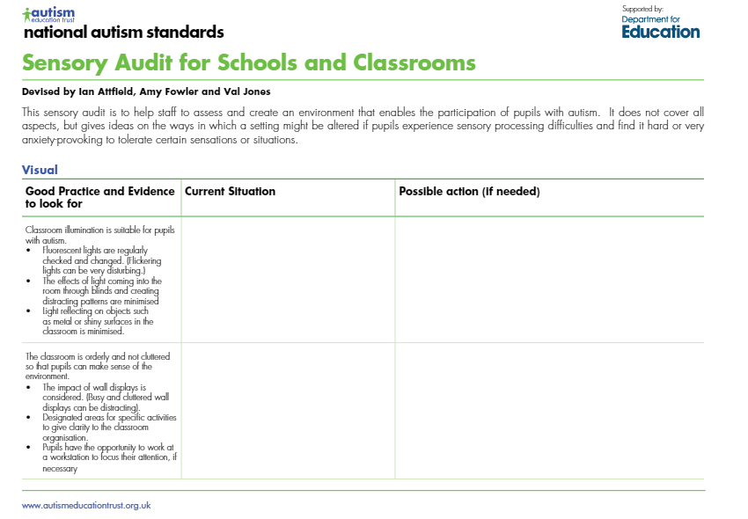
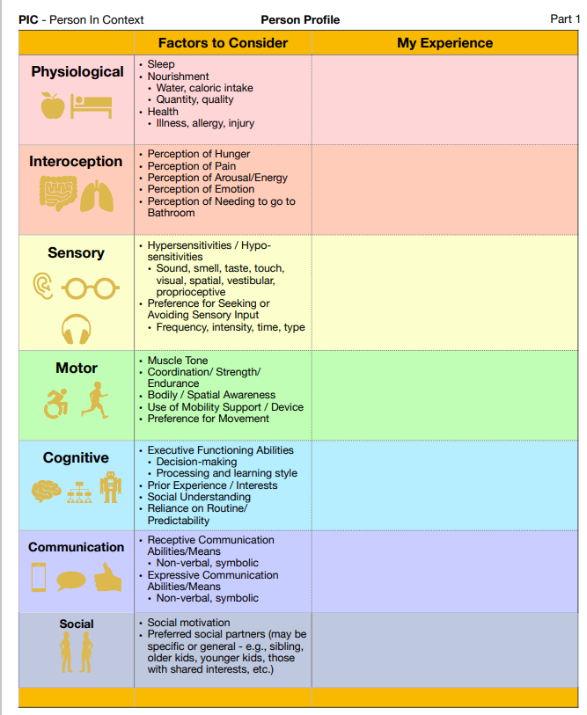
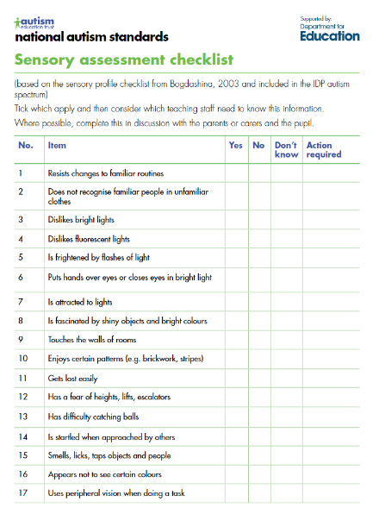
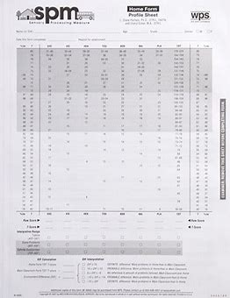
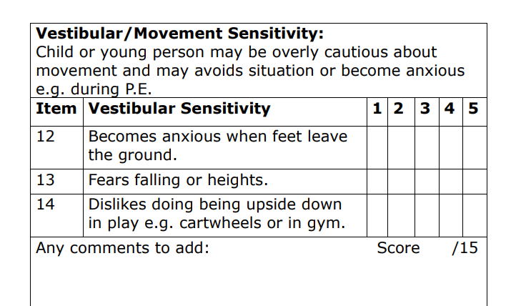
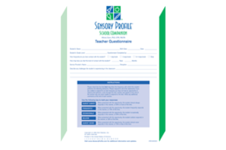
Sensory profiles

Slide 14
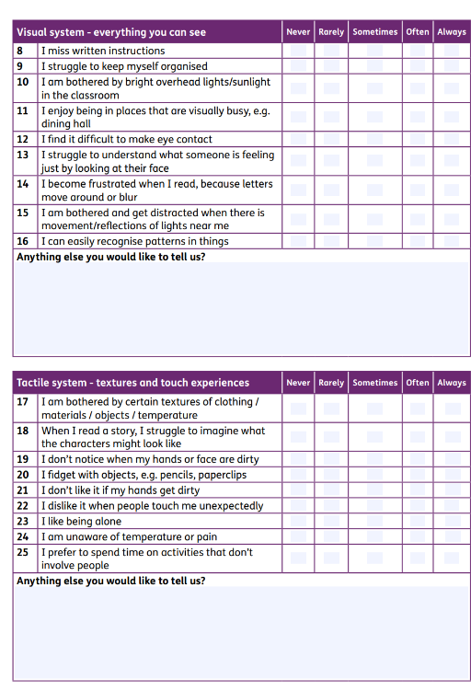
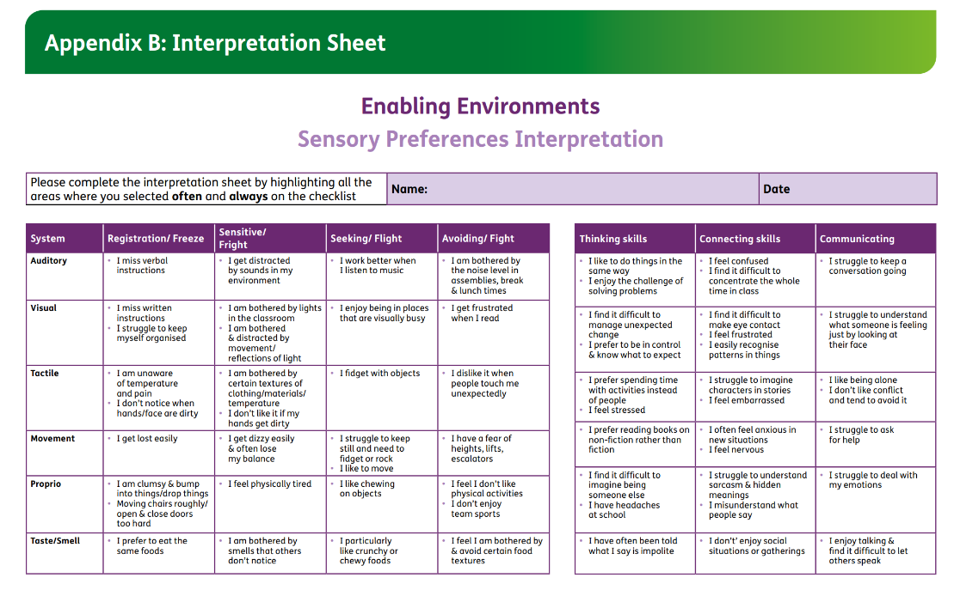
Interpreting checklists

Slide 15
Sensory assessment
Profile:
Hypo or hyper reactive?
Motor Skills
Environment
Task analysis

Slide 16
Things to remember:
Bribing can reinforce the behaviour.
Sensory based activities as a calming strategy for behaviour could also reinforce the behaviour. These activities are used as preventatives – give before the individual needs it. Schedule them!

Slide 17
Accessing support
Start with ABC form
Liaise with professionals: SALT, SEN OT, EP, Inspire specialist educators
SEN OT:
EHCP with OT in Sec F
Consult allocated OT
Tiered support

Slide 18
Resources & references
Students with emotional and behavioural difficulties in Irish post-primary schools: a role for occupational therapy. O’Donnell et al. 2022, Irish Journal of Occupational Therapy, 51/1 (2023) 14-20.
How to deal with challenging behaviour in children - Social care and support guide - NHS (www.nhs.uk)
Avoid or obtain Therapro: Occupational Therapy Products, Assessments, Toys, Games, Activities
Smearing – ERIC
What can be learnt from parents about school avoidance in Autistic pupils? | PDA Society Resources
Challenging Behaviour | Parents' Guide To Support | YoungMinds
For Whose Benefit? Evidence, Ethics, and Effectiveness of Autism Interventions. (Autistic Self-Advocacy Network)
Autism Education Trust - The Autism Resource Suite | Autism Education Trust

Slide 19




Whole System OT Transformation
Network SENCO Forum 22/5/24
https://forms.office.com/e/TsyGQp6wEf

