Slide 1

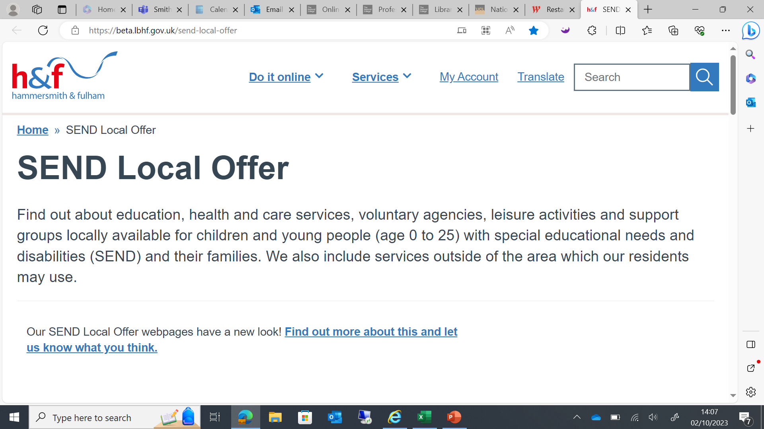

Welcome to Network SENCo Forum Meeting
Thanks to Hammersmith Academy for having us

Slide 2
Agenda
3:30- Welcome
3:35- Peter Haylock- Operational Director for Education and SEND
3:50- Dr Gillian O'Shea and Dr Shona Landon- Educational Psychologists- ELSA Workshop
4:20- Dorette Vermeulen and Claire Brundell- OT Workshop
4:35- Comfort Break
4:45- Natasha Patten, Sara Buttle and Lamlat Shabi- Accessing Support for CYP with Medical Needs
5:00- Dr Erik Dwyer- EBSA Workshop
5:15- Open Forum, Your Voice
5:30- Close

Slide 3
Peter Haylock- Operational Director for Education and SEND

Slide 4
Dr Gillian O'Shea and Dr Shona Landon- Educational Psychologists- ELSA Workshop

Slide 5
Dorette Vermeulen and Claire Brundell- OT Workshop

Slide 6




Whole System OT Transformation
Network SENCO Forum 22/5/24
https://forms.office.com/e/TsyGQp6wEf

Slide 7


Comfort Break

Slide 8
Natasha Patten, Sara Buttle and Lamlat Shabi- Accessing Support for CYP with Medical Needs- TEAMS CALL IN.

Slide 9
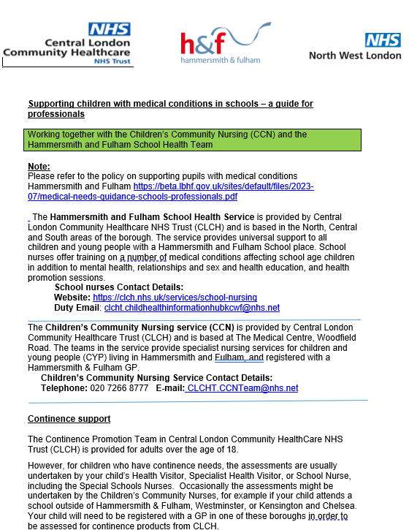

Current- but this will change for next academic year due to changes in staffing.
11 Pages

Slide 10
Dr Erik Dwyer- EBSA Workshop

Slide 11
EBSA support plan
Summer Term 2024
EPS / Education staff to finish draft ‘Toolkit’ hosted on the Learning Partnership website
Emotionally Based School Avoidance Guidance and Resources for Schools - Learning Partnership (lbhflearningpartnership.com)
Consult with SENCos and finalise Toolkit
Toolkit to be shared with other school support services, health and social care colleagues.
Autumn Term 2024
All schools to receive input in using the EBSA Toolkit resources.
All schools to receive a pack of physical resources to support early intervention
All schools to receive training/support in aspects of good EBSA practice most appropriate to their context (e.g. belongingness, emotional differentiation, whole school audit, policy development, etc) – to be decided in consultation with SMHL and SENCo.
EDLT team to develop resources and solutions to support the more entrenched EBSA cases, based in evidence-based best practice. Working group to look at resourcing this? (Joint approach with Social Care partners and Health).

Slide 12
Open Forum, Your Voice

Slide 13
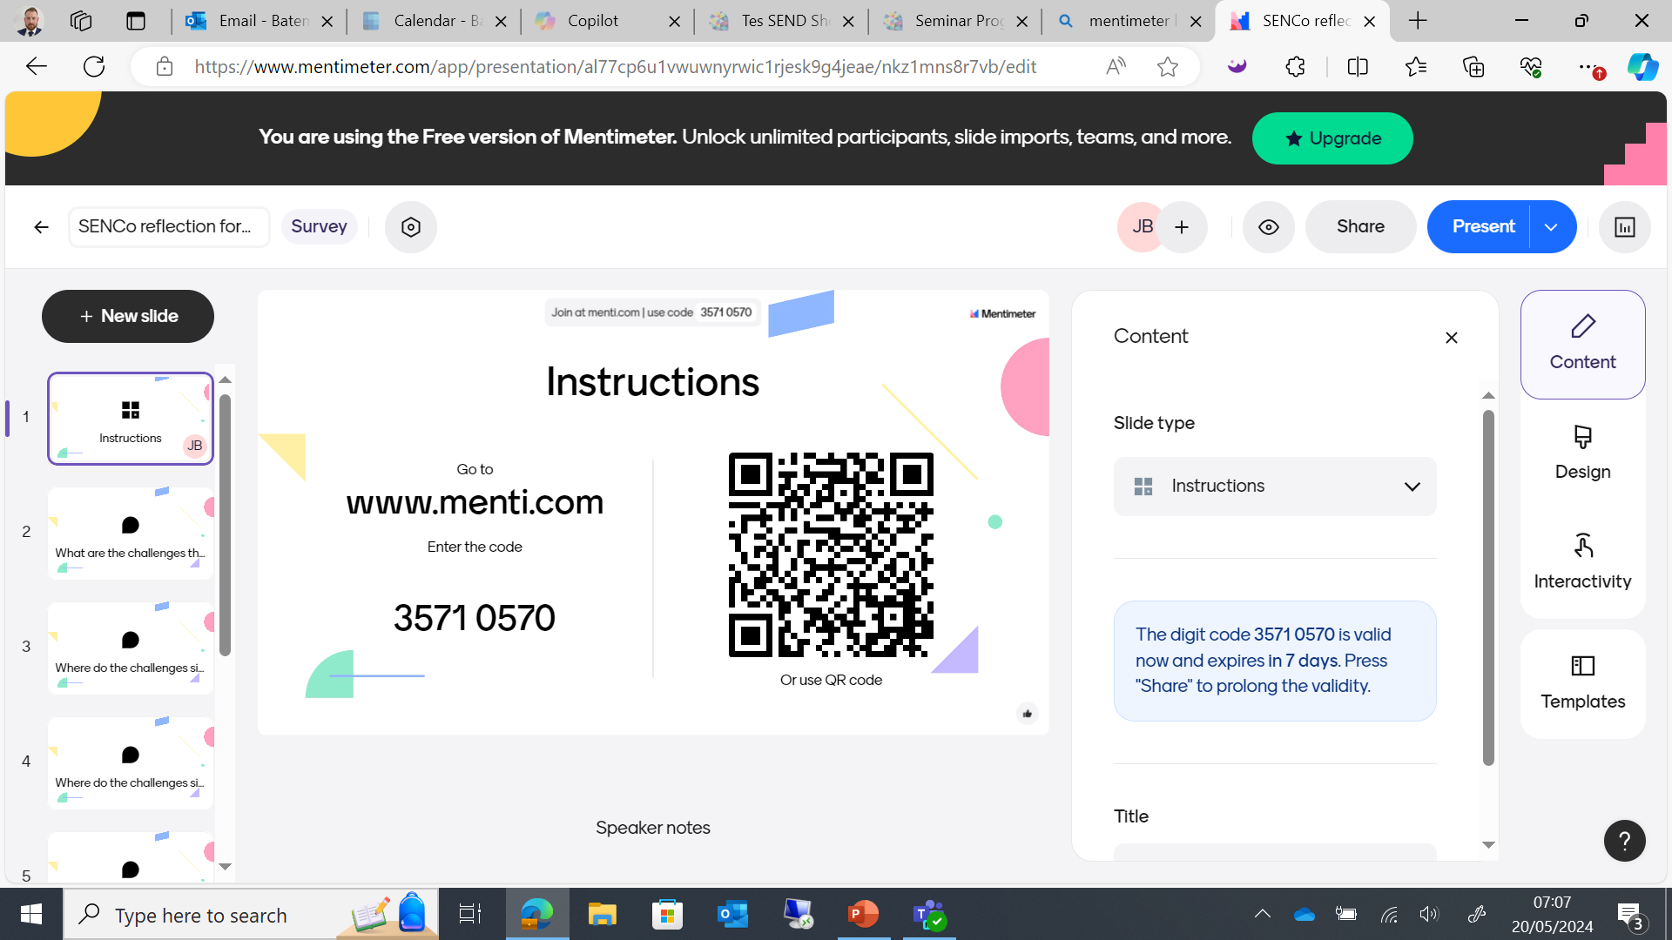
MENTI- www.menti.com

Slide 14
H&F updates
Things that are coming up

Slide 15
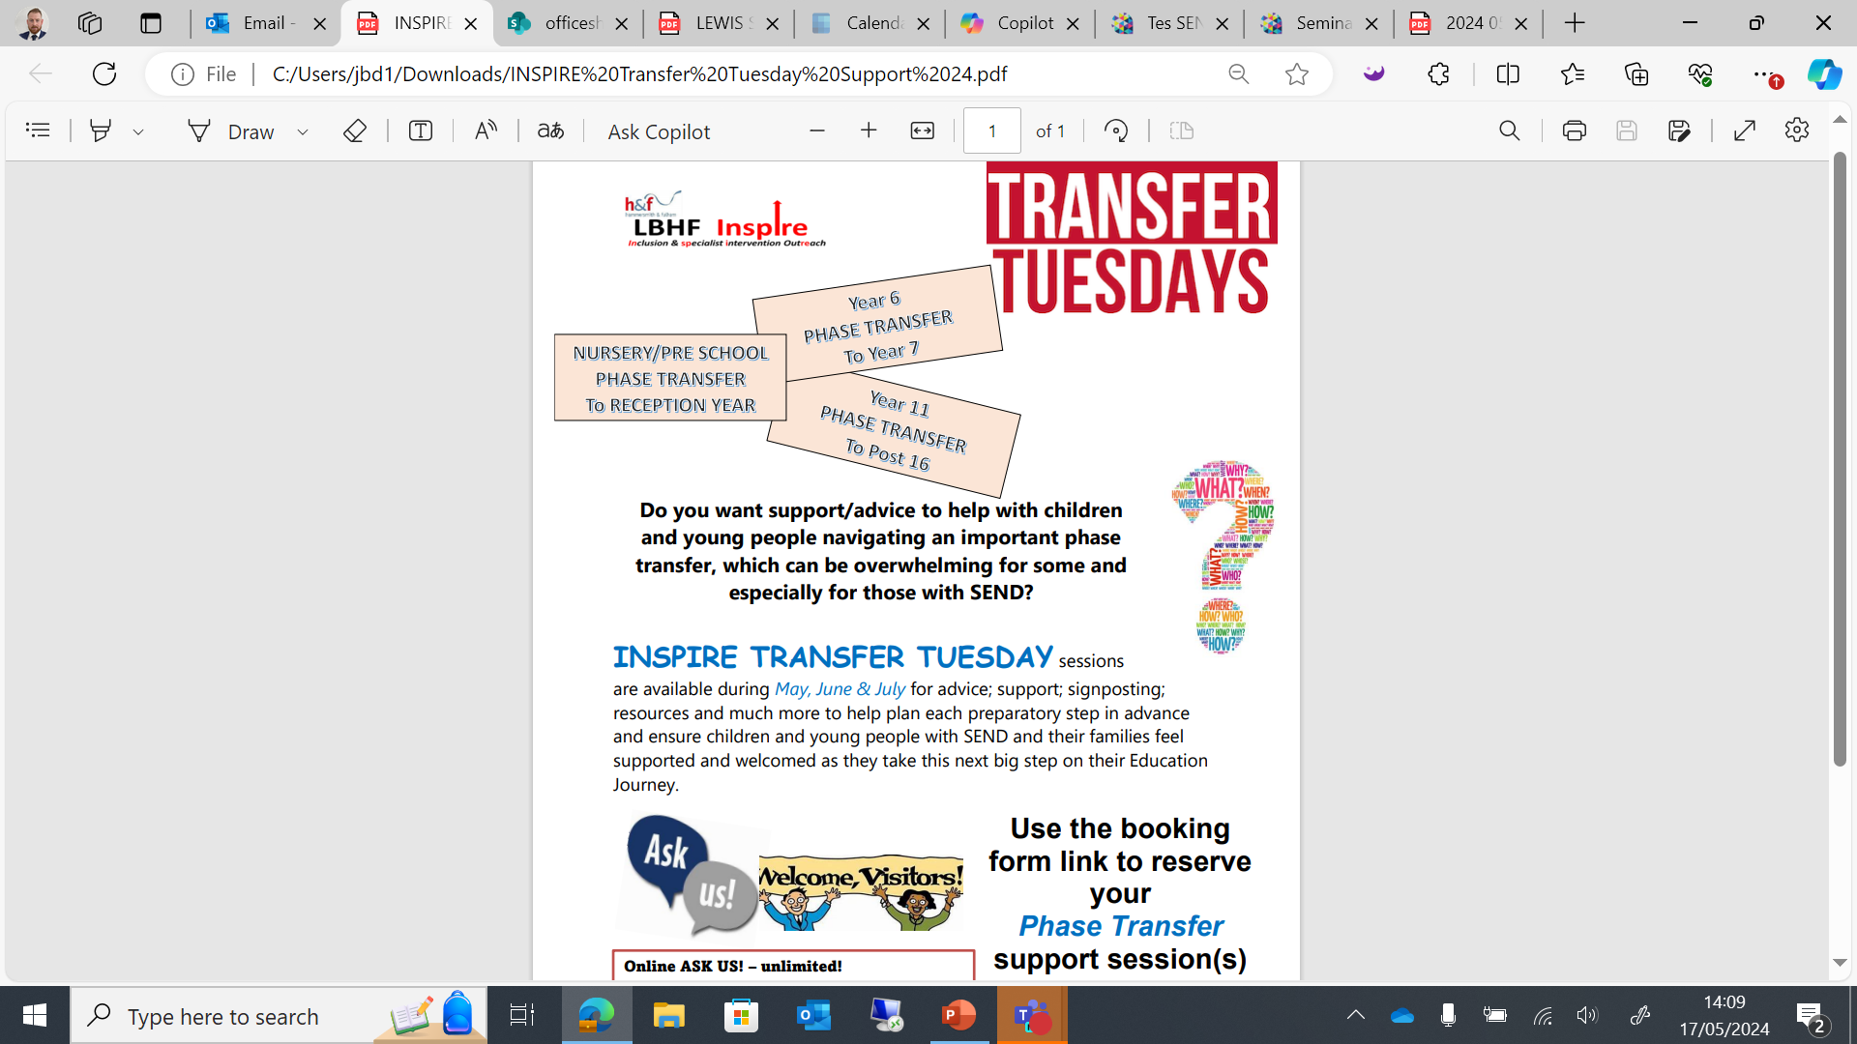
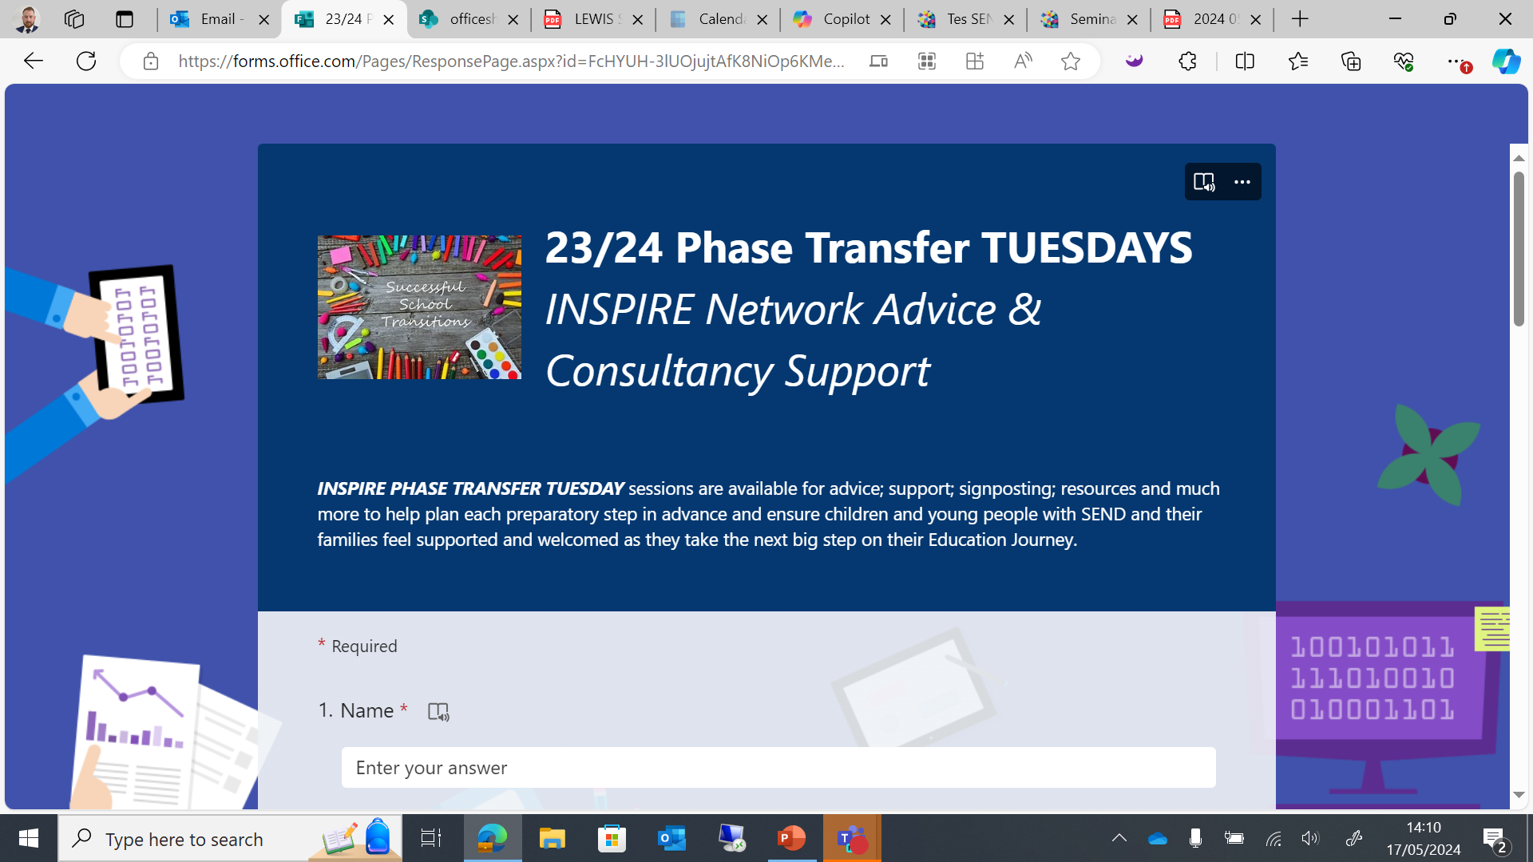
23/24 Phase Transfer TUESDAYS INSPIRE Network Advice & Consultancy Support (office.com)

Slide 16
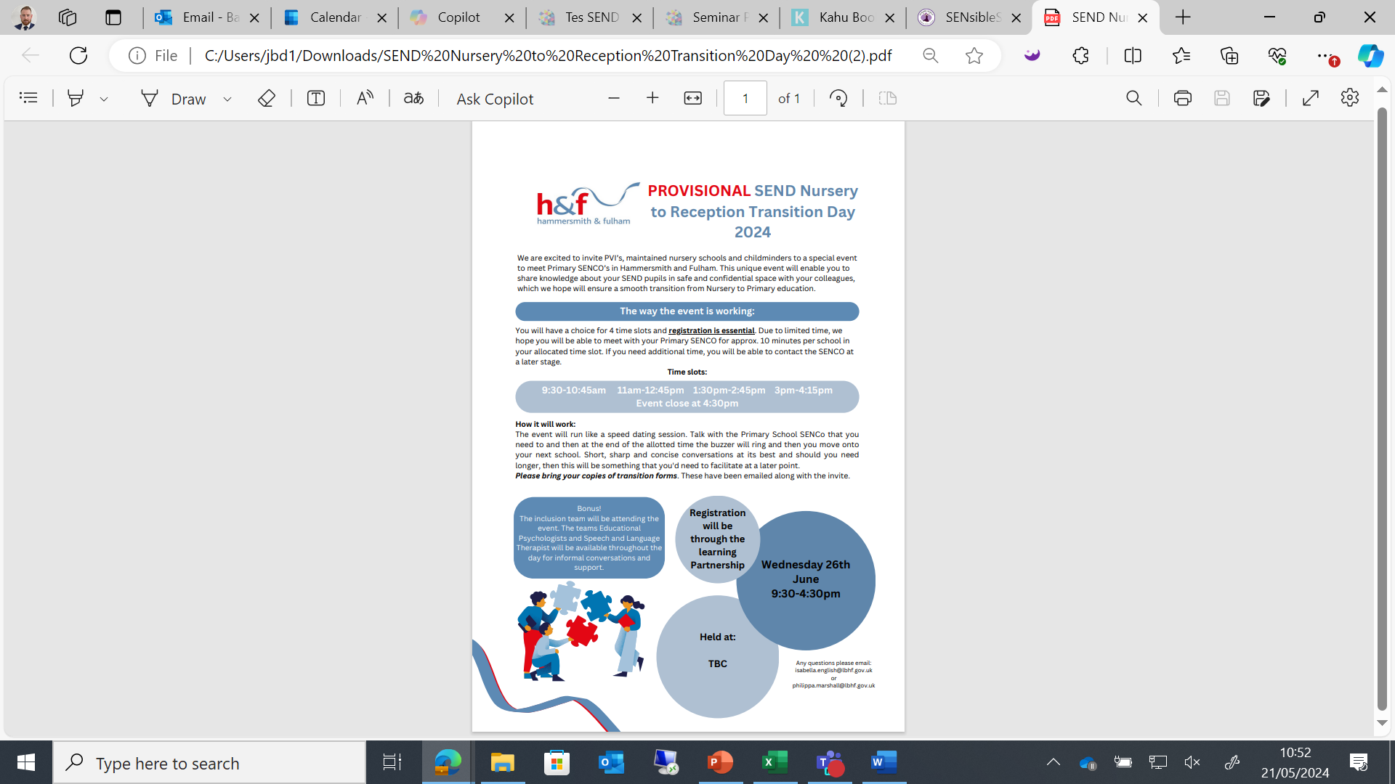
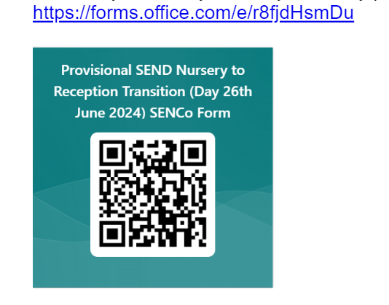
Availability checker- this information is needed by 28th May. Thank you. Just complete the below form.

Slide 17
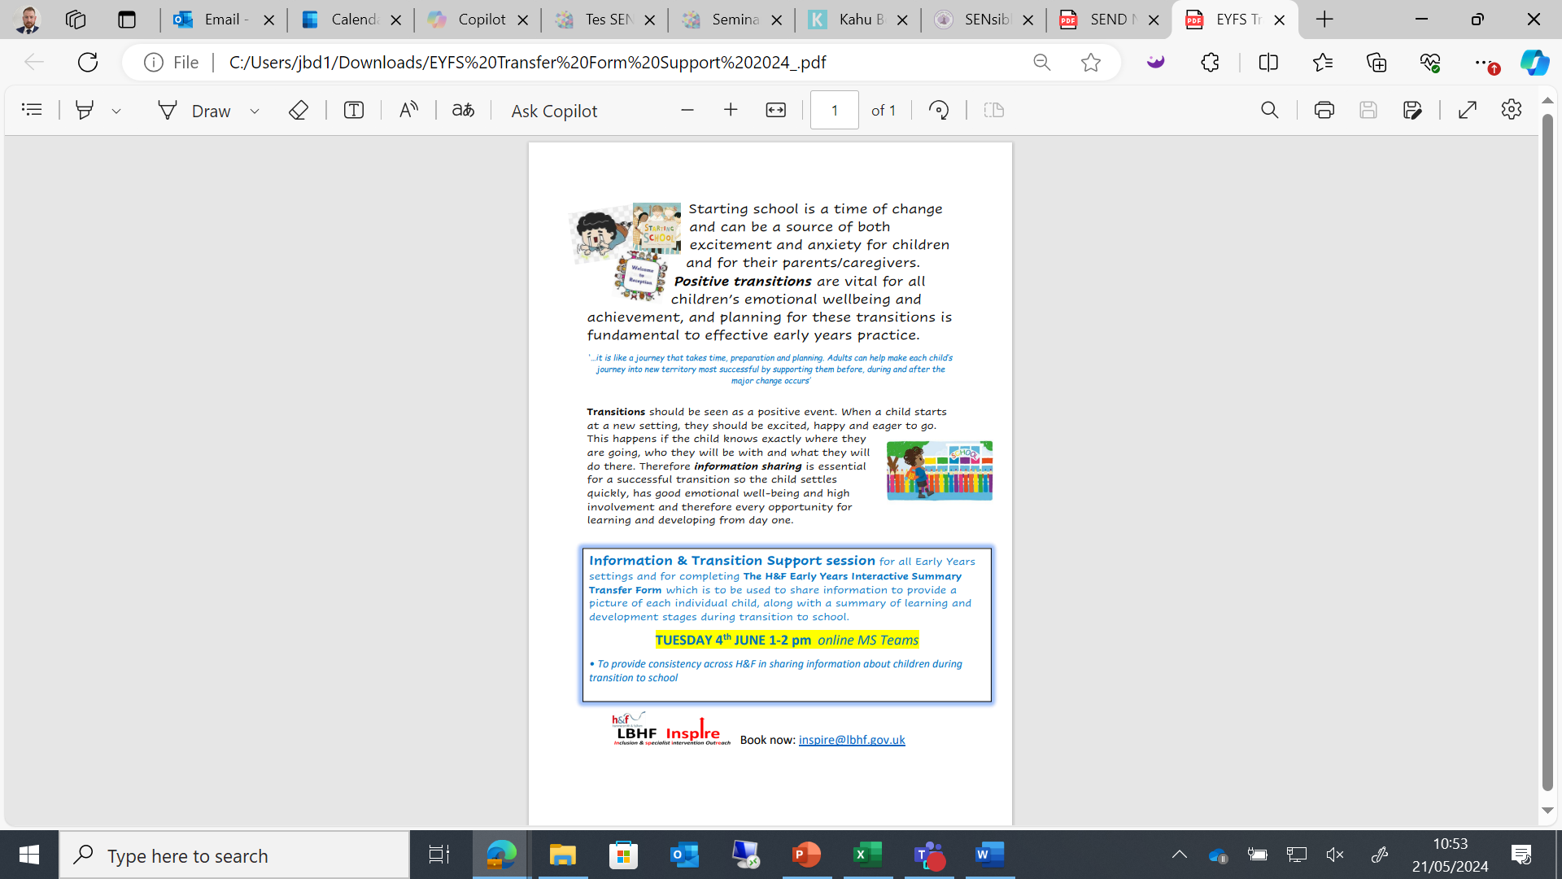

Slide 18
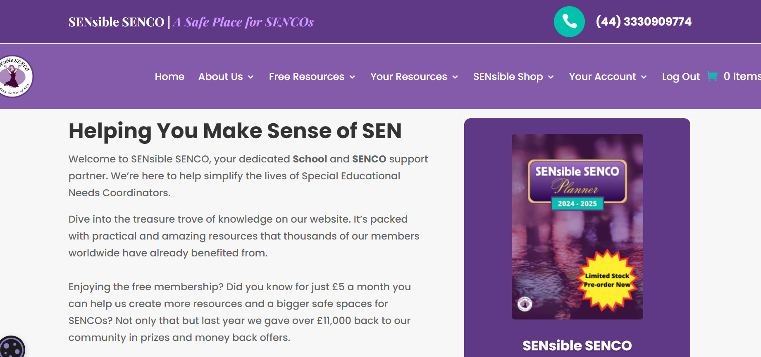
SENCO Community, Join SENsible SENCOs in our Safe Space!
SENCO Planner by SENsible SENCO - SENsible SENCO
Discount Code- SXKJ9VCG- Saves you £4

Slide 19

Enjoy you half term

Slide 20

Thank you to Hammersmith Academy for hosting.

