Slide 1

Executive Functioning (EF)
Educational Psychology Service
Dr Amal Hussein and Dr Emma Denholm

Slide 2
What’s The Plan?
To practice using tools and strategies that will support learners with Executive Functioning differences.
An opportunity to share experiences and collaboratively problem solve.
To develop a shared understanding of Executive Functioning and what difficulties in this area might look like in the classroom.

Slide 3
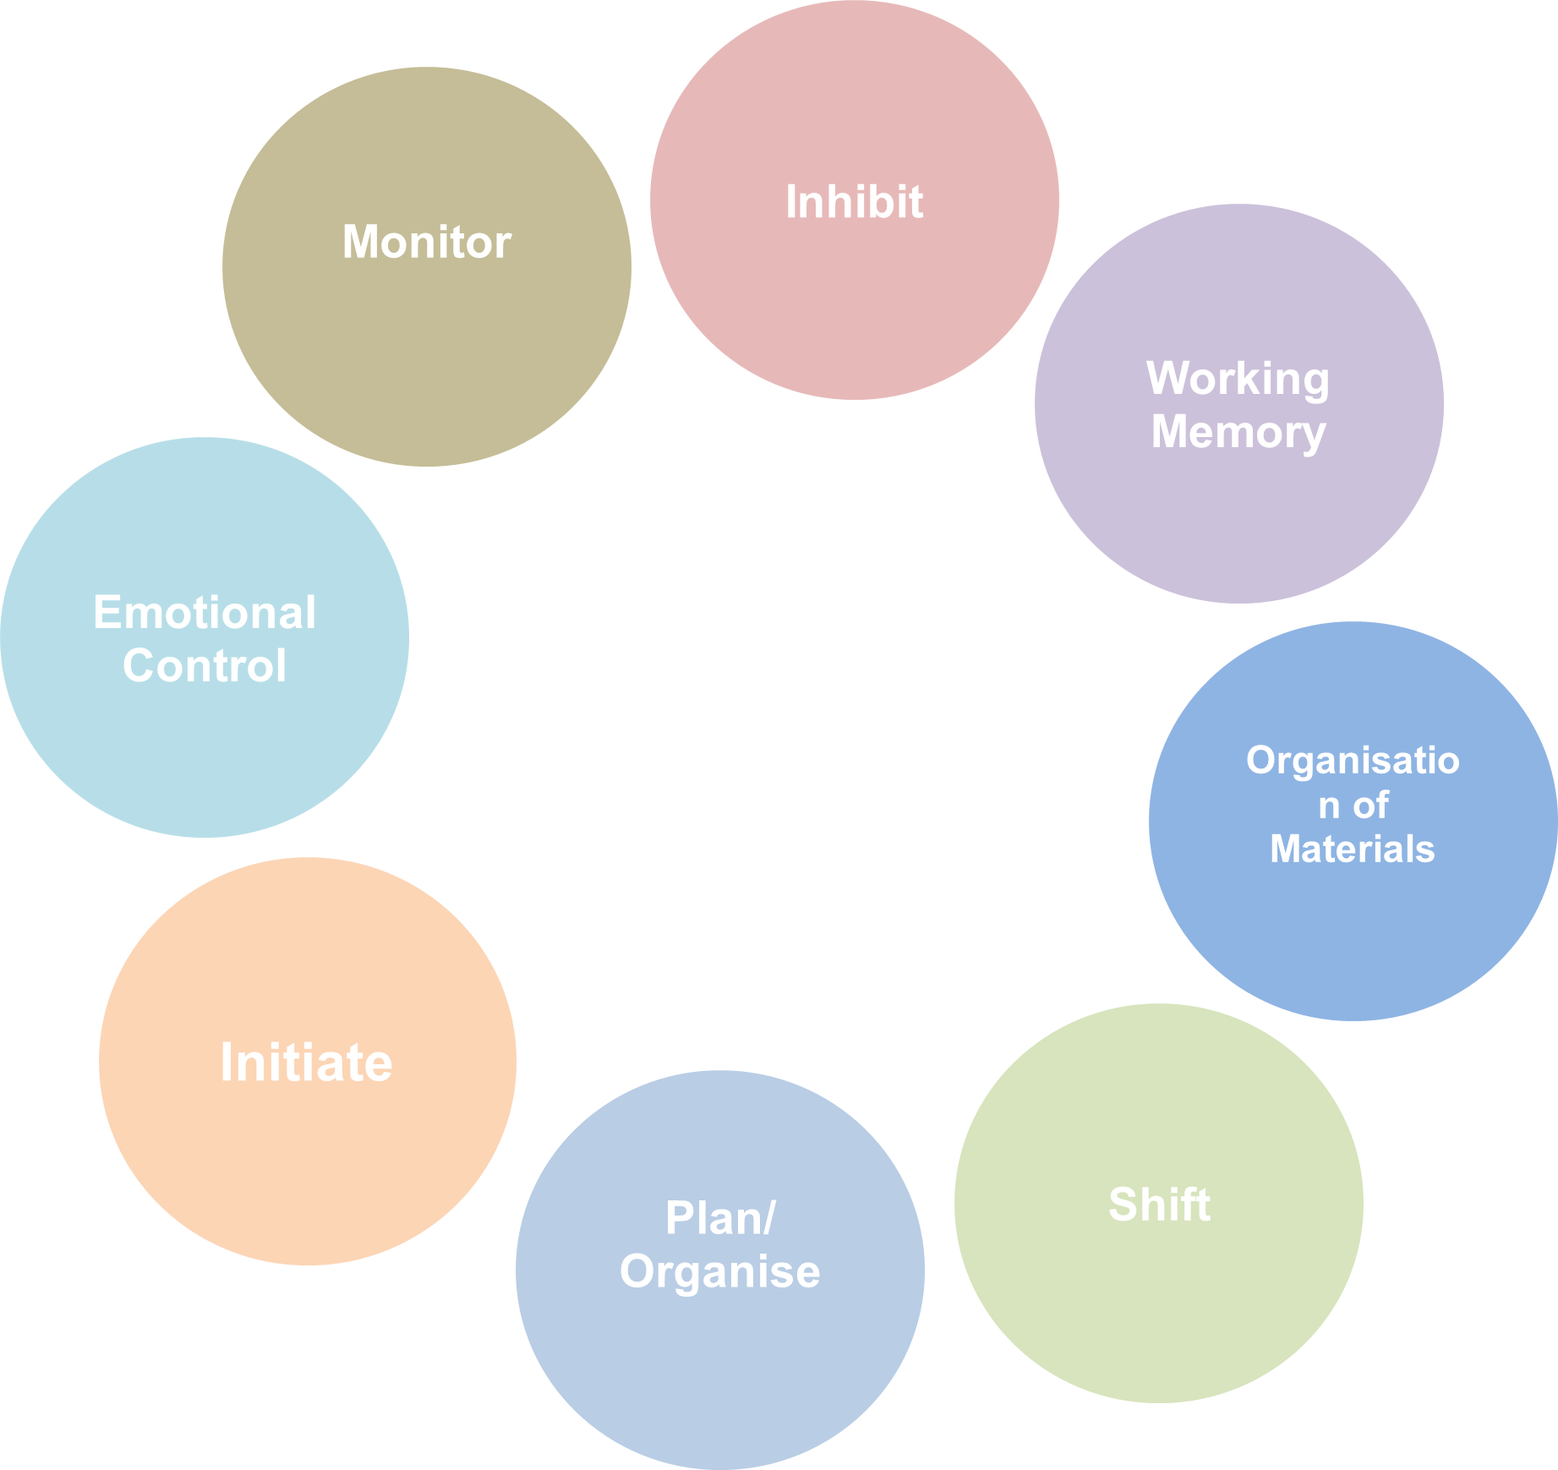
What is Executive Functioning
Executive functioning refers to a set of mental skills that provide critical supports for learning and development, and we use these skills every day to learn, work and manage daily life.
Just as a highly effective air traffic control system functions to oversee the safe arrival and departure of multiple aircraft on multiple runways simultaneously, the brain also needs a similar set of skills (executive functions) to hold onto and work with information, filter out distractions, plan and prioritise tasks and evaluate performance.

Slide 4
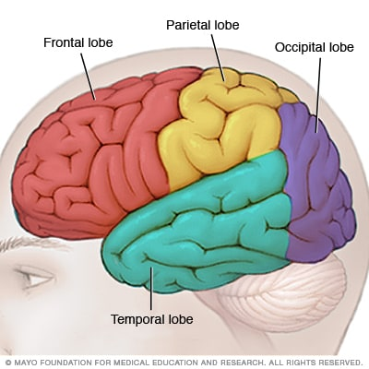
What Is Executive Functioning?
Executive functions are situated in the frontal lobe of the brain
The frontal lobe has connections with the rest of the brain and so impacts a range of our other cognitive functions.
“Control centre” of the brain

Slide 5




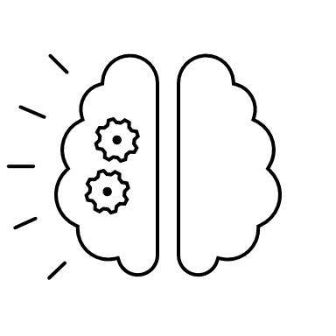



What Are the Executive Functions?
The capacity to stop and think before doing something. The ability to resist an impulse and think through a situation (e.g., consequences) and appropriately stop a behaviour at the appropriate time.
Monitor
The ability to check one’s performance during or after finishing a task and adjust to changing demands.
The ability to keep track of the effects of one’s own behaviour, including on others.
Shift
Plan/Organise
Inhibit
Working Memory
Organisation of Materials
Initiate
Emotional Regulation

Slide 6


What Are the Executive Functions?
Monitor
The ability to move freely from one situation, activity, or part of a problem to another. The ability to ‘switch’ between different thinking processes or skills within a task.
Shift
Plan/Organise
Inhibit
Working Memory
Organisation of Materials
Initiate
Emotional Regulation

Slide 7

What Are the Executive Functions?
Monitor
The ability to anticipate future events, set goals and map out steps towards those goals. This involves being able to decide what is or is not important to focus on.
Bringing order to information and appreciating main ideas or key concepts when learning or communicating information.
Shift
Plan/Organise
Inhibit
Working Memory
Organisation of Materials
Initiate
Emotional Regulation

Slide 8

What Are the Executive Functions?
The capacity to stop and think before doing something. The ability to resist an impulse and think through a situation (e.g., consequences) and appropriately stop a behaviour at the appropriate time.
Monitor
The capacity to stop and think before doing something. The ability to resist an impulse and think through a situation (e.g., consequences) and appropriately stop a behaviour at the appropriate time.
Shift
Plan/Organise
Inhibit
Working Memory
Organisation of Materials
Initiate
Emotional Regulation

Slide 9

What Are the Executive Functions?
Monitor
The ability to hold verbal or visual information in mind and process this for the purpose of completing a task and being able to stick with an activity.
Shift
Plan/Organise
Inhibit
Working Memory
Organisation of Materials
Initiate
Emotional Regulation

Slide 10


What Are the Executive Functions?
Monitor
The ability to keep workspace and materials in order. To be able to order information and resources around us. This can be general (i.e., daily activities) or task specific.
Shift
Plan/Organise
Inhibit
Working Memory
Organisation of Materials
Initiate
Emotional Regulation

Slide 11

What Are the Executive Functions?
Monitor
The ability to begin a task or activity and to independently generate ideas.
Shift
Plan/Organise
Inhibit
Working Memory
Organisation of Materials
Initiate
Emotional Regulation

Slide 12

What Are the Executive Functions?
Monitor
The ability to recognise and regulate emotions in order to achieve the goal we have set. Big feelings take away the attention from the task/situation and focus this on self-preservation.
Shift
Plan/Organise
Inhibit
Working Memory
Organisation of Materials
Initiate
Emotional Regulation

Slide 13
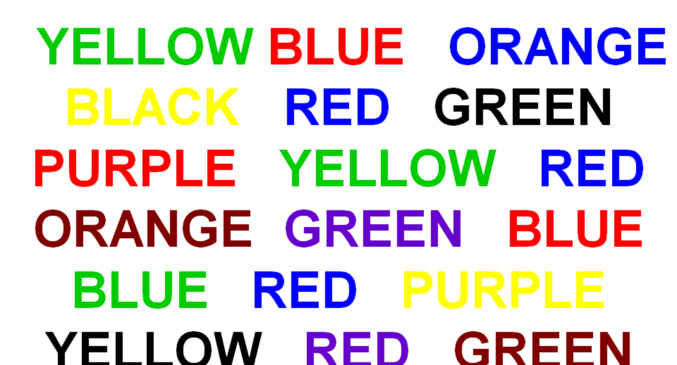

Slide 14
Executive Functioning in Practice
What Executive Functioning skills did you need to use in that task?
How did it feel?
What would have made it easier?
How would it have felt to try and complete that task if you were
  Tired?
  Stressed?
  Worrying about something else?
  Asked to do it out loud in front of the whole room?
  Needing the bathroom?

Slide 15

Who Might Experience EF Difficulties?
Anyone – as we just demonstrated, EF can be impacted by stress, capacity, lack of sleep, individual differences.
Some learners may be particularly vulnerable to barriers to learning associated with EF:
  YP on the Autism Spectrum
  YP with ADHD
  YP with Anxiety or MH needs
  Attachment/early experiences

Slide 16
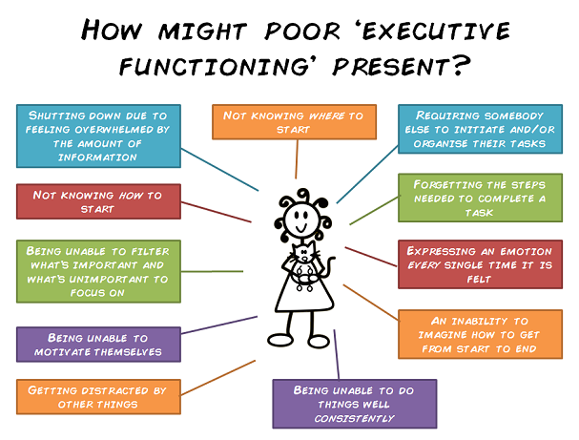
What might it look like…

Slide 17
EF IN THE CLASSROOM
Finding it difficult to filter out distractions.
Constantly moving, getting up out chair, finding it hard to sit still.
Not knowing where to start with a task.
Not being able to plan out how to work through a task.
Forgetting things learnt in a previous lesson.
Interrupting the teacher, calling out, talking to others at inappropriate times.
Not checking or correcting their work.
Having big emotional reactions to seemingly small triggers.
Forgetting things or being disorganised.
Leaving things to the last minute then ‘cramming’.
Being overwhelmed by too much information.
Needing lots of reminders to stay focused.
Being too alert (or not alert enough) for learning.
Not waiting their turn.
Not understanding why a behaviour leads to a consequence.
Not seeing things through to completion
Notes:
BUT ALSO...
Creativity/imagination
Flexible problem solving
Energy and enthusiasm
Helping others
Discussion and debate
New ideas
Expressing selves

Slide 18
Supporting EF Difficulties
Putting into the environment what isn’t automatic for the YP
Reducing competing task demands
Structures, cues, planning
Practice that feels like play
Resource Pack

Slide 19


Slide 20

Activity
Using the document, highlight in one colour strategies you have seen or have used yourself to support Executive Functioning in the classroom.
In a different colour highlight strategies you think you will try following this training and with who.

