Slide 1

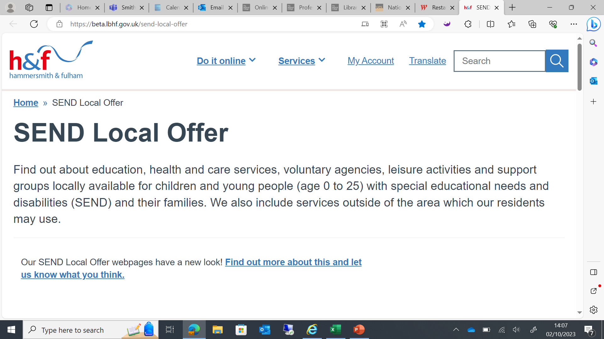

Welcome to Network SENCo Forum Meeting
Thanks Phoenix Academy for having us

Slide 2



Before we begin- Housekeeping

Slide 3
Agenda
Welcome
H&F Notices
OAT- Lynne Blake and Divna Aleksic
Matt McArthur- Whole School SEND- Working with children with complex C&I profiles, including autism.
Break for 10 minutes
Dr Emma Denholm and Dr Amal Hussein- Educational Psychologists- Executive Functioning
A.O.B

Slide 4
11th-15th March 2024 Inspection of Local Authority Children’s Services (ILACS)
The inspection will focus on the effectiveness of local authority services and arrangements:
• to provide early help, children in need and child protection
• the experiences and progress of children in care wherever they live, including those children who return home
• the arrangements for permanence for children who are looked after, including adoption
• the experiences and progress of care leavers
• children missing education and electively home educated
• virtual school for cared for child
• fostering

Slide 5
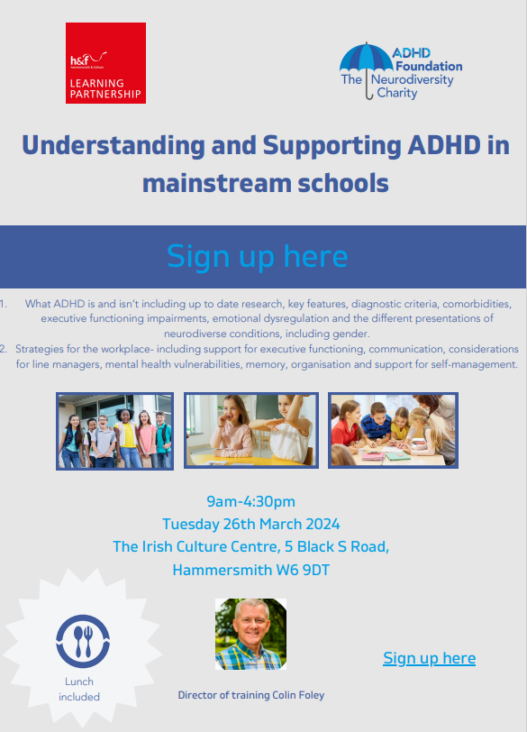
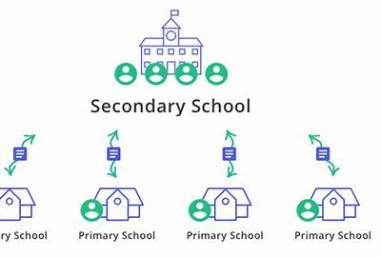

26th March- ADHD Course and 1st May Primary to Secondary School Transition event
Understanding and Supporting ADHD in mainstream schools - Learning Partnership (lbhflearningpartnership.com)

Slide 6

Neurodiversity Celebration Week 2024
NCW 2024 Events Schedule v1.0 (neurodiversityweek.com)
Monday 18 March to Sunday 24 March 2024

Slide 7


ORMISTON PRIMARY OUTREACH TEAM
Lynne Blake Head of OAT London Outreach lblake@olamail.co.uk
Divna Aleksic Specialist teacher (Behaviour and SEMH) daleksic@olamail.co.uk
Ormiston Primary Outreach Team offers support for schools in behaviour for learning and aspects of social, emotional and mental health.
Targeted support in mainstream schools, with specialist early interventions
Consultations - structured meetings for class teachers and/or SENDCos to clarify and prioritise concerns, identify further information to collect and discuss possible strategies with regards to individuals or whole classes.
Support for teaching assistants/LSAs/SENTAs - This may involve structured, time-limited support for TAs/LSAs new to role or SENTAs; setting up and running skills teaching groups; strategies to support crisis situations.

Slide 8
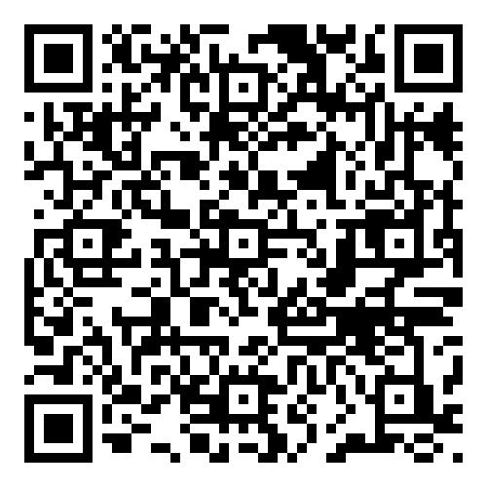




Hammersmith and Fulham
SENDCo Network
Communication and Interaction Needs
Matt McArthur
Deputy Regional SEND Leader
South Central England and North West London
@WSSscnwlon

Slide 9


Comfort Break

Slide 10

Executive Functioning (EF)
Educational Psychology Service
Dr Amal Hussein and Dr Emma Denholm

Slide 11
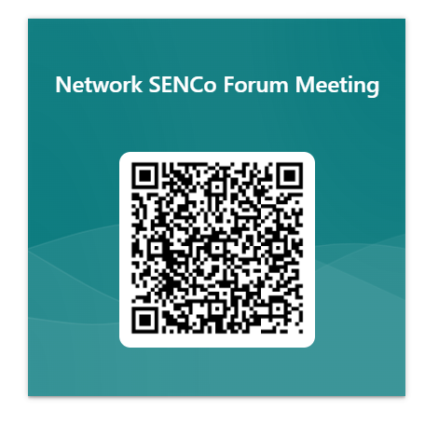
Network SENCO Forum Meeting Dates 2023/2024- ALL Face to Face
Wednesday 22nd May- Time and Venue TBC
Tuesday 2nd July- Time and Venue TBC
If your setting are prepared to host, please either scan the QR code or click the link to register your interest.
https://forms.office.com/Pages/ResponsePage.aspx?id=FcHYUH-3lUOjujtAfK8NiOFivPgAMFBDmi1Vtlt5L6tURUZFSVNTRU9XUk9GWVRCTEpTQ1RWRllBQS4u

Slide 12
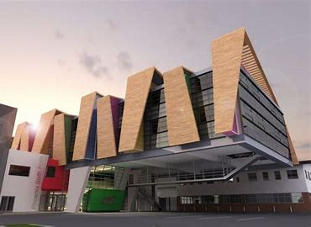
Thank you to Phoenix Academy for hosting.

