Slide 4
What to expect on an inspection

Slide 5
What to expect on an inspection

Slide 6
What to expect on an inspection

Slide 7
What to expect on an inspection

Slide 8
What inspectors will look for
Inspectors will gather and evaluate evidence about how you:
Are ambitious for all pupils with SEND
Identify, assess and meet the needs of pupils with SEND, including when they are self-isolating and/or receiving remote education
Develop and adapt the curriculum so that it's coherently sequenced to all pupils' needs, starting points and aspirations for the future
Involve parents, carers and other professionals/specialist services (as necessary) in deciding how best to support pupils with SEND, including agreeing the approach to remote education
Include pupils with SEND in all aspects of school life
Assess learning and development of pupils with SEND, and whether pupils' outcomes are improving as a result of the different or additional provision being made for them, including any reasonable adjustments in providing remote education. This covers outcomes in:
Communication and interaction
Cognition and learning
Physical health and development
Social, emotional and mental health
Prepare pupils with SEND for:
Their next steps in further or higher education, employment and training
Their adult lives (independent living, participating in society and being as healthy as possible in adult life)

Slide 9
How inspectors will gather evidence

Slide 10
How inspectors will gather evidence

Slide 11
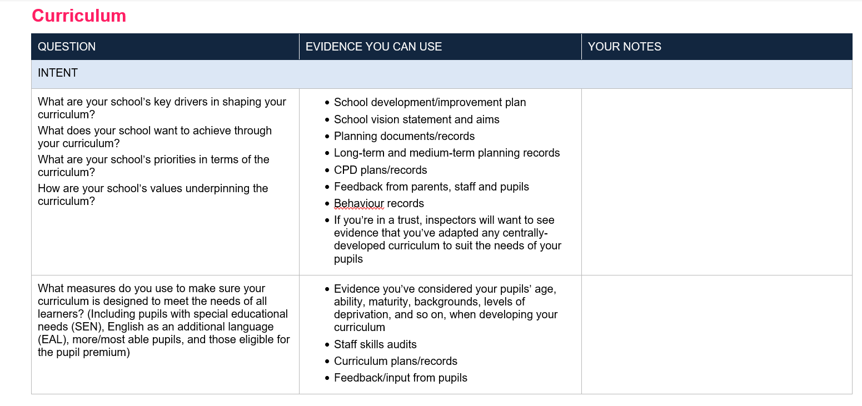
What Ofsted might ask you as the SENCo?

Slide 12
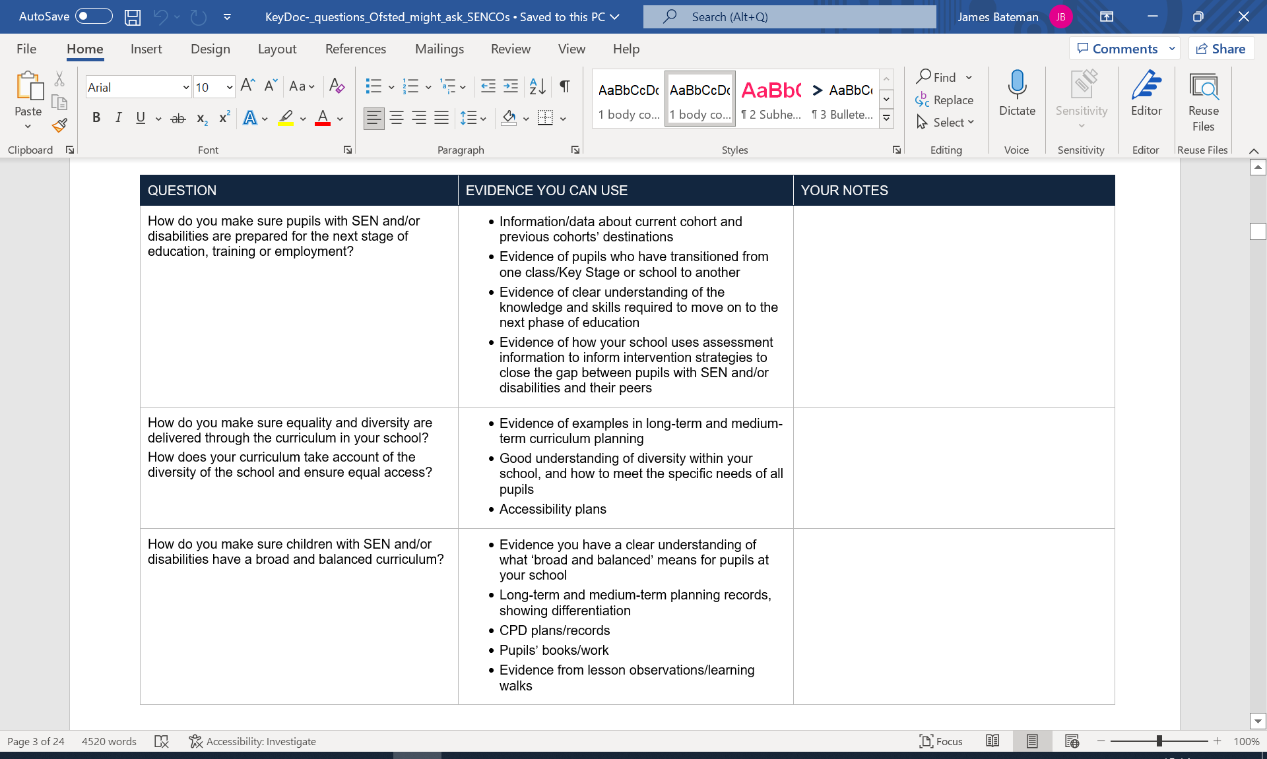
What Ofsted might ask you as the SENCo?

Slide 13
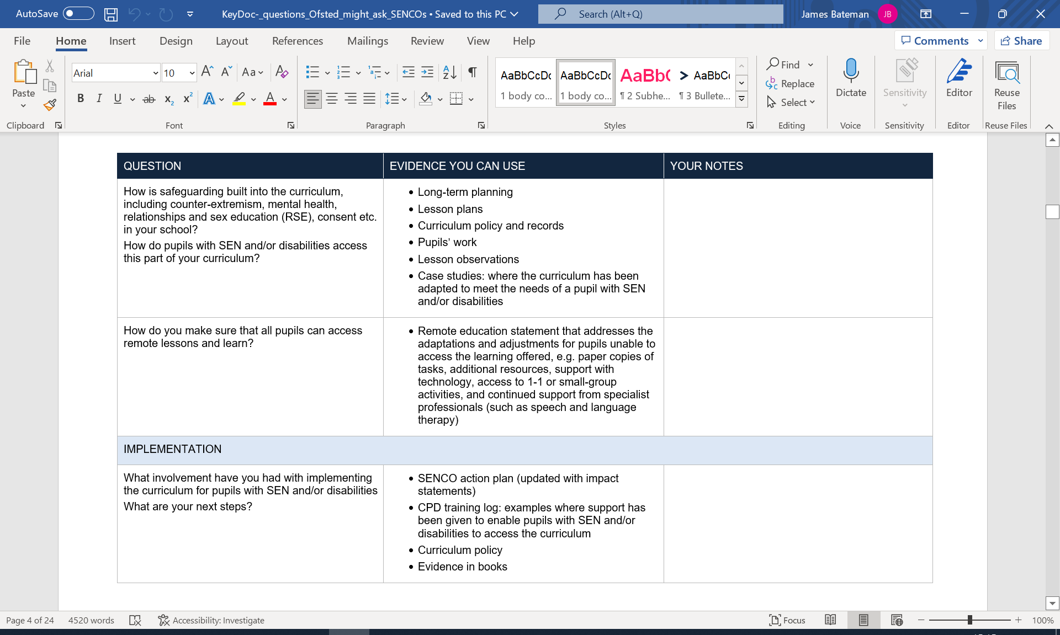
What Ofsted might ask you as the SENCo?

Slide 14
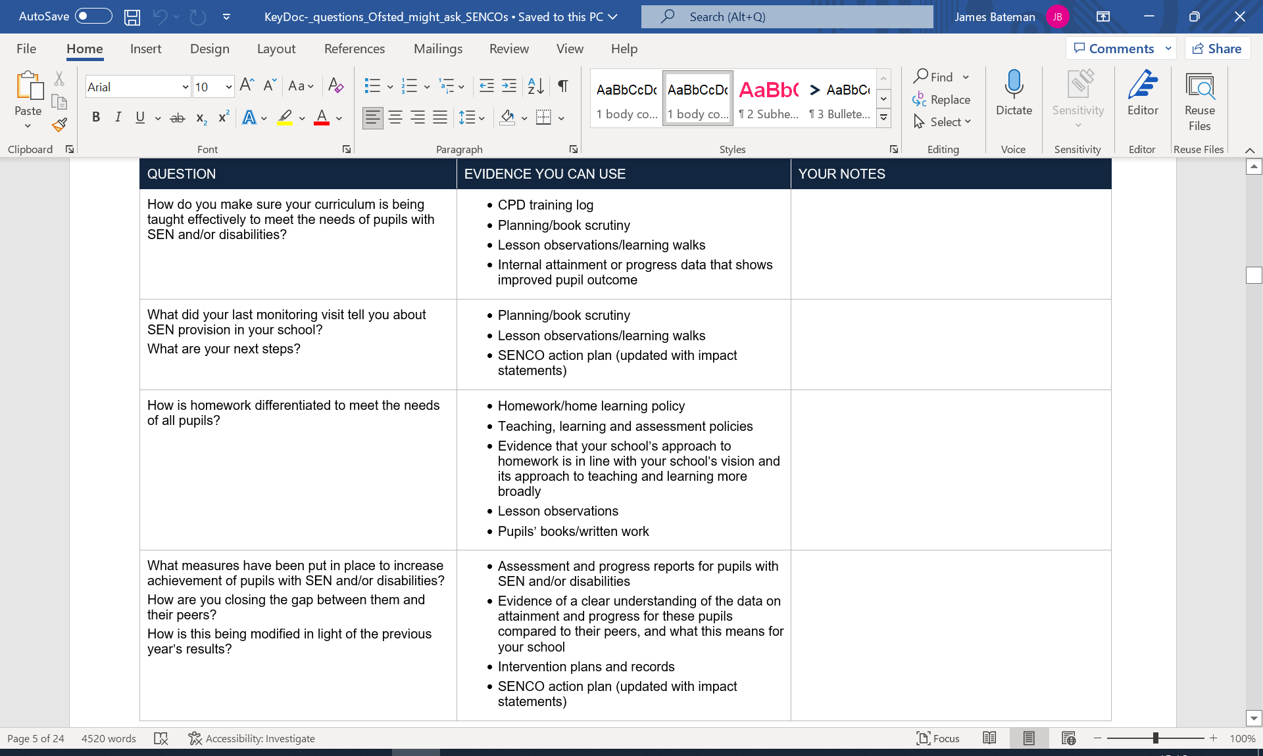
What Ofsted might ask you as the SENCo?

Slide 15
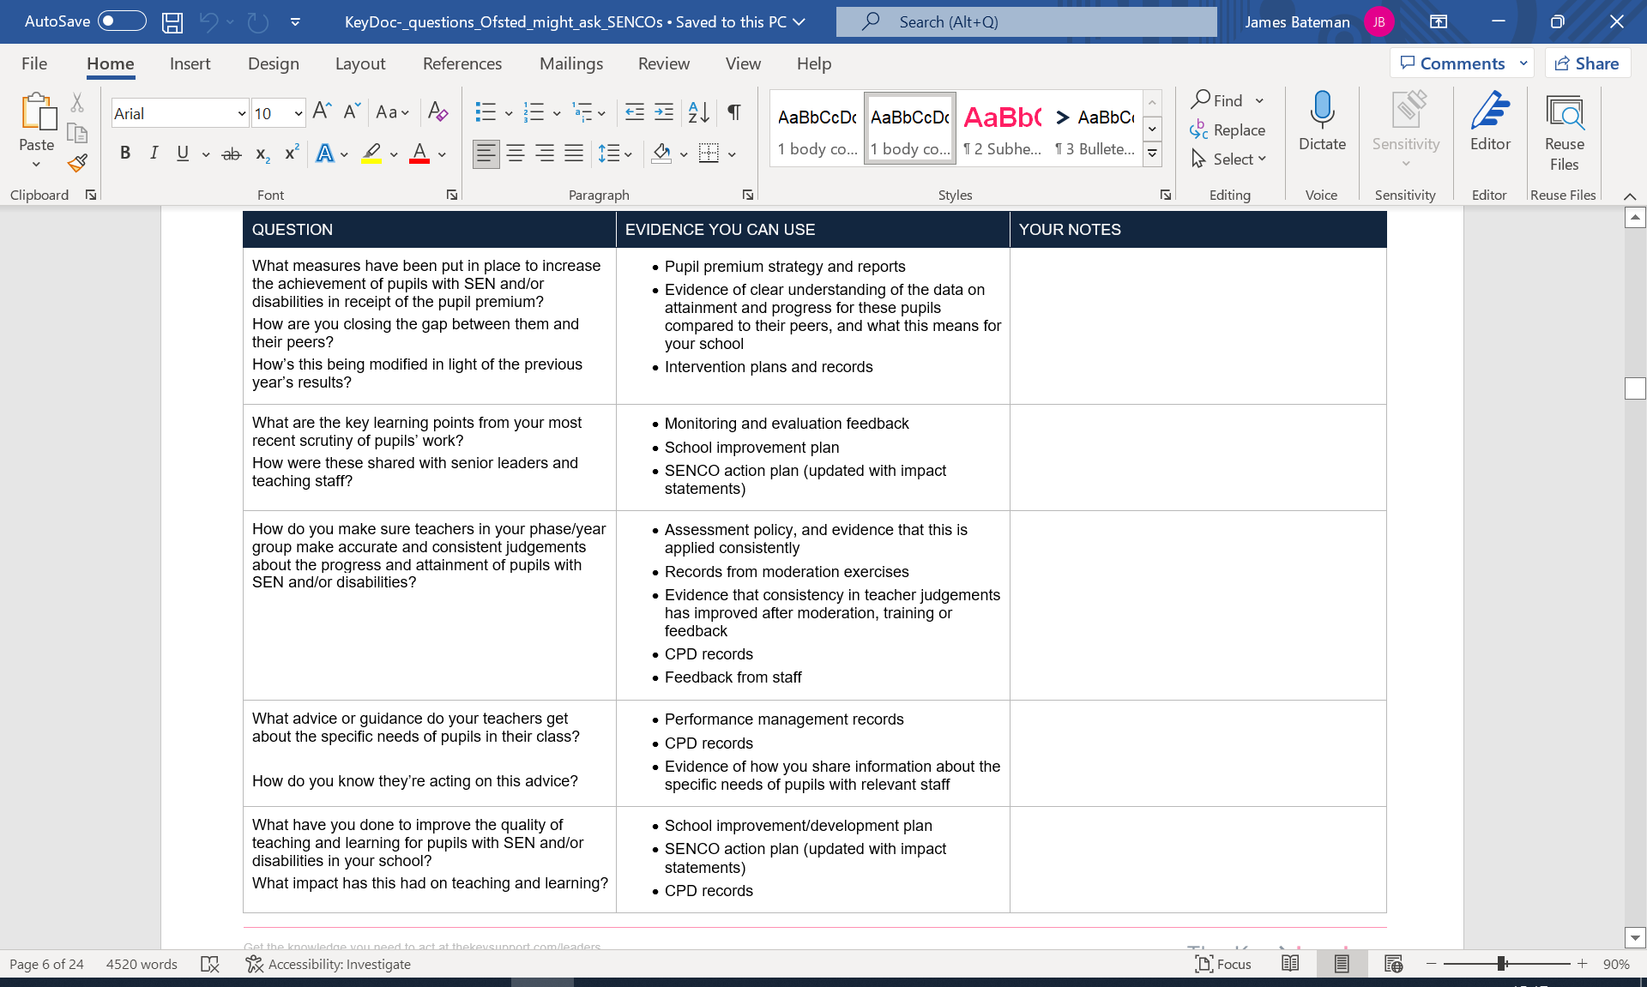
What Ofsted might ask you as the SENCo?

Slide 16
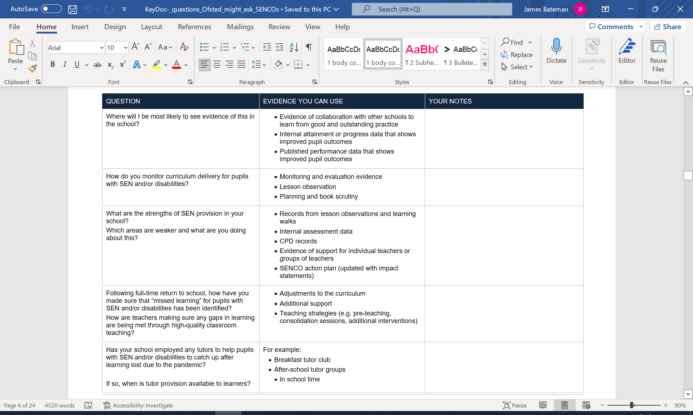
What Ofsted might ask you as the SENCo?

Slide 17
What Ofsted might ask you as the SENCo?

Slide 18
What Ofsted might ask you as the SENCo?

Slide 19
What Ofsted might ask you as the SENCo?

Slide 20
What Ofsted might ask you as the SENCo?

Slide 21
What Ofsted might ask you as the SENCo?

Slide 22
What Ofsted might ask you as the SENCo?

Slide 23
What Ofsted might ask you as the SENCo?

Slide 24
What Ofsted might ask you as the SENCo?

Slide 25
What Ofsted might ask you as the SENCo?

Slide 26
What Ofsted might ask you as the SENCo?

Slide 27
What Ofsted might ask you as the SENCo?

Slide 28
What Ofsted might ask you as the SENCo?

Slide 29
What Ofsted might ask you as the SENCo?

Slide 30
What Ofsted might ask you as the SENCo?

Slide 31
What Ofsted might ask you as the SENCo?

Slide 32
What Ofsted might ask you as the SENCo?

